Slide 1
Chemistry and the Environment
The air we breathe
The ozone layer
Climate change
Energy - fossil fuels, nuclear, hydrogen
Water - water quality, acid rain
Polymers

Slide 2
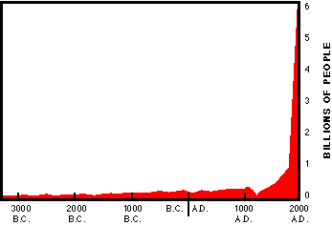
2

Slide 3
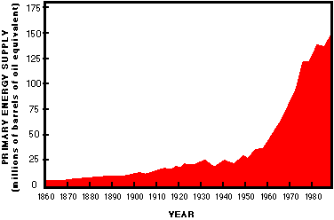
3

Slide 4
Air
What we should be breathing
vs.
What we are breathing
4

Slide 5
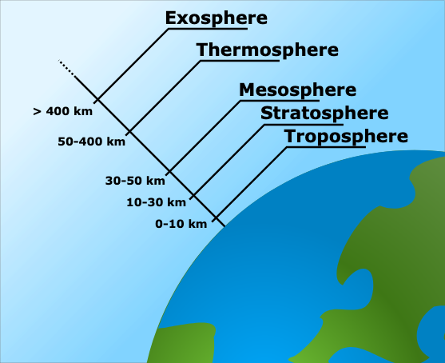
"File:Atmospheric Layers.svg" by Original by en:Bredk, converted to SVG by tiZom, globe borrowed from File:Earth clip art.svg is licensed under CC BY-SA 3.0
5

Slide 6
Air
mostly nitrogen, oxygen, argon, carbon dioxide, water.
gaseous water vapor: 0 (trace) to 4 %
6
Notes:
1

Slide 7
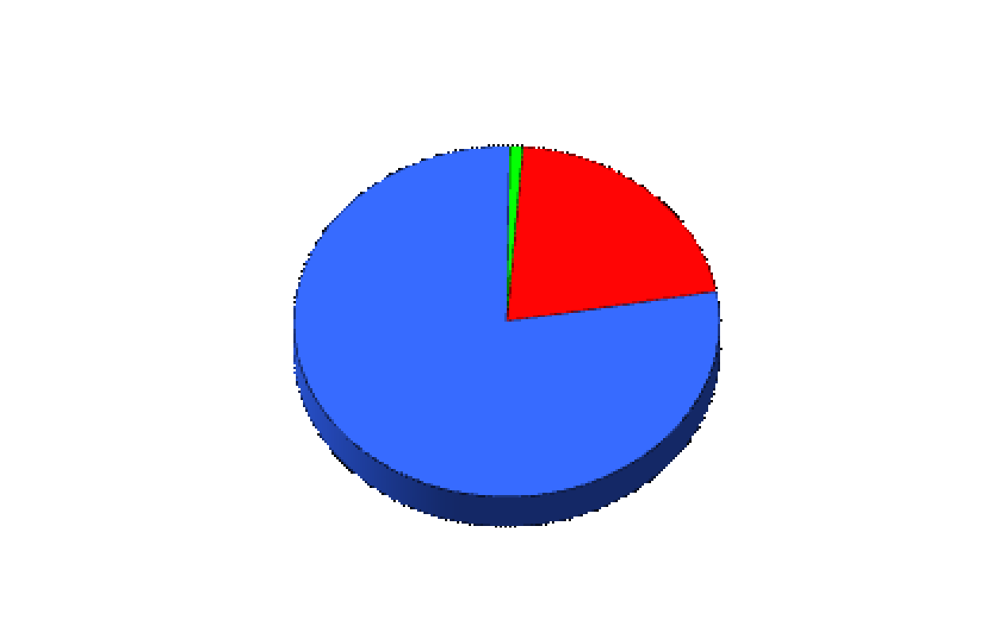
The composition of dry air
Other Gases 1%
Oxygen 21%
Nitrogen 78%
7

Slide 8
Major common air pollutants
(small parts of the 1%)
Carbon monoxide (oxygen delivery)
Ozone (respiratory)
Sulfur oxides (respiratory)
Nitrogen oxides (respiratory)
8

Slide 9
Atoms and Molecules
we will normally deal with them in terms of their chemical symbol
examples:
  Carbon = C
  Carbon Monoxide = CO
  Carbon Dioxide = CO₂
9

Slide 10
chemistry
Chemical Reactions
reactants products
Law of Conservation of Matter
atoms on left = atoms on right
10

Slide 11
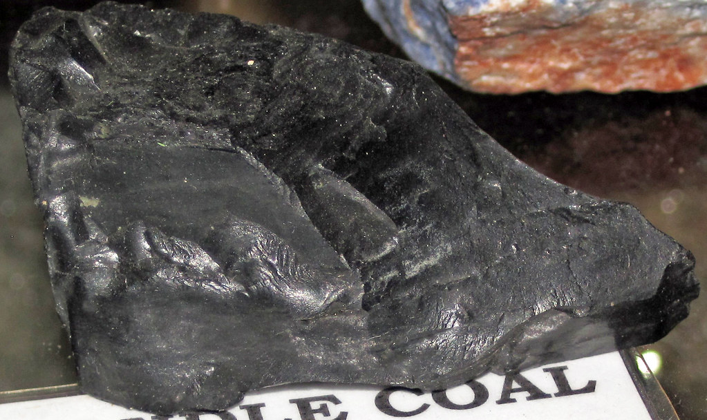
Coal = carbon, trace sulfur
"Cannel coal (Tennessee, USA) 2" by James St. John is licensed under CC BY 2.0
11

Slide 12
Major common air pollutants
(components of the 1%)
Carbon Monoxide (oxygen delivery)
Ozone (respiratory)
Sulfur Oxides (respiratory)
Nitrogen Oxides (respiratory)
12

Slide 13
What is the balanced chemical reaction for the combustion of methane (CH₄)?
13

Slide 14
Write the balanced chemical reations for the combustion of ethane (C₂H₆), ethanol (C₂H₅OH), and octane (C₈H₁₈).
14

Slide 15
Catalytic Converter
Exhaust emission device that facilitates the conversion of toxic pollutants to less toxic substances.

Slide 16
Catalyst
a substance that increases the rate of a chemical reaction, but does not itself undergo permanent change.
16

Slide 17
Concentration Terms
Parts per hundred (percent)
Parts per million (ppm)
1 part solute in 1,000,000 parts solvent = 1 in 1 x 10⁶
Parts per billion (ppb)
1 part solute in 1,000,000,000 parts solvent = 1 in 1 x 10⁹
Ex: The maximum contaminant level [MCL] for dioxin in drinking water is set at 3 × 10⁻⁸ ppm. A sample of drinking water is found to contain 2 × 10⁻⁴ ppb. Is the sample of water safe to drink?
1 g of NaCl as part of 100 g of solution is a 1% NaCl solution
1 in 100 = 1 in 1 x 10²
17
5.4

Slide 18
The 1 %
For example, present carbon dioxide concentrations in air ~ 0.040 %
18

Slide 19
The 1 %
For example, present carbon dioxide concentrations in air ~ 0.040 %
Q - if the indoor CO₂ concentration in a building is measured at 4002 ppm, would this be considered normal?
19

Slide 20
The 1 %
For example, present carbon dioxide concentrations in air ~ 0.040 %
Q - if the indoor CO₂ concentration in a building is measured at 4002 ppm, would this be considered normal?
  ie. What is the 0.040 % concentration expressed as ppm?
20

Slide 21
The 1 %
For example, carbon dioxide = 0.040 %
or 400 ppm.
So, the measurement of 4002 ppm is 10 times the normal tropospheric [CO₂].
(most likely, more outside air would need to be introduced to the building)
21

Slide 22
The permissible upper limit for concern for ground level carbon monoxide is given as 0.009 ppt. A researcher finds the level in Winnipeg one day to be measuring at 6 ppm. What is the measured value in ppt and is this permissible?
  A. 0.06 ppt, this is not permissible
  B. 0.06 ppt, this is permissible
  C. 0.006 ppt, this is not permissible
  D. 0.006 ppt, this is permissible
  E. 0.0006 ppt, this not permissible
22

Slide 23
The permissible upper limit for ground level ozone is 0.12 ppm. A researcher finds the level in Toronto one day to be measuring at 580 ppb. What is the measured value in ppm and is this of concern?
  A. 58 ppm, this is of concern
  B. 0.00058 ppm, this is of no concern
  C. 0.58 ppm, this is of concern
  D. 58 ppm, this is of no concern
  E. 0.58 ppm, this is of no concern.
23

