Slide 1

Climate Change

Slide 2
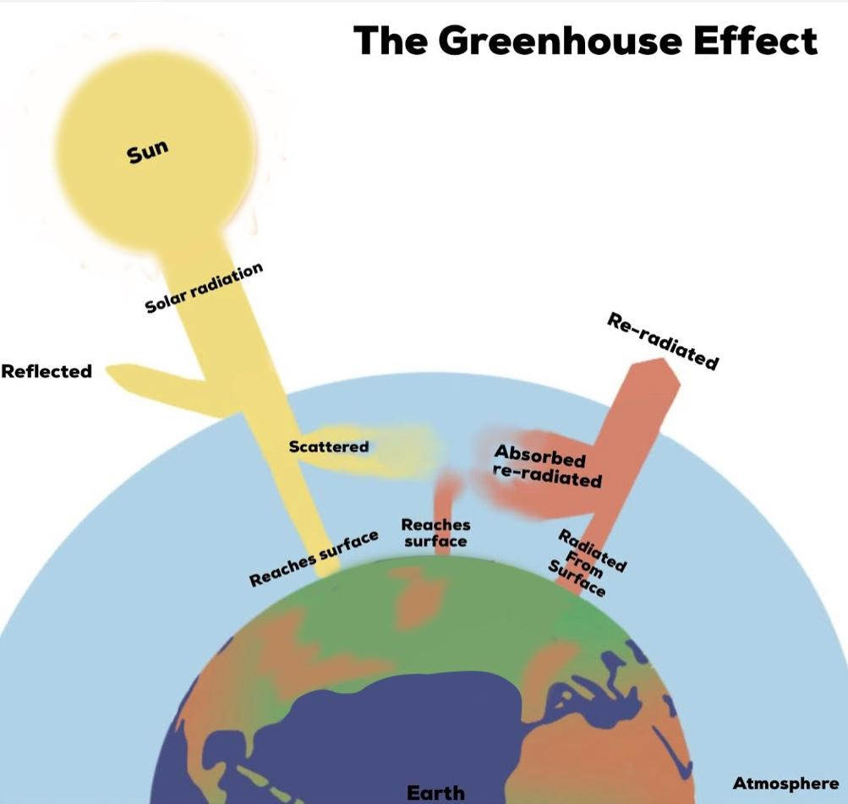
2
Notes:
2

Slide 3
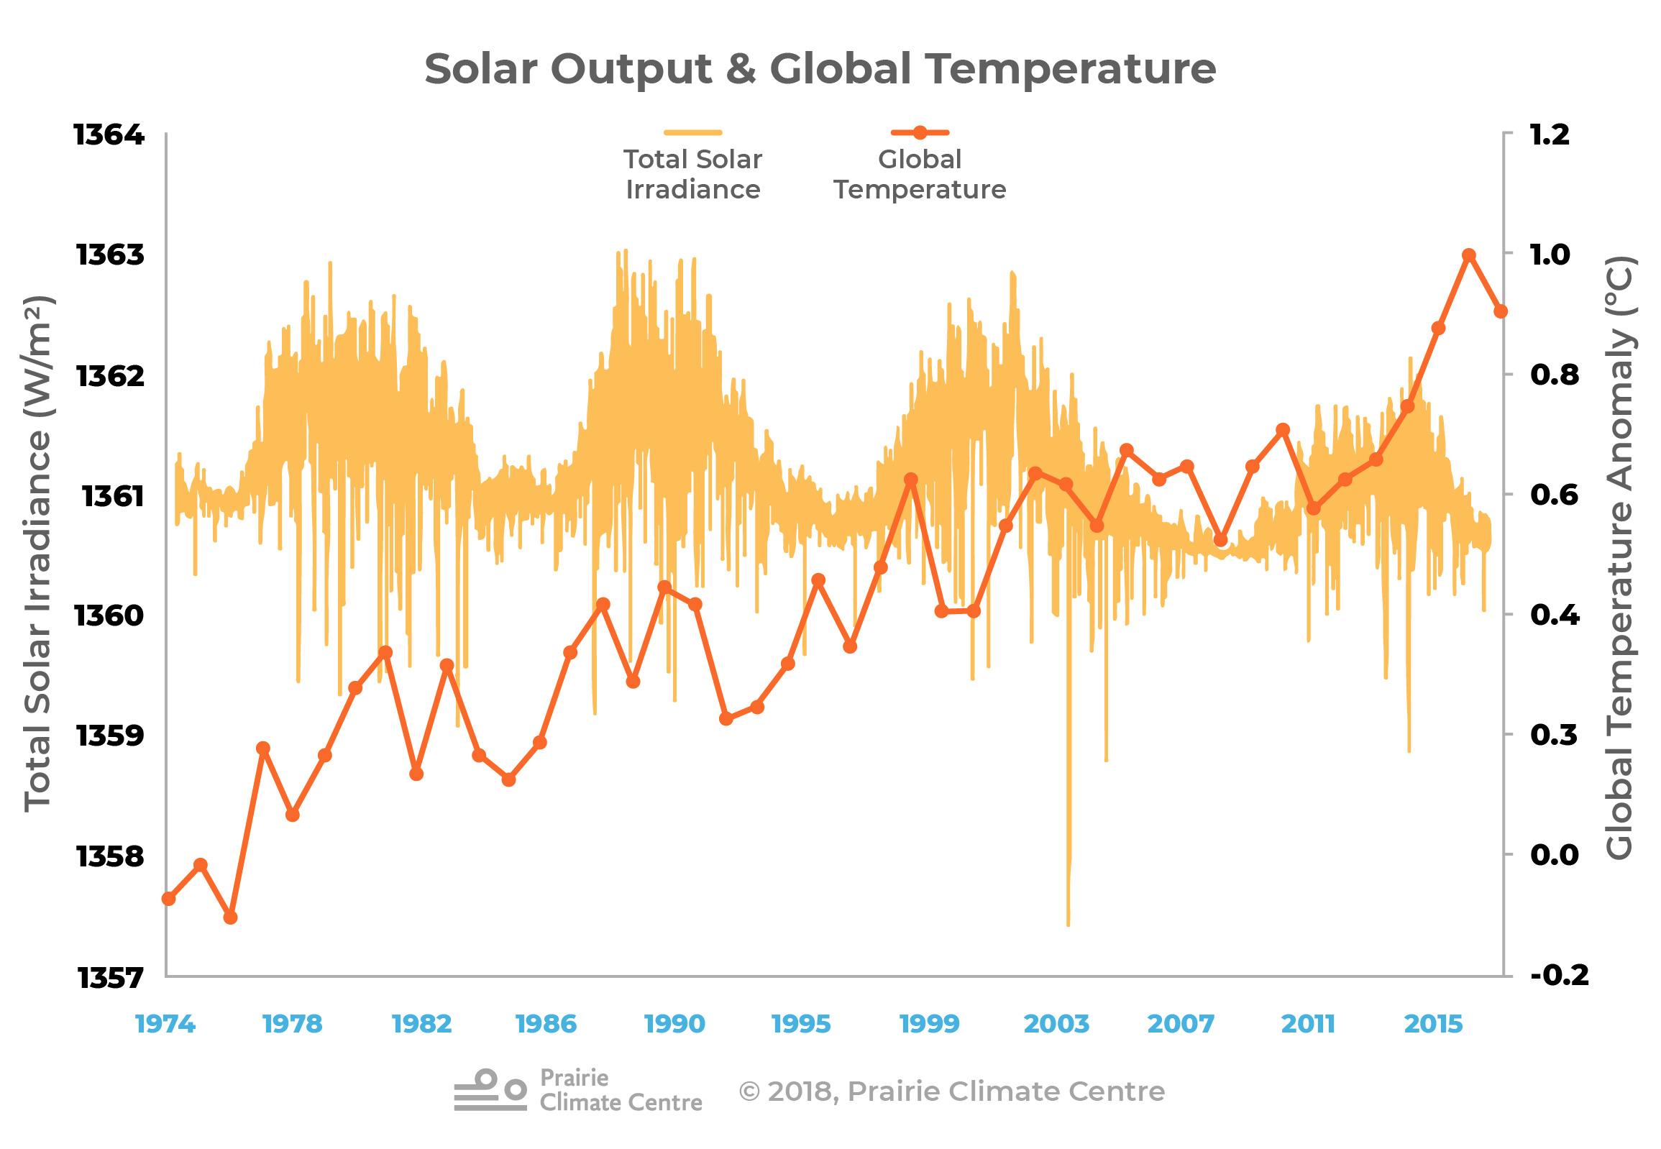
Prairie Climate Centre. The Climate Atlas of Canada (version 2, July 10, 2019). https://climateatlas.ca

Slide 4
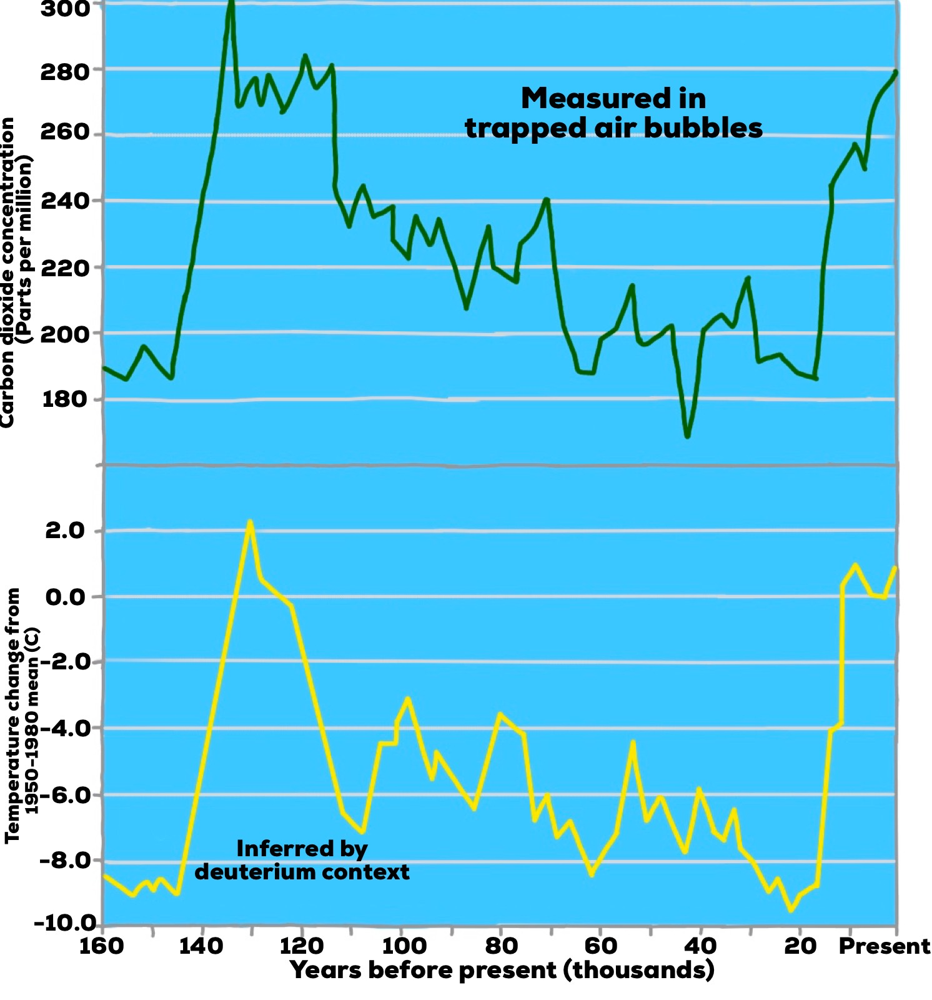
CO₂ Concentration vs. Earth’s temperature
4
Notes:
4

Slide 5
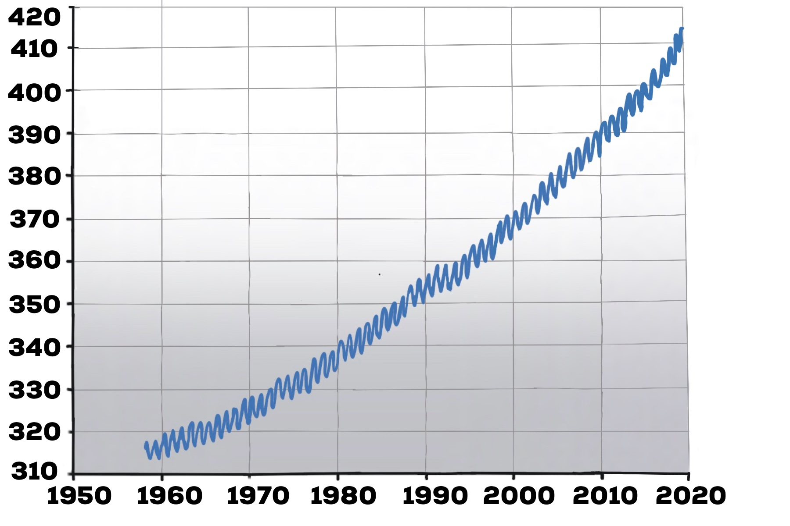
[CO2]
ppm
Direct measurement of atmospheric CO₂
5
Notes:
5

Slide 6
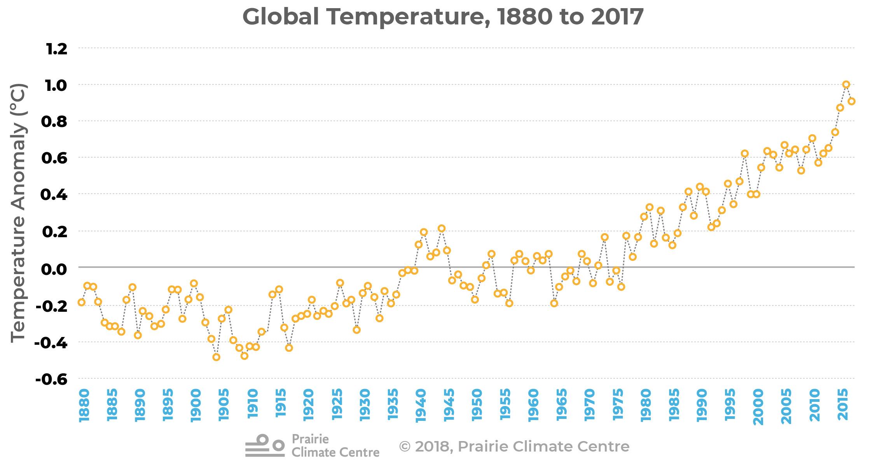
Prairie Climate Centre. The Climate Atlas of Canada (version 2, July 10, 2019). https://climateatlas.ca
6

Slide 7
Climate Atlas - 1 ºC and its impacts
https://climateatlas.ca/video/one-degree-and-its-impacts
Rebroadcast with permission of the Climate Atlas, Prairie Climate Centre
https://climateatlas.ca/
7

Slide 8
Galileo Movement Australia- Axe the Tax
https://www.youtube.com/watch?t=7&v=BC1l4geSTP8
Rebroadcast with permission of the Galileo Movement Australia
http://www.galileomovement.com.au/
8

Slide 9
Molecular Shape
The 3-dimensional positions of bonded atoms in the molecule with respect to a central atom.
  Valence Shell Electron Pair Repulsion (VSEPR)
9

Slide 10
Ex: Determine the molecular shape of CO₂
consider the central atom and determine the number of ‘groups of electrons’ (symmetry number, SN), then determine the molecular shape.
Ex: H₂CO Ex: CH₄
Ex: CF₂Cl₂ Ex: NH₃
10
Notes:
10

Slide 11
non-bonding electrons
VSEPR predicts the positions of all electrons around a central atom (electron pair geometry).
Molecular geometry involves the 3-dimensional positions of atoms only.
Further, lone pairs of electrons take up more room than bonding pairs of electrons.
11

Slide 12
Electron groups | Examples | Shape
4 groups of bonding electrons | CH₄ CF₂Cl₂ | Tetrahedral
3 bonding, 1 non-bonding | NH₃ PF₃ | pyramidal
2 bonding, 2 non-bonding | H₂O SF₂ | bent

Slide 13
What is the shape of the H₂S molecule?
A. Linear
B. Triangular planar
C. Tetrahedral
D. Triangular pyramid
E. Bent
13
Notes:
13

Slide 14
What is the shape of the CHF₃ molecule?
A. Linear
B. Triangular planar
C. Tetrahedral
D. Triangular pyramid
E. Bent
14

Slide 15
What is the shape of the SO₃ molecule (S is central)?
A. Linear
B. Triangular planar
C. Tetrahedral
D. Triangular pyramid
E. Bent
15

Slide 16
What is the shape of the NF₃ molecule?
A. Linear
B. Triangular planar
C. Tetrahedral
D. Triangular pyramid
E. Bent
16

Slide 17
Bond Polarity
when two different atoms form a bond, one attracts the shared pair of electrons more strongly than the other.
17

Slide 18
the displacement of the bonding pair causes a partially positive charge on one atom and a partially negative on the other.
The bond is said to have electric poles and be a polar bond.

Slide 19
Molecular Polarity
In a polar molecule, electron density accumulates toward one side of the molecule.
19
Notes:
19

Slide 20
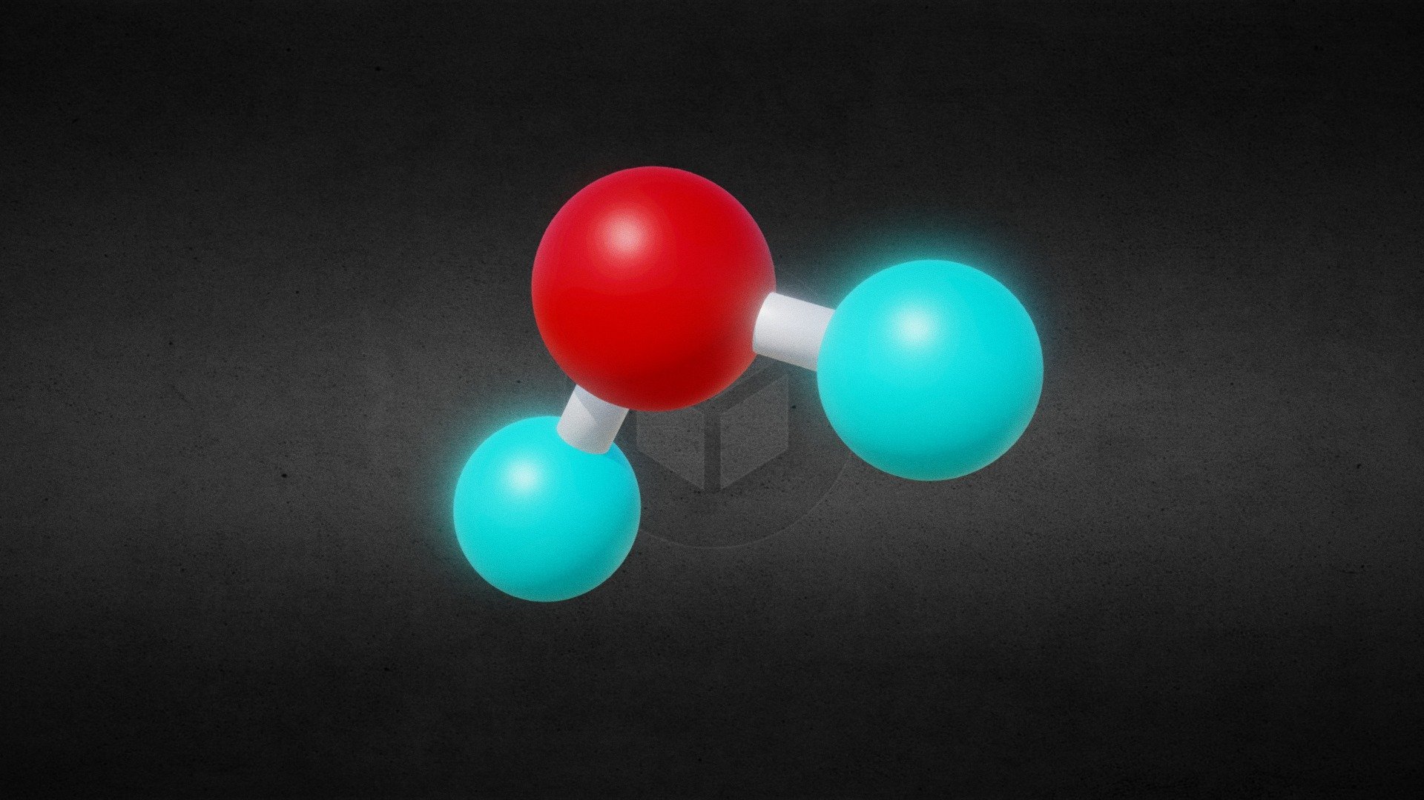
Water
"Water Molecule ball-and-stick model" by borkia is licensed under CC BY-SA 4.0

Slide 21
Is the CHF₃ molecule polar?
A. yes
B. no
C. Not enough information given
21
Notes:
21

Slide 22
Is the F₂ molecule polar?
A. yes
B. no
C. Not enough information given
22

Slide 23
Is the SO₃ molecule (S is central) polar?
A. yes
B. no
C. Not enough information given
23

Slide 24
Is the Cl₂O molecule polar?
A. yes
B. no
C. Not enough information given
24

Slide 25
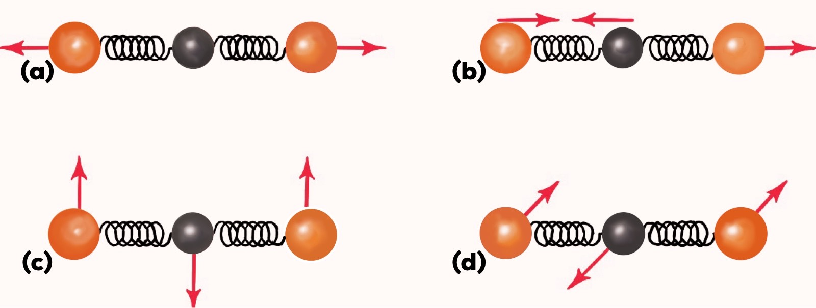
Vibrational States of Molecules
Based on its molecular geometry, a molecule’s bonds are able to undergo certain vibrations. These are known as its ‘fundamental modes of vibration’.
25

Slide 26
Like electronic states, there are vibrational states which occur at certain ‘fixed’ or ‘quantized’ energy levels.
26

Slide 27
Infrared radiation
is not of sufficient energy to break bonds (as in UV/ozone) but can be energetic enough to cause an increase in the amplitude of the ‘vibrating’.
27

Slide 28
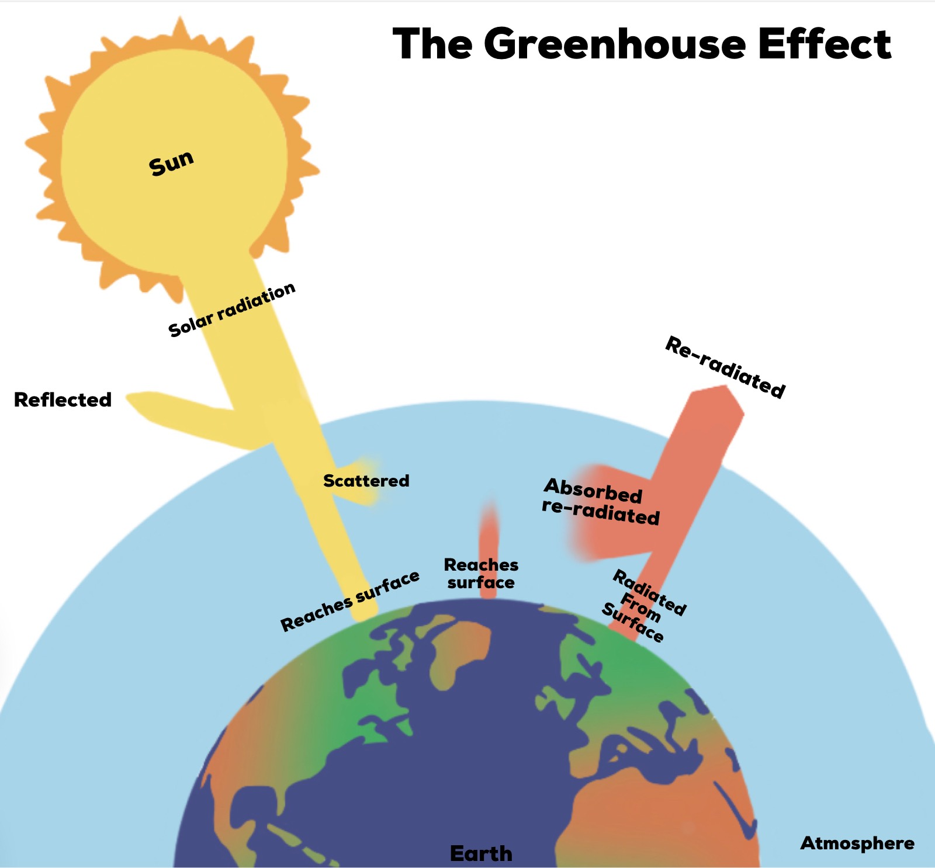
The Earth’s Energy Balance
28
Notes:
28

Slide 29
The amount of energy that is absorbed depends on the type of vibration as well as the change in dipole moment as the bonded atoms vibrate.
29

Slide 30
Molecular geometry and absorption of IR radiation
Molecular vibrations in CO₂. Each spring represents a C=O bond.
(a) = no change in dipole moment - no IR absorption.
(b, c, d) = these vibrations have a net change in dipole, so absorption/emission of IR can accompany a vibrational state transition.
30
Notes:
30

Slide 31
Choose all of the molecules which can absorb infrared radiation?
A. N₂
B. O₂
C. Ar
D. CO₂
D. CH₄
31

Slide 32
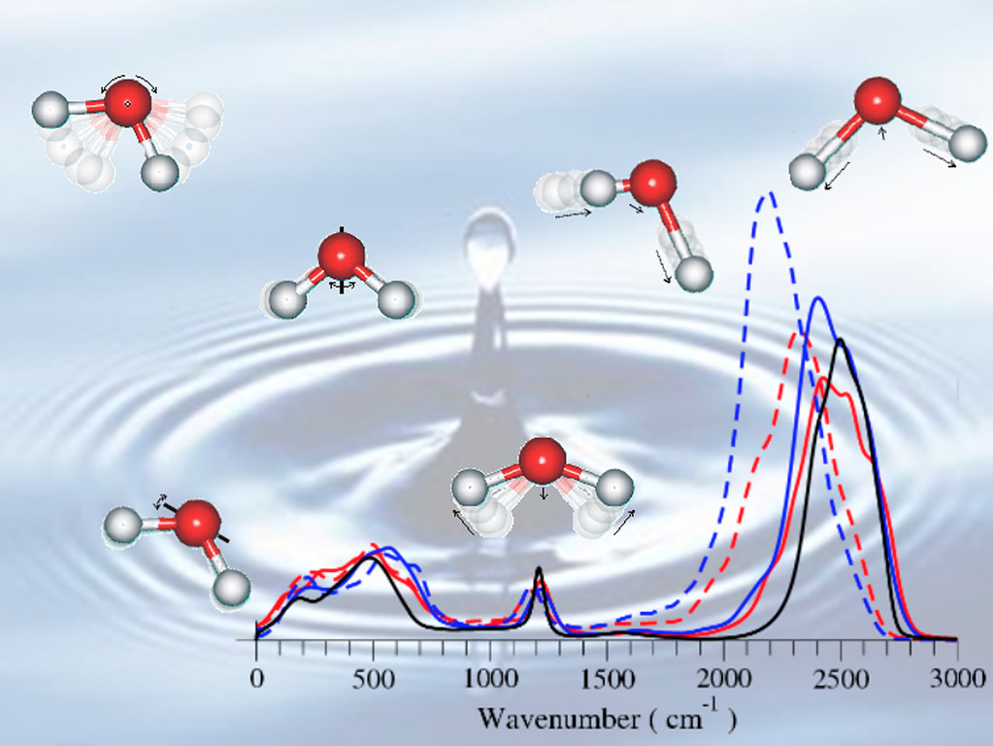
Infrared Spectroscopy
"Infrared Spectrum of Liquid Water" by Argonne National Laboratory is licensed under CC BY-NC-SA 2.0

Slide 33
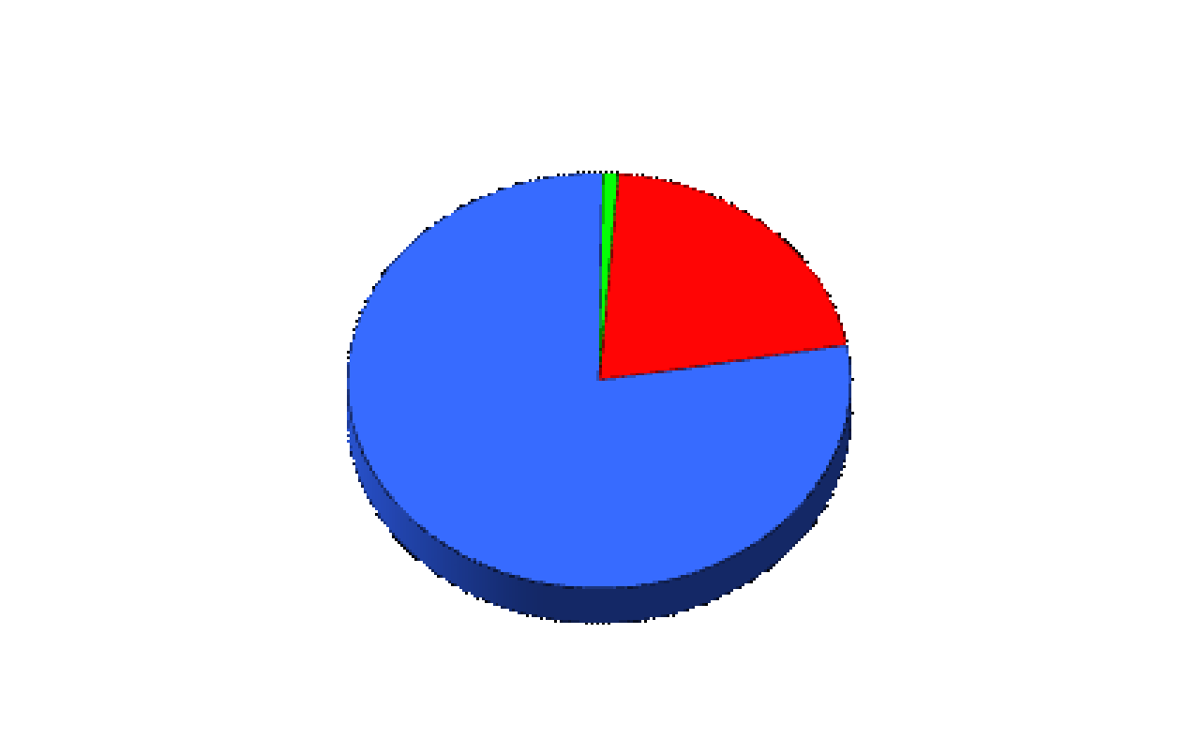
The Composition of Dry Air
Other Gases 1%
Oxygen 21%
Nitrogen 78%
33

Slide 34
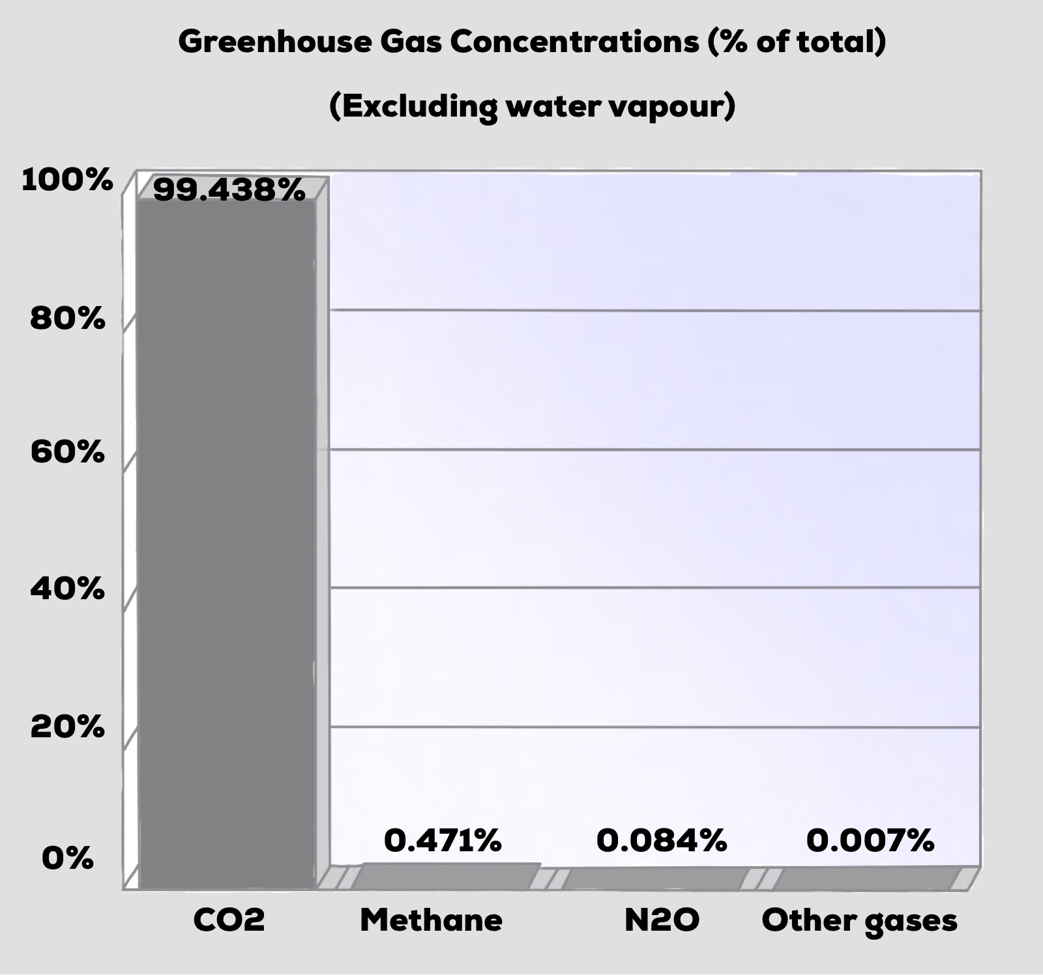
34

Slide 35
Global Warming Potential (GWP) represents the relative contribution of a molecule of an atmospheric gas to global warming.
Compound | Name | anthropogenic sources | GWP
CO₂ | carbon dioxide | fossil fuel combustion, deforestation | 1
CH₄ | methane | fossil fuel production, livestock | 21
N₂O | nitrous oxide | combustion, fertilizers | 310
CCl₂F₂ | CFC-12 | refrigeration, aerosols | 8100
35

Slide 36
Not considering average atmospheric lifetimes, which of the following would you expect to have the greatest global warming potential?
A. N₂
B. CH₂F₂
C. CO₂
D. CH₄
E. F₂
36

Slide 37
Not considering average atmospheric lifetimes, which of the following would you expect to have the greatest global warming potential?
A. CO₂
B. CH₃F
C. N₂
D. CH₄
E. CH₂F₂
37

Slide 38
Compare the effectiveness of CFC-12 as a ghg to that of CO₂
Compound | Name | anthropogenic sources | GWP | 2020 atmospheric concentration
CO₂ | carbon dioxide | fossil fuel combustion, deforestation | 1 | 427 ppm
CH₄ | methane | fossil fuel production, livestock | 21 | 1875 ppb
N₂O | nitrous oxide | combustion, fertilizers | 310 | 332 ppb
CCl₂F₂ | CFC-12 | refrigeration, aerosols | 8100 | 498 ppt
38

Slide 39
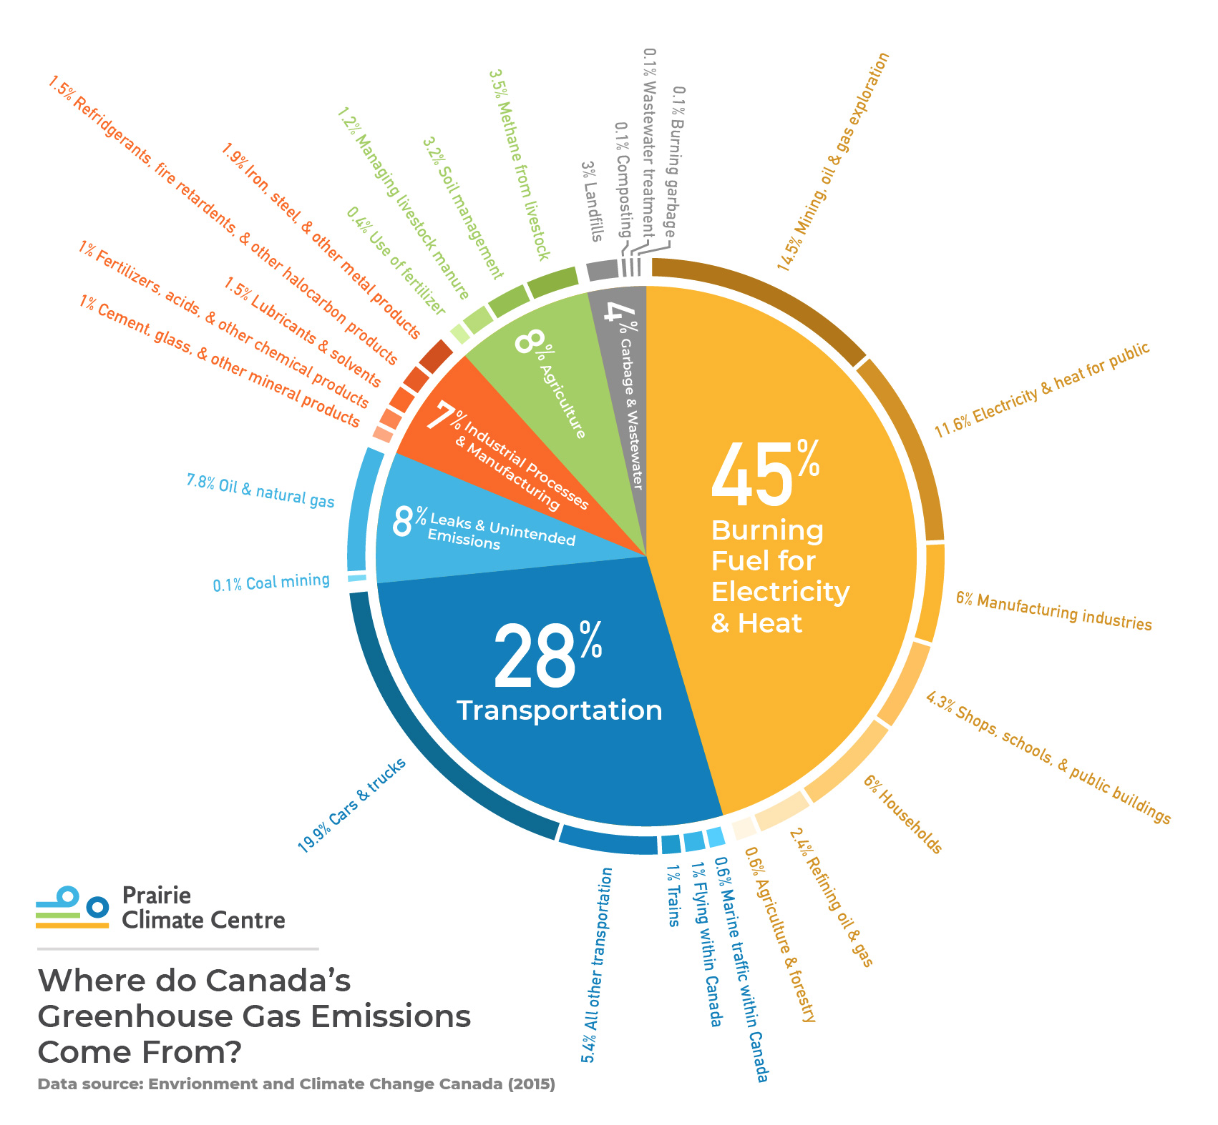
Prairie Climate Centre. The Climate Atlas of Canada (version 2, July 10, 2019). https://climateatlas.ca

Slide 40
40

Slide 41
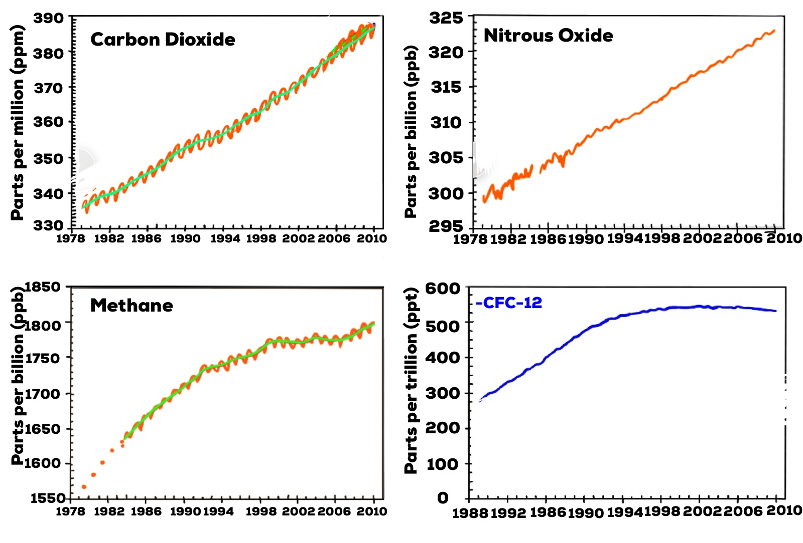
41

Slide 42
Prairie Climate Centre. The Climate Atlas of Canada (version 2, July 10, 2019). https://climateatlas.ca
42

Slide 43
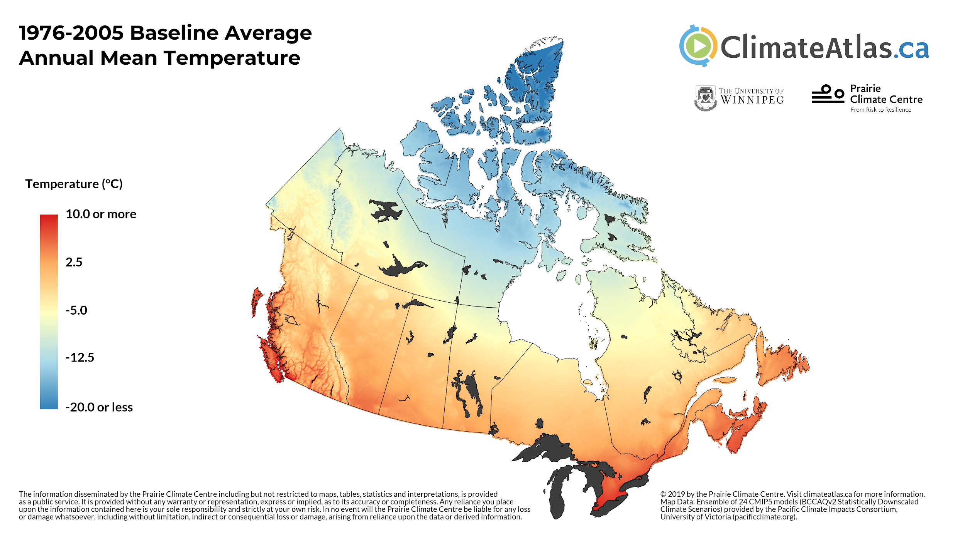
Prairie Climate Centre. The Climate Atlas of Canada (version 2, July 10, 2019). https://climateatlas.ca

Slide 44
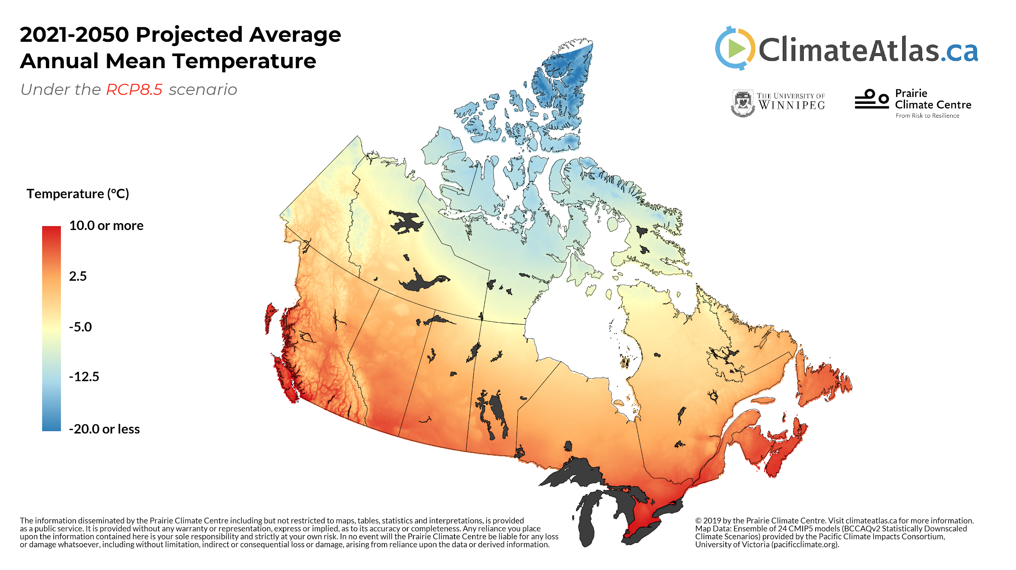
Prairie Climate Centre. The Climate Atlas of Canada (version 2, July 10, 2019). https://climateatlas.ca

Slide 45
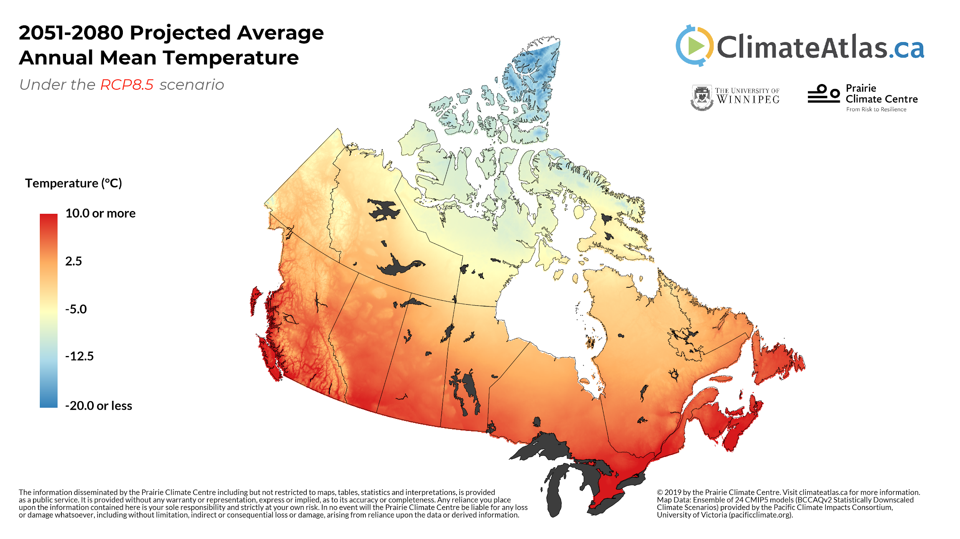
Prairie Climate Centre. The Climate Atlas of Canada (version 2, July 10, 2019). https://climateatlas.ca

Slide 46
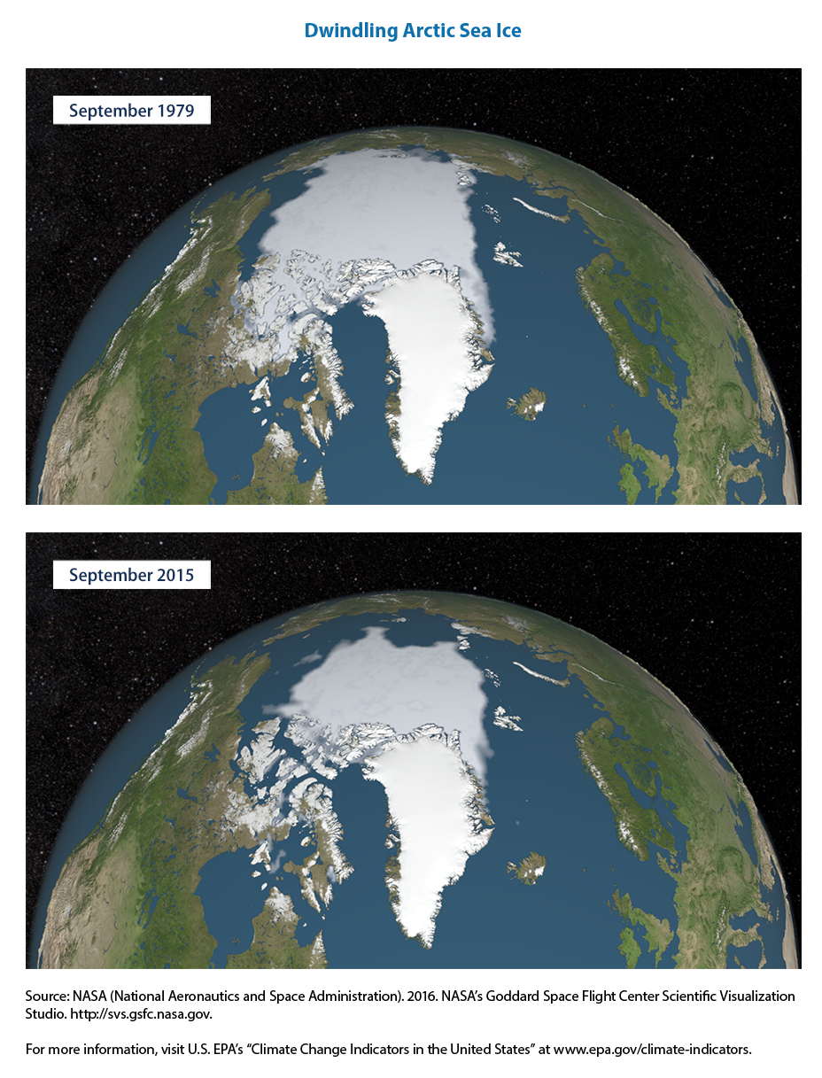
46
Notes:
46

Slide 47
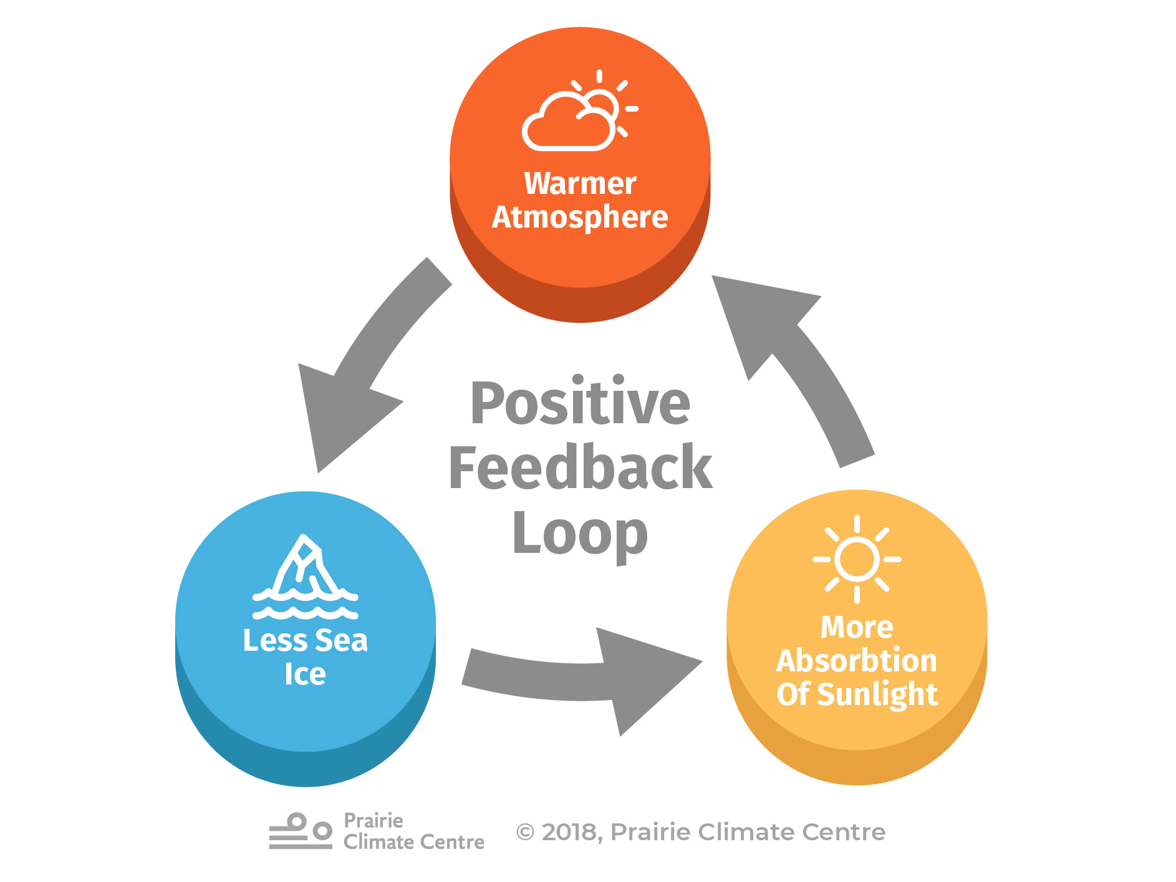
Prairie Climate Centre. The Climate Atlas of Canada (version 2, July 10, 2019). https://climateatlas.ca

Slide 48
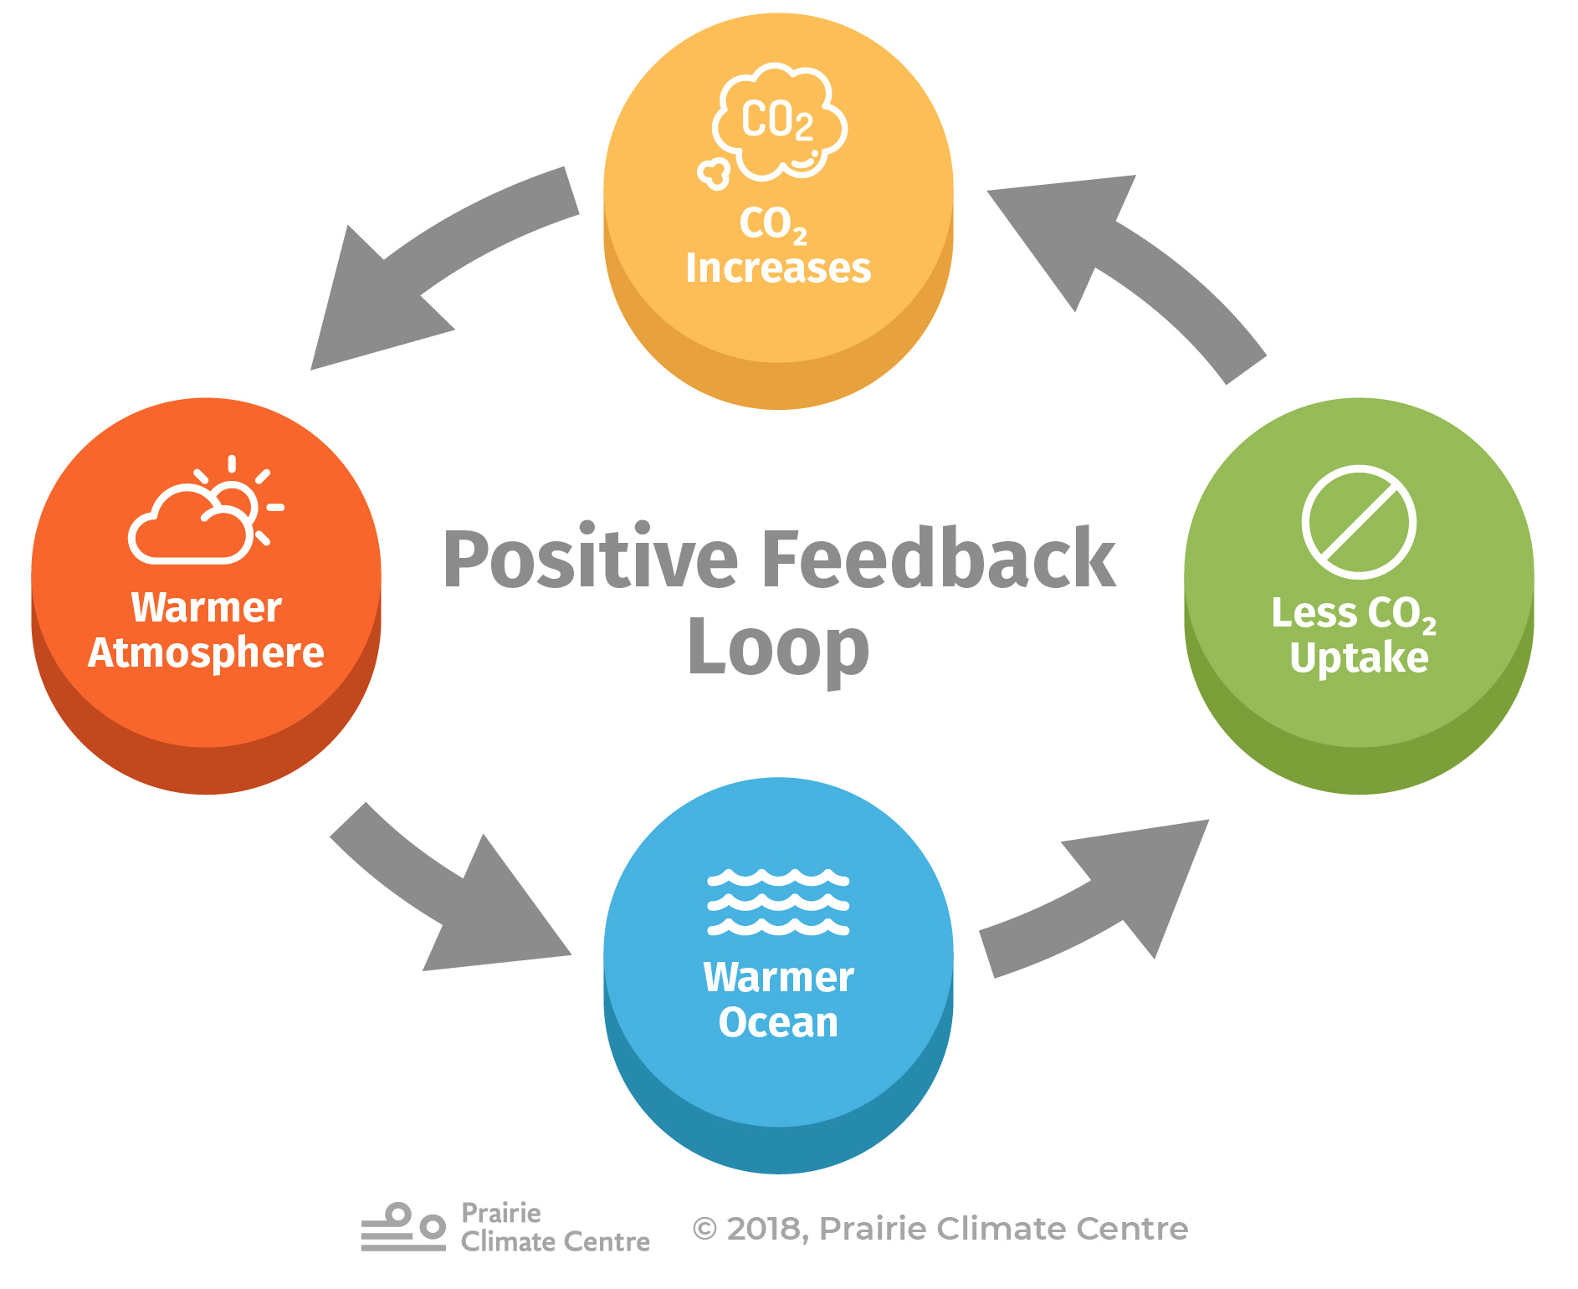
Prairie Climate Centre. The Climate Atlas of Canada (version 2, July 10, 2019). https://climateatlas.ca

Slide 49
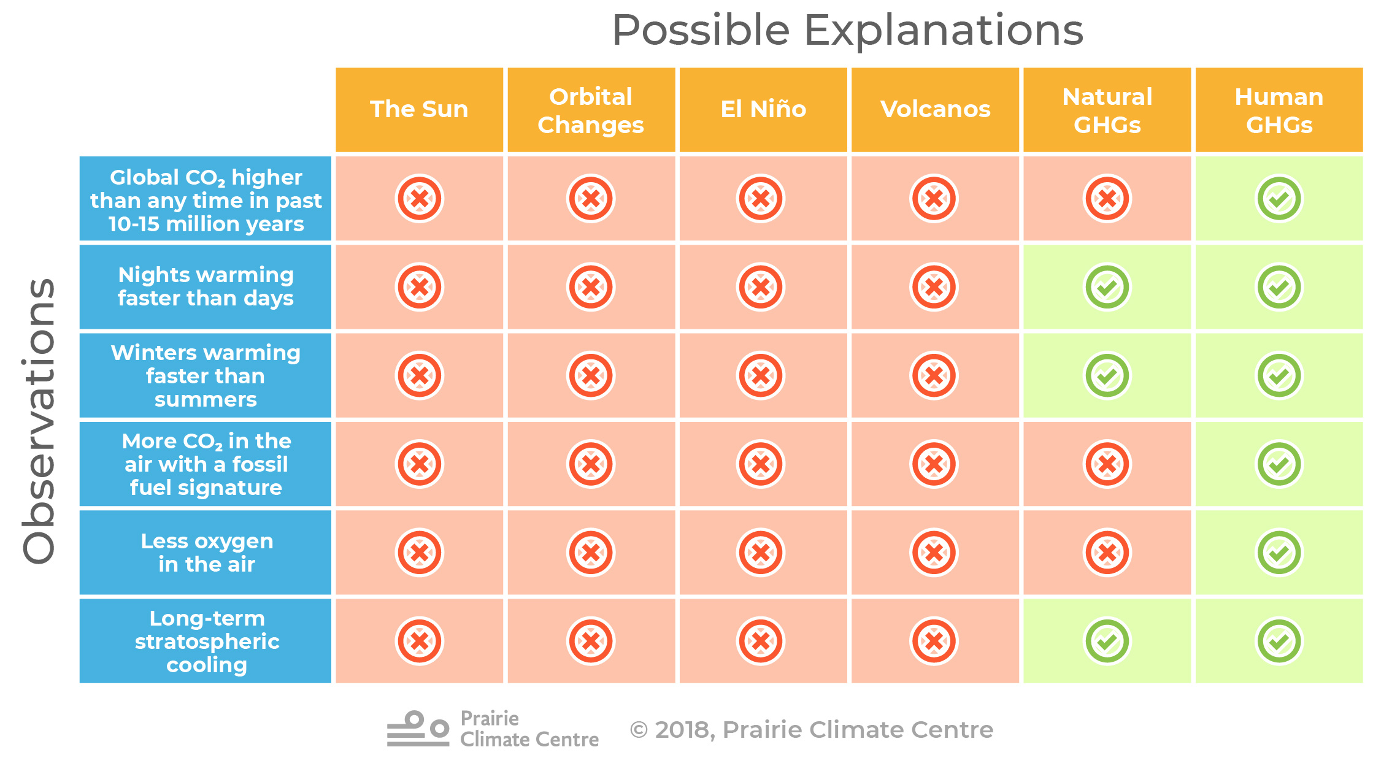
Prairie Climate Centre. The Climate Atlas of Canada (version 2, July 10, 2019). https://climateatlas.ca

Slide 50
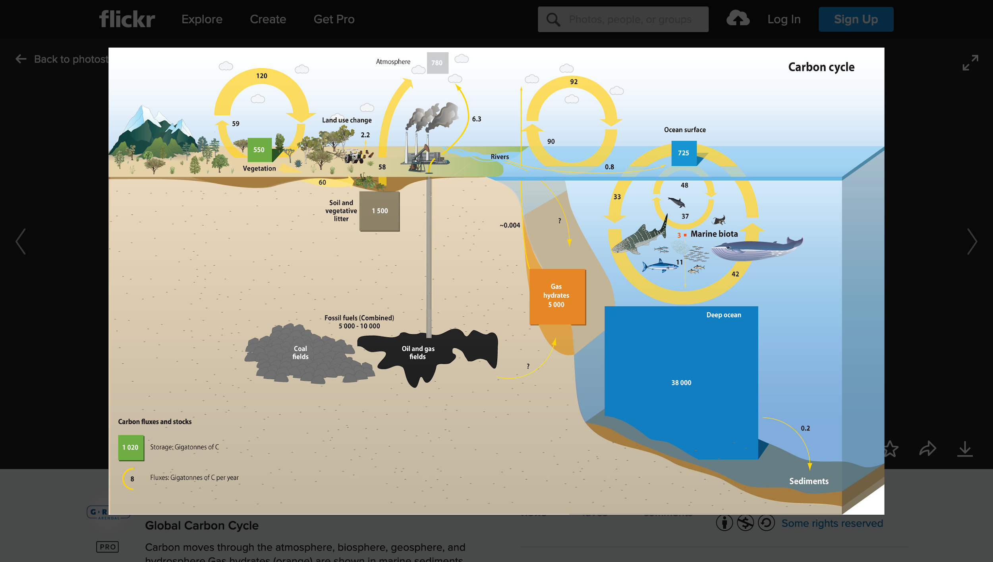
GRID-Arendal https://www.grida.no/resources/6614

Slide 51
Intergovernmental Panel on Climate Change (IPCC) 1988
Kyoto Protocol - 1997
IPCC certified the scientific basis of the greenhouse effect.
Emission targets set to reduce emissions of six greenhouse gases from 1990 levels.
(CO₂, CH₄, N₂O, HFC’s, PFC’s, and SF₆)
U.S.A. did not ratify
Many members such as Canada did not meet targets. Canada has since withdrawn.
51
Notes:
51

Slide 52
Kyoto successors
'Washington Declaration' - 16 February 2007
Copenhagen 2009
Cancun 2010
South Africa 2011
Qatar/South Korea 2012 (COP 18)
Warsaw, 2013
UN Climate Summit, 2014
Paris, 2016
52

Slide 53
Remember: Ozone/CFC’s summary
Potentially catastrophic series of events.
Smoking gun.
Substitutes were (are) available.
Economic setback (but not devastating).
Montreal Protocol, and current refinements.
53

Slide 54
Climate change summary
Scientific events.
54

Slide 55
Climate change summary
Scientific events.
Smoking gun?
55

Slide 56
Climate change summary
Scientific events.
Smoking gun?
Substitutes available?
56

Slide 57
Climate change summary
Scientific events.
Smoking gun?
Substitutes available?
Economic setback?
57

Slide 58
Climate change summary
Scientific events.
Smoking gun?
Substitutes available?
Economic setback?
Government, industry, personal action? Protocols?
58

