Slide 1
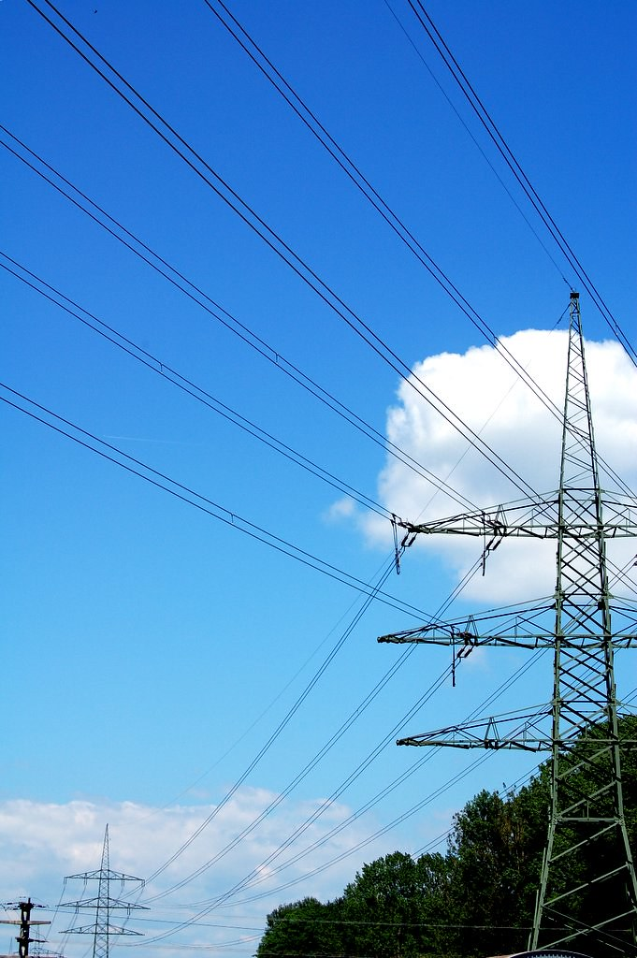
Energy
1
"DSC_0120" by berndnow is licensed under CC BY-ND 2.0
Notes:
1

Slide 2
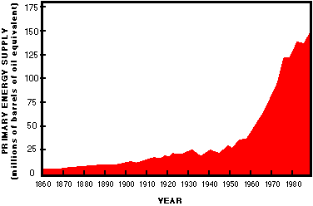

Slide 3
Energy
Energy can be defined as the capacity to supply heat or do work. One type of work (w) is the process of causing matter to move against an opposing force.

Slide 4
potential energy - the energy an object has because of its relative position, composition, or condition.
kinetic energy - the energy that an object possesses because of its motion.

Slide 5
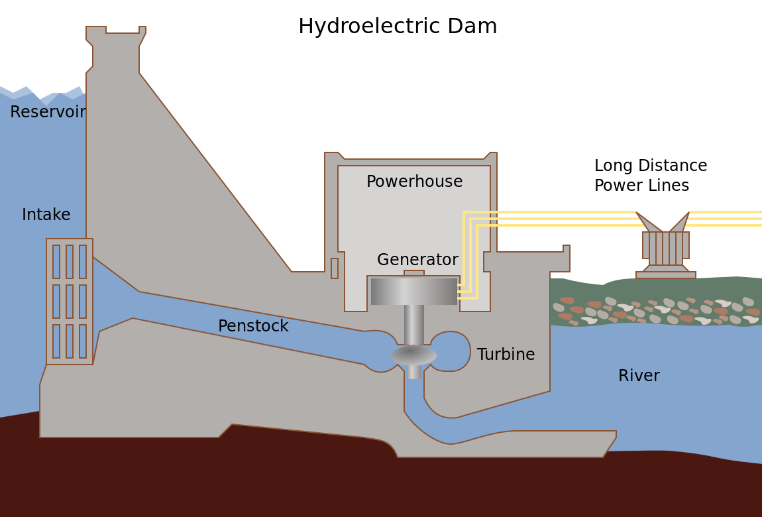
Tennessee Valley Authority; SVG version by Tomia. Licenced GFDL and CC-BY-2.5

Slide 6
Some sources of Energy
Hydro Reservoirs
Chemical Bonds
Nuclear Transformations
Solar Power
6
Notes:
6

Slide 7
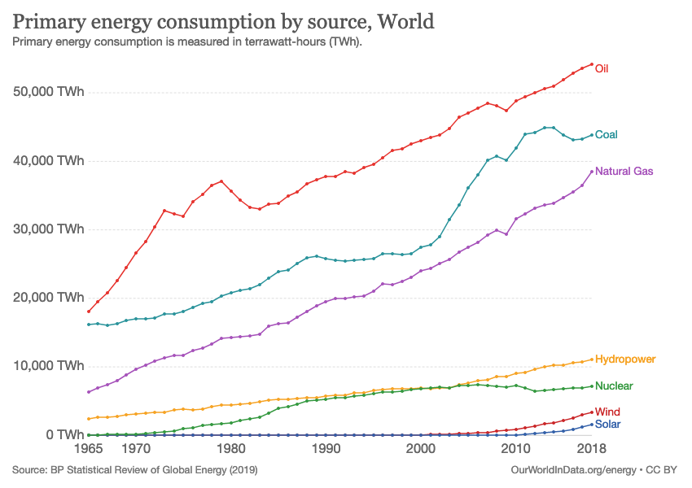
"File:Primary energy consumption by source, OWID.svg" by Our World In Data is licensed under CC BY 3.0
7

Slide 8
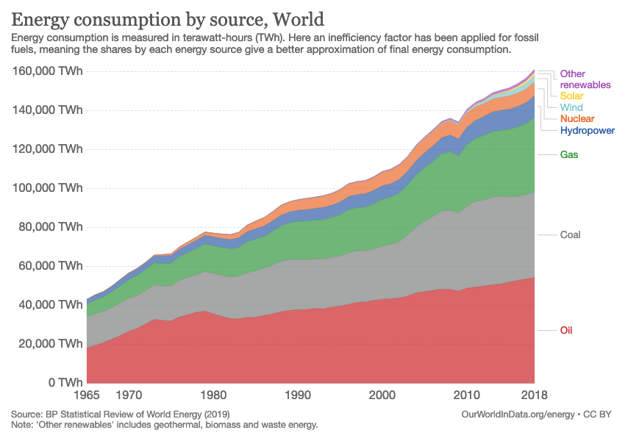
"File:Energy consumption by source, OWID.svg" by Our World In Data is licensed under CC BY 3.0

Slide 9
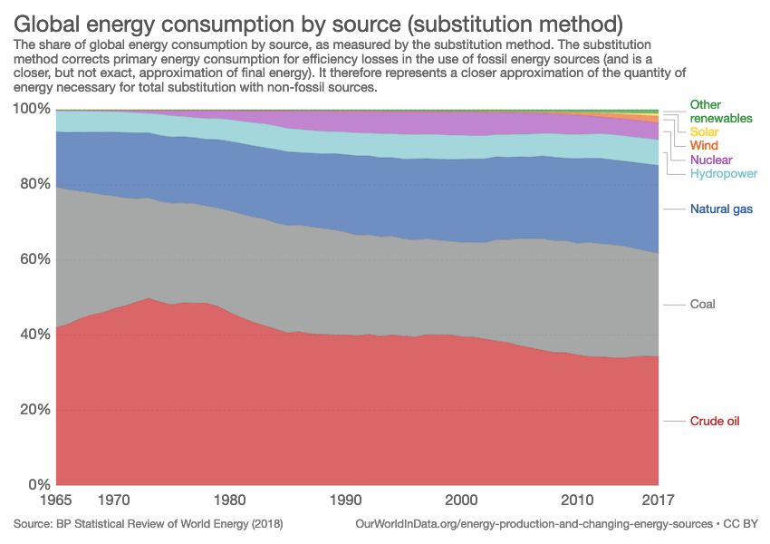
"File:Global energy consumption by source (substitution method), OWID.svg" by Our World In Data is licensed under CC BY 3.0

Slide 10
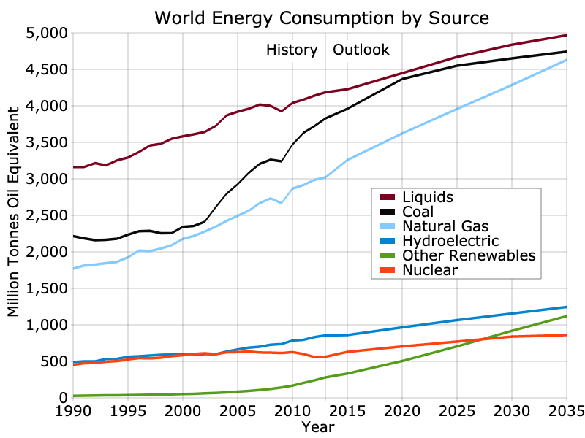
"File:World Energy Consumption Outlook 2014.svg" by Delphi234 is licensed under CC0 1.0

Slide 11
Chemical Bond Energy
The rearrangement of atoms in chemical reactions… breaking bonds and forming new bonds... may require energy, or it may release energy.

Slide 12
Bond energy - is the amount of energy that is required to break a chemical bond. Thus, it is also the amount of energy that is released when that same chemical bond is formed.
Exothermic - releases energy
Endothermic - requires energy

Slide 13
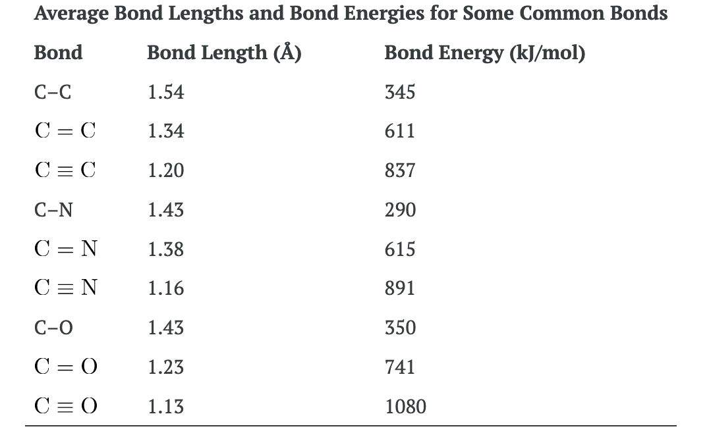
Chemistry and the Environment (sec 7.5) by Devin R. Latimer is licensed under a Creative Commons Attribution 4.0 International License

Slide 14
Ex: combustion of hydrogen

Slide 15
Chemistry and the Environment (sec 7.5) by Devin R. Latimer is licensed under a Creative Commons Attribution 4.0 International License

Slide 16
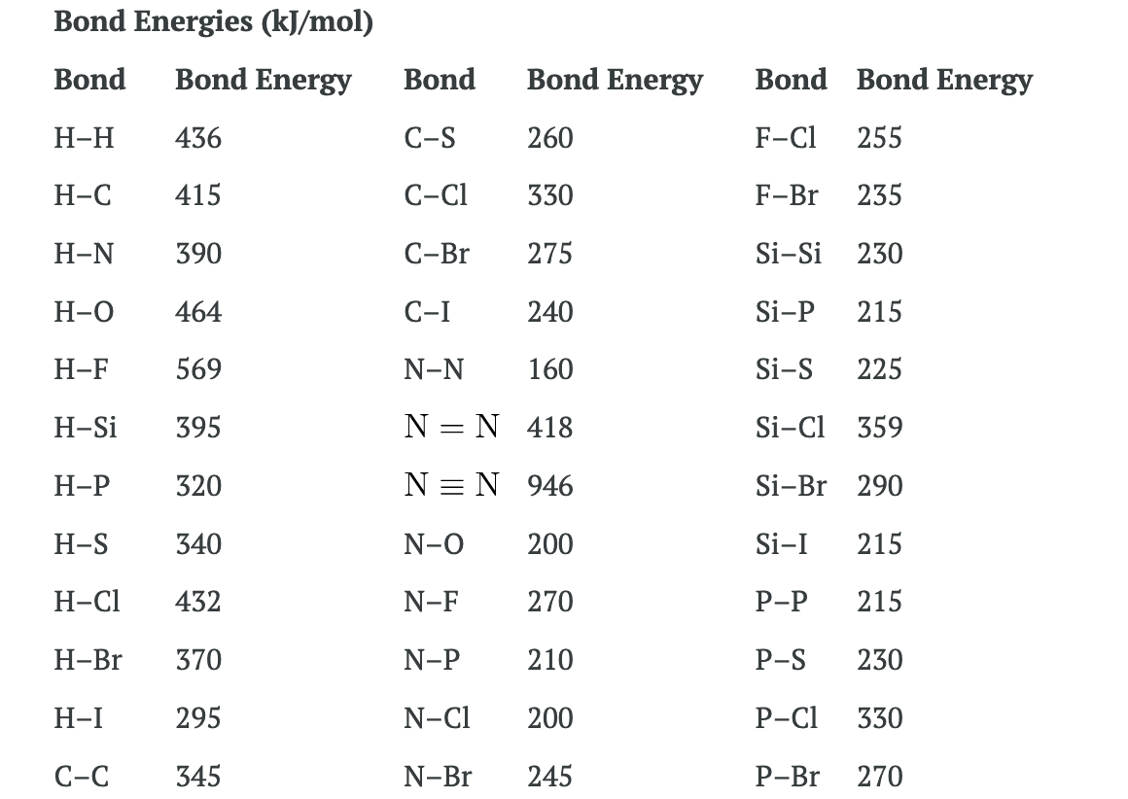
Chemistry and the Environment (sec 7.5) by Devin R. Latimer is licensed under a Creative Commons Attribution 4.0 International License

Slide 17
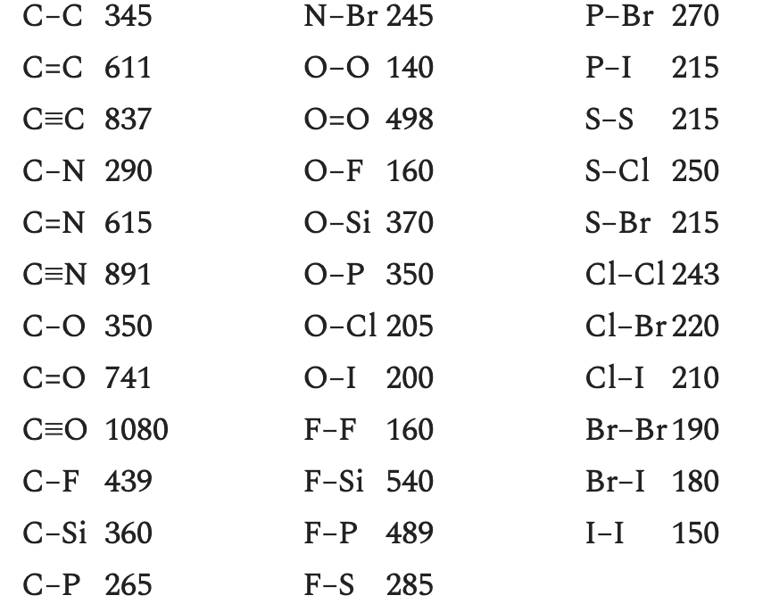
Chemistry and the Environment (sec 7.5) by Devin R. Latimer is licensed under a Creative Commons Attribution 4.0 International License

Slide 18
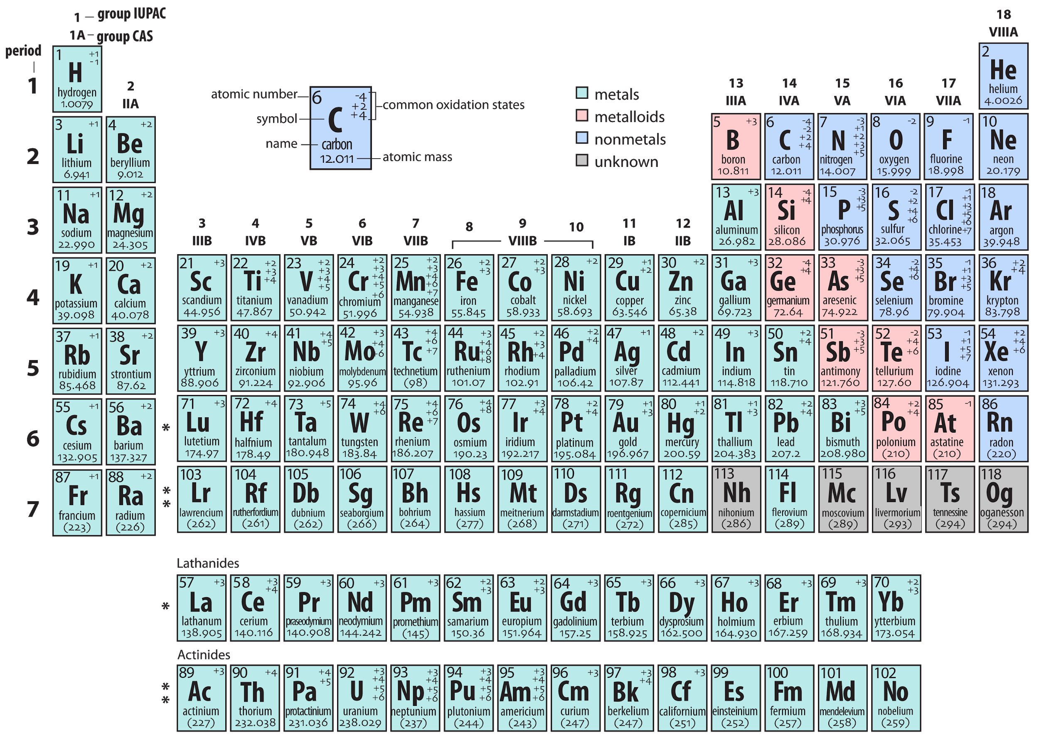
"File:Periodic table AH.png" by Ahazard.sciencewriter is licensed under CC BY-SA 4.0

Slide 19
What is the approximate energy change associated with the combustion of methane (CH₄)?
19

Slide 20
"File:Global energy consumption by source (substitution method), OWID.svg" by Our World In Data is licensed under CC BY 3.0

Slide 21
Coal
~ C135H96O9NS
~ 85 % Carbon
21
Notes:
21

Slide 22
Coal
~ C135H96O9NS
~ 85 % Carbon
~ 30 kJ per gram
solid
22

Slide 23
Coal
~ C135H96O9NS
~ 85 % Carbon
~ 30 kJ per gram
solid
various grades
there’s lots of it. (~ 400 years)
23

Slide 24
http://www.worldometers.info/
Energy at:
  http://www.worldometers.info/
24

Slide 25
Petroleum
Various Hydrocarbons
~ 48 kJ per gram
25

Slide 26
Petroleum
Various Hydrocarbons
~ 48 kJ per gram
liquid
must first be refined (distillation)
26

Slide 27
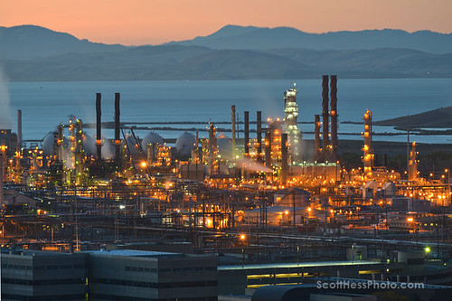
One of the drawbacks to petroleum is that it must be refined before use.
"13-aug_507x-72" by Scott Hess is licensed under CC BY-NC 2.0
27

Slide 28
Petroleum
Various Hydrocarbons
~ 48 kJ per gram
liquid
must first be refined (distillation)
‘value’ based captures and conversions
28
Notes:
28

Slide 29
Petroleum
Various Hydrocarbons
~ 48 kJ per gram
liquid
must first be refined (distillation)
value captures/conversions
there’s less known reserves (~ 40 years) and it’s becoming harder to extract
29
Notes:
29

Slide 30
Petroleum
Various Hydrocarbons
~ 48 kJ per gram
liquid
must first be refined (distillation)
value captures/conversions
40 years left
‘Where oil is’ vs. ‘Where oil is used’
30
Notes:
30

Slide 31
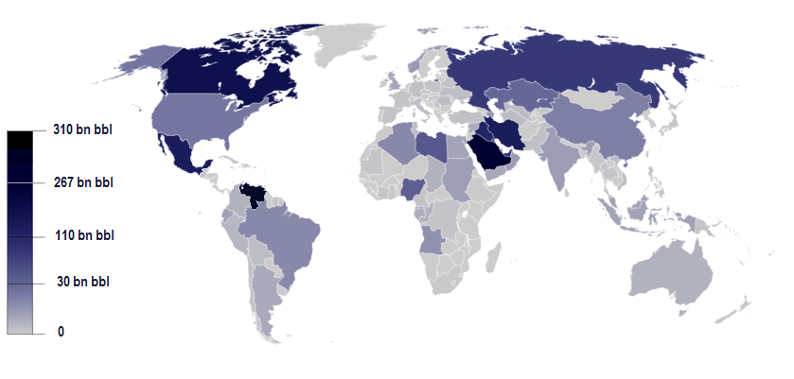
Oil reserves by country
"File:Reservas de petroleo.png" by Vicmath is licensed under CC BY-SA 4.0

Slide 32
Tetraethyl lead
used to be added to gasoline to minimize premature firing.
Pb would be released to the environment
Pb interferes with the function of certain enzymes
32

Slide 33
Elimination of octane enhancing tetraethyl lead (TEL) created a need to find substitutes.
MTBE (methyl tertiary-butyl ether)
Due to groundwater contamination concerns, MTBE is now banned in the U.S., Canada and Japan.
Ethanol (ethyl alcohol)
33

Slide 34
Natural Gas
C₁-C₄ hydrocarbons
gas
approximately 55 kJ per gram
Approximately 150 years remain of known reserves
34
Notes:
34

Slide 35
Biomass
Wood
Biodiesel
Ethanol
35
Notes:
35

Slide 36
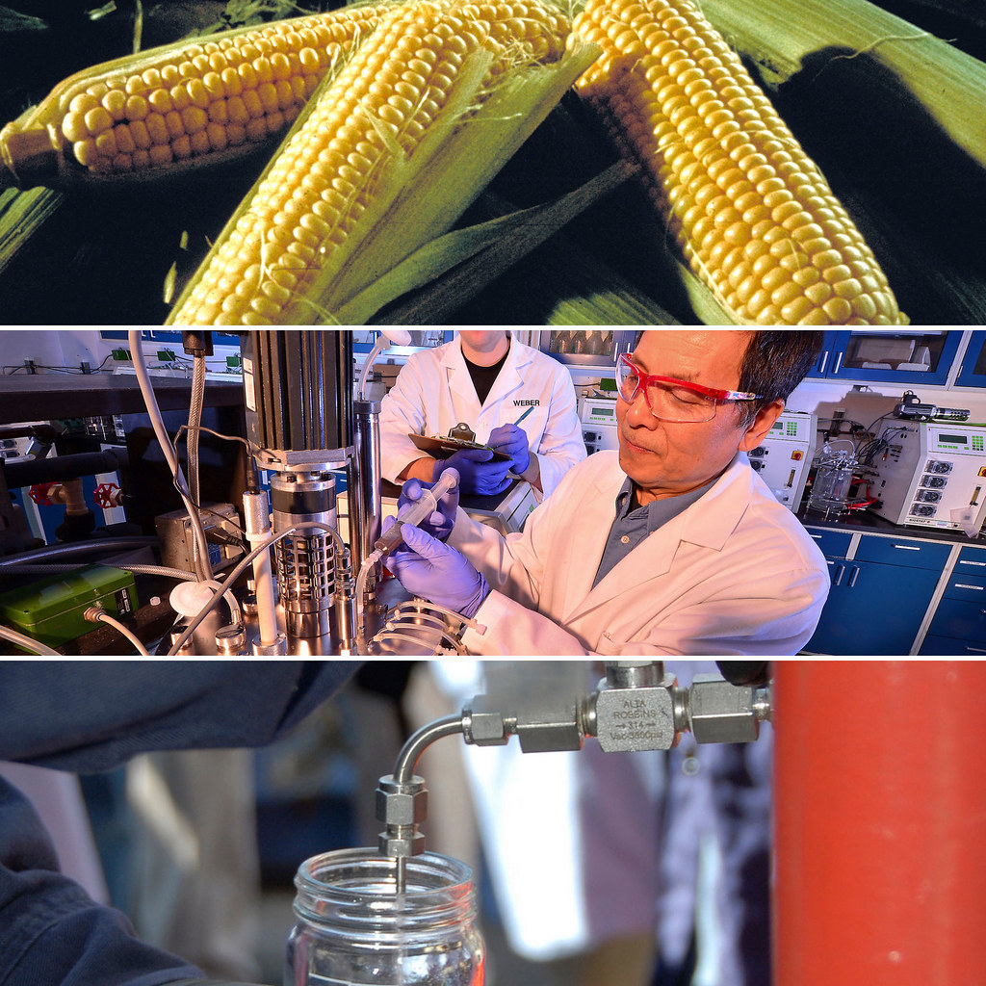
Ethanol
Brazil, USA, Manitoba, others
  corn, sugarcane
  cellulosic ethanol
"A collage of corn, scientists and a man holding a jar of ethanol" by USDAgov is licensed under CC PDM 1.0
36

Slide 37
Alternative Combustibles
C(s) + H2O ------> CO + H2 (water gas)
--> Fisher-Tropsch synthesis of gasoline (Fe or Co catalyst)
37

Slide 38
Biogas
The ferment of animal and vegetable wastes
60% methane
38
Notes:
38

Slide 39
Garbage
More than 1/3 is directly combustible, as little as 10% of the original volume may end up as landfill
Japan, Germany, US
39

Slide 40
Fossil Fuels, Biofuels - Photosynthesis
Chlorophyll in plants captures solar energy
6 CO₂ + 6 H₂O + sunlight🡪 C₆H₁₂O₆ + 6 O₂
40

Slide 41
Fossil Fuels
Conservation, Alternatives…
Pollution
Climate Change
41

Slide 42
Fossil Fuels
Conservation, Alternatives…
Pollution
Climate Change
Finite Resources - ‘Peak oil’
Political consequences
Fossil ‘Fuels’!
  Are practically non-renewable. Now is the time to ensure we have energy for the future.
  are very important feedstocks for chemical synthesis
42

