Slide 1
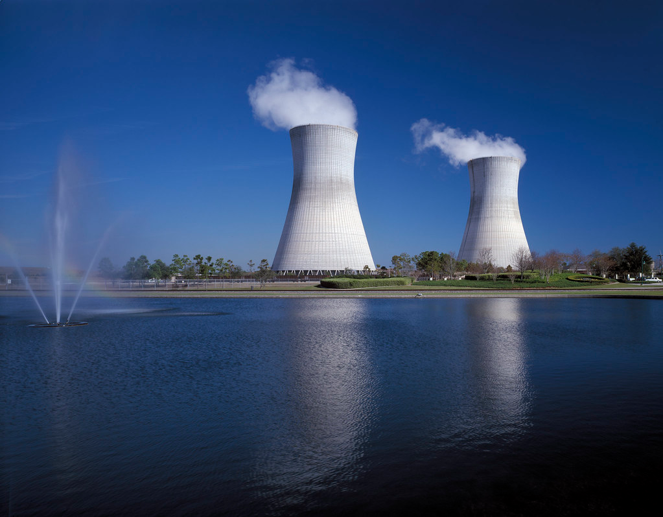
Nuclear Energy
1
"Cooling towers" by US Department of State is licensed under CC BY-NC 2.0
Notes:
1

Slide 2
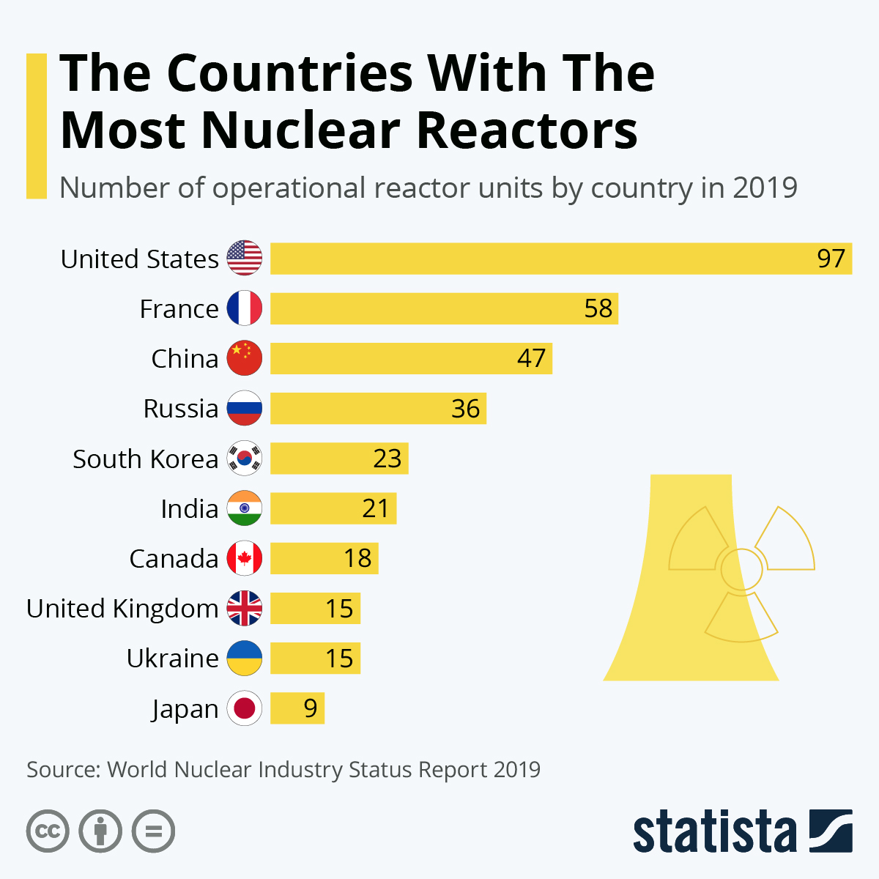
Approximately 15% of the world’s electricity is generated by nuclear power plants
2

Slide 3
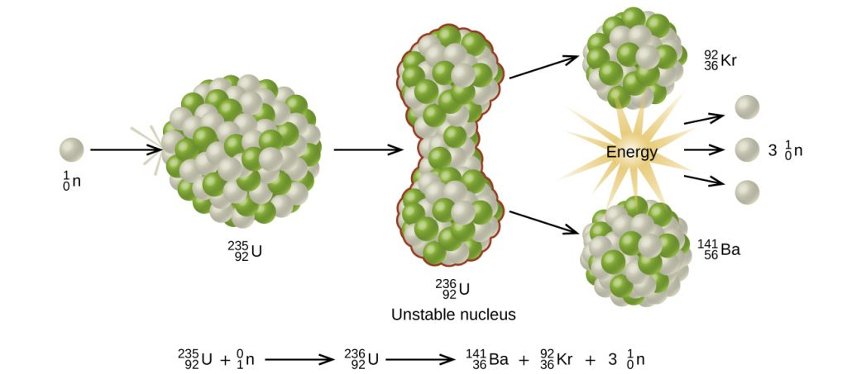
Nuclear fission - the splitting of a large nucleus into smaller ones with the release of energy.
Chemistry and the Environment by Devin R. Latimer is licensed under a Creative Commons Attribution 4.0 International License
3
Notes:
3

Slide 4
Energy is released because the sum of the masses of these fragments is less than the original mass, and this missing mass (about 0.1 percent of the original mass of U-235) has been converted into energy according to Einstein's equation: E=mc²
4

Slide 5
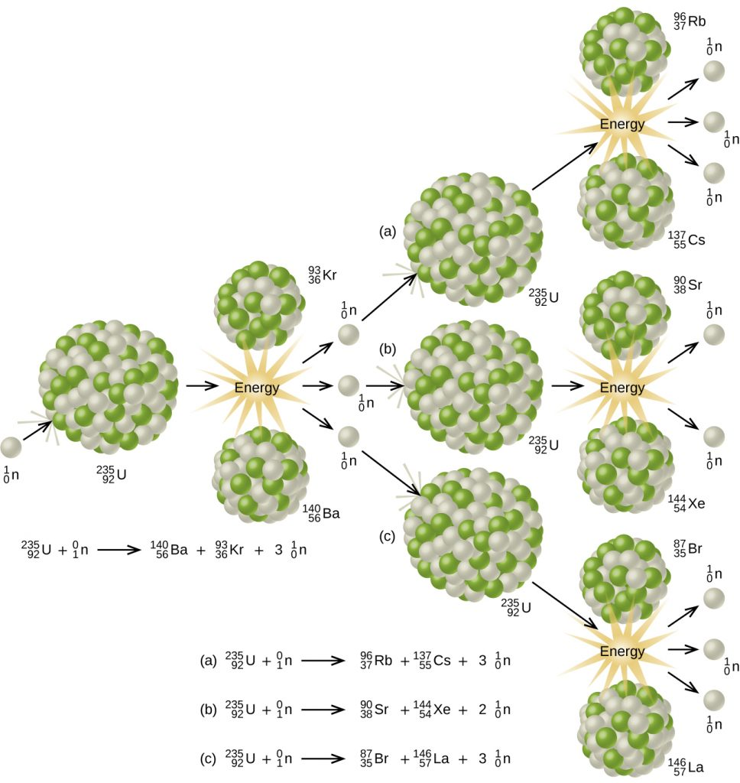
Chain Reaction
5
Chemistry and the Environment by Devin R. Latimer is licensed under a Creative Commons Attribution 4.0 International License

Slide 6
E = mc²
Ex: 1.0 kg of U-235
6

Slide 7
E = mc²
Ex: 1.0 kg of U-235
0.1 % of the mass is converted to energy
7

Slide 8
What is the amount of energy produced from the fission of 600 g of U-235?
8

Slide 9
CANDU
(CANada Deuterium Uranium) reactor
natural U ---> UO2
ceramic pellets --> rods ---> bundles
9
Notes:
9

Slide 10
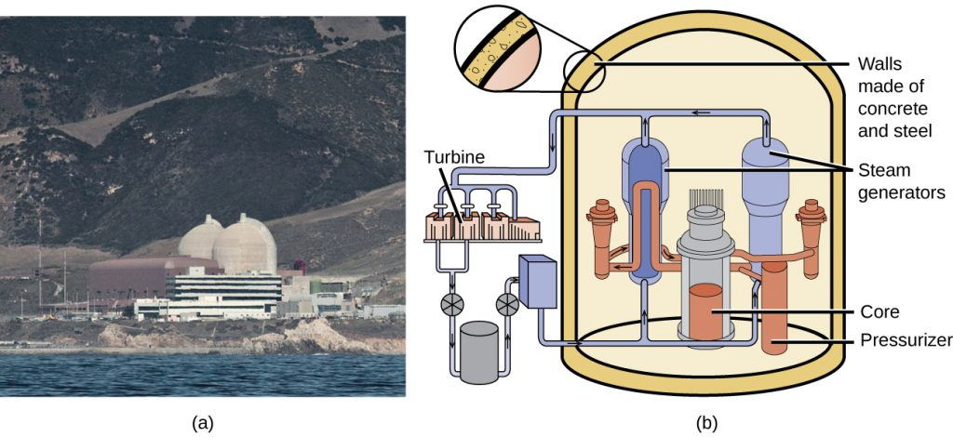
Nuclear Reactor
Chemistry and the Environment by Devin R. Latimer is licensed under a Creative Commons Attribution 4.0 International License
10
Notes:
10

Slide 11
3-400 tons coal
emitting:
  1400 tons CO2
  12 tons SOx
  4 tons NOx
Expensive and becoming more so
one CANDU bundle
no C, S or N oxides emitted into air
Postulated to potentially be a very cheap source of energy
11

Slide 12
Nuclear power considerations
12
Notes:
12

Slide 13
Could a nuclear power plant undergo a nuclear explosion?
13
Notes:
13

Slide 14
Could a nuclear power plant undergo a nuclear explosion?
Power plant (controlled fission)
= 0.7- 5 % U-235
Nuclear explosion (critical mass)
= 90 % U-235
14
Notes:
14

Slide 15
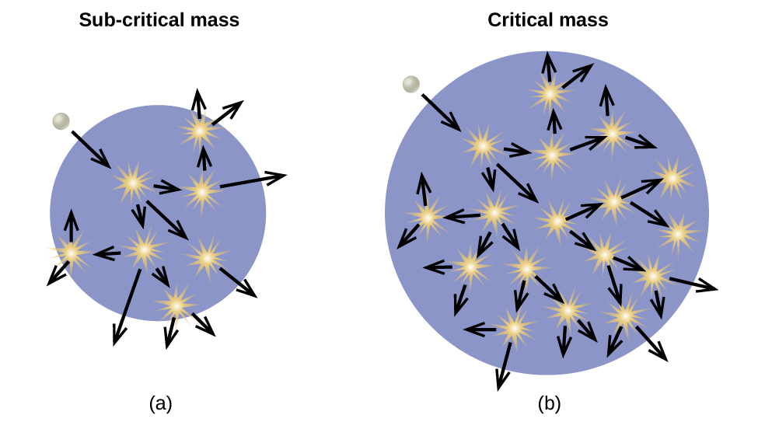
Chemistry and the Environment by Devin R. Latimer is licensed under a Creative Commons Attribution 4.0 International License
15

Slide 16
Could nuclear power plant fuel be used to make weapons?
16

Slide 17
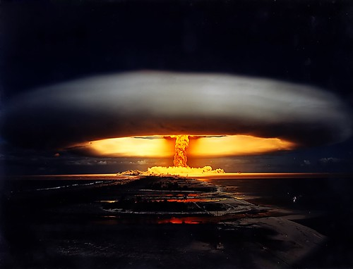
"Nuclear explosion" by Fotos CGQ is licensed under CC BY-NC 2.0
The isotopes U-235 and U-238 behave essentially the same in all chemical reactions, so the separation/purification of either of these isotopes is extremely difficult.
17

Slide 18
Accidents/Waste
Large amounts of radioactivity can be very dangerous.

Slide 19
Radioactivity
the spontaneous emission of radiation by certain elements
19
Notes:
19

Slide 20
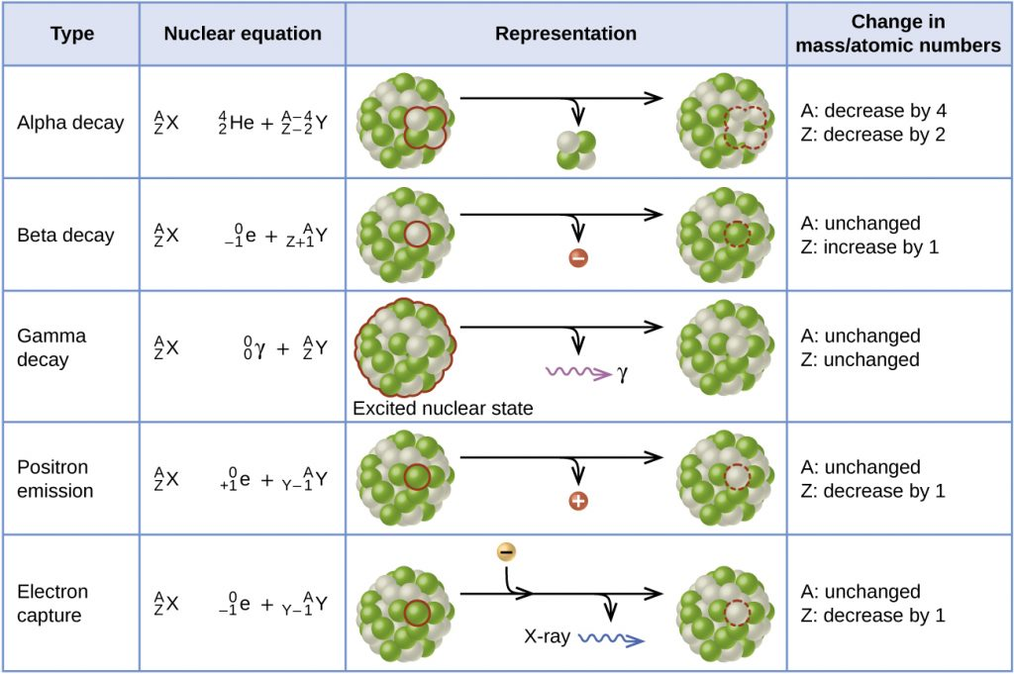
Chemistry and the Environment by Devin R. Latimer is licensed under a Creative Commons Attribution 4.0 International License

Slide 21
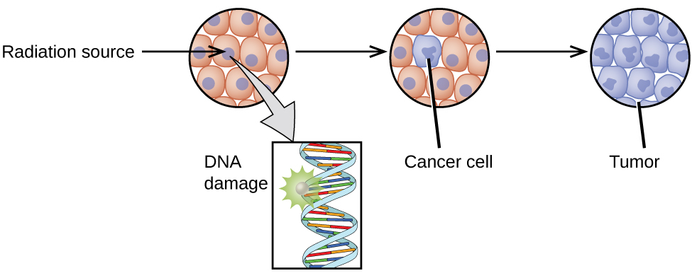
Chemistry and the Environment by Devin R. Latimer is licensed under a Creative Commons Attribution 4.0 International License

Slide 22
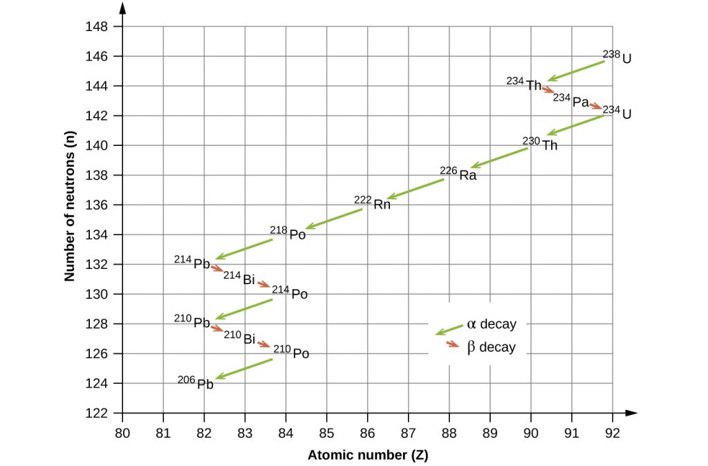
Chemistry and the Environment by Devin R. Latimer is licensed under a Creative Commons Attribution 4.0 International License

Slide 23
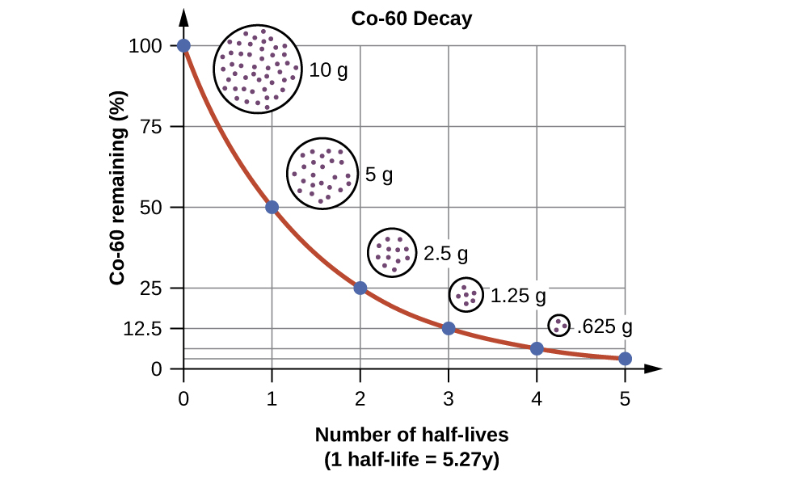
Half-life (t_{1⁄2}): the time required for a quantity to reduce to half of its initial value.
Chemistry and the Environment by Devin R. Latimer is licensed under a Creative Commons Attribution 4.0 International License

Slide 24
Chemistry and the Environment by Devin R. Latimer is licensed under a Creative Commons Attribution 4.0 International License

Slide 25
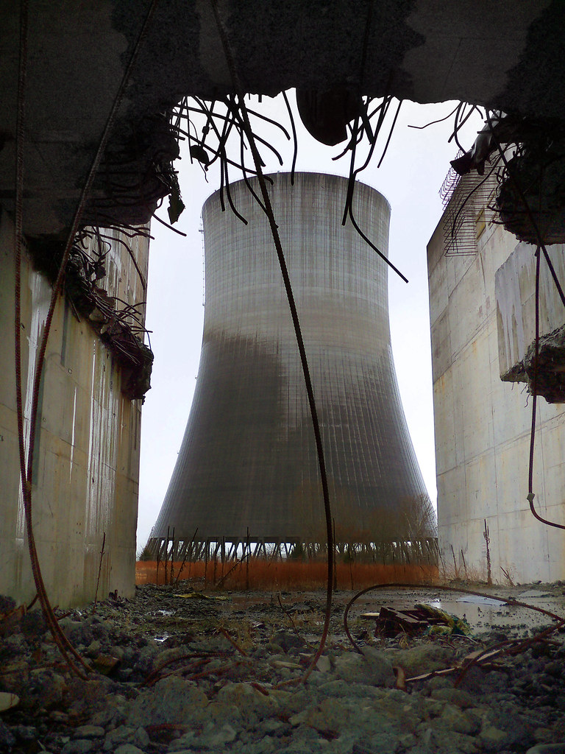
Accidents
Chernobyl
  design flaw, graphite moderator, fire/explosion
- Fukushima
- earthquake/tsunami
"Wreckage of the Reactor" by Avius Quovis is licensed under CC BY-NC 2.0
25

Slide 26
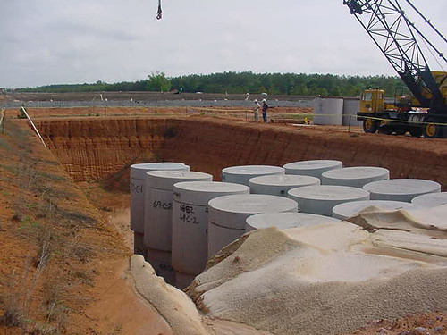
Nuclear Waste
"Low-Level Waste Disposal site" by NRCgov is licensed under CC BY 2.0

Slide 27
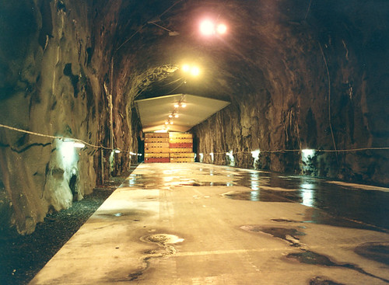
Long-term geologic repository
"Forsmark Horizontal silo" by Fred Dawson is licensed under CC BY-NC-ND 2.0

Slide 28
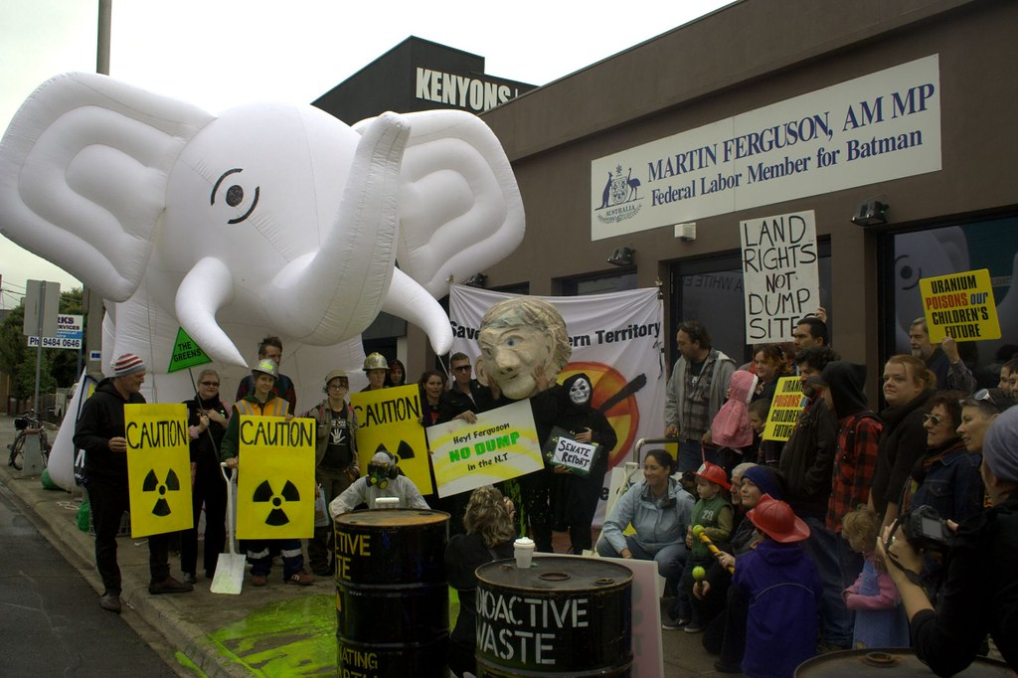
"No nuclear waste from Muckaty to Melbourne" by John Englart (Takver) is licensed under CC BY-SA 2.0

Slide 29
Spent Nuclear Fuel: A Trash Heap Deadly for 250,000 Years or a Renewable Energy Source?
http://www.scientificamerican.com/article.cfm?id=nuclear-waste-lethal-trash-or-renewable-energy-source
29

Slide 30
Half-life (t_{1⁄2}): the time required for a quantity to reduce to half of its initial value.
Chemistry and the Environment by Devin R. Latimer is licensed under a Creative Commons Attribution 4.0 International License

Slide 31
A sample of 10 Kg of Thorium-234 is allowed to radioactively decay for 96.4 days. Approximately, how much Th-234 remains?
[Th-234 t_{1/2} = 24.1 days]
A. 7.5 Kg
B. 5 Kg
C. 2.5 Kg
D. 1.25 Kg
E. 0.625 Kg
31

Slide 32
A sample of 10 Kg of Thorium-234 is allowed to radioactively decay for 96.4 days. Approximately, how much Th-234 remains?
[Th-234 t_{1/2} = 24.1 days]
A. 7.5 Kg
B. 5 Kg
C. 2.5 Kg
D. 1.25 Kg
E. 0.625 Kg
32

Slide 33
Carbon Dating
A sample of fossilized remains is found to contain 6% of the original (living organism) ¹⁴C. Approximately, how old are the remains? [C-14 t_{1/2} = 5715 years]
33
Notes:
33

Slide 34
Summary
Fossil Fuels
BioFuels
Nuclear Fuels
34
Notes:
34

