Slide 1
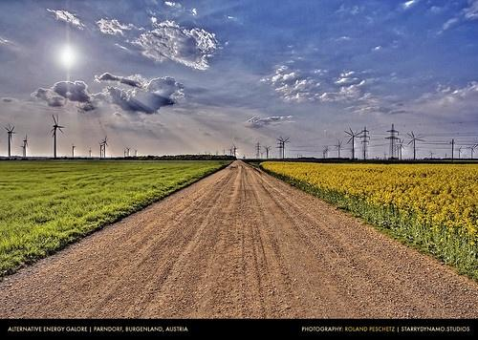
Renewable and Alternative Energy Sources
"Alternative Energy Galore" by roliathBrickworx is licensed under CC BY-NC 2.0
1

Slide 2
Solar Power
Direct Heat
2

Slide 3

Solar Power
Direct Heat
Wind - the movement of air between high and low pressures
"Wind Power" by Grathio is licensed under CC BY-NC-SA 2.0
3
Notes:
3

Slide 4
Solar Power
Direct Heat
Wind
Water - the hydrologic cycle.
4

Slide 5
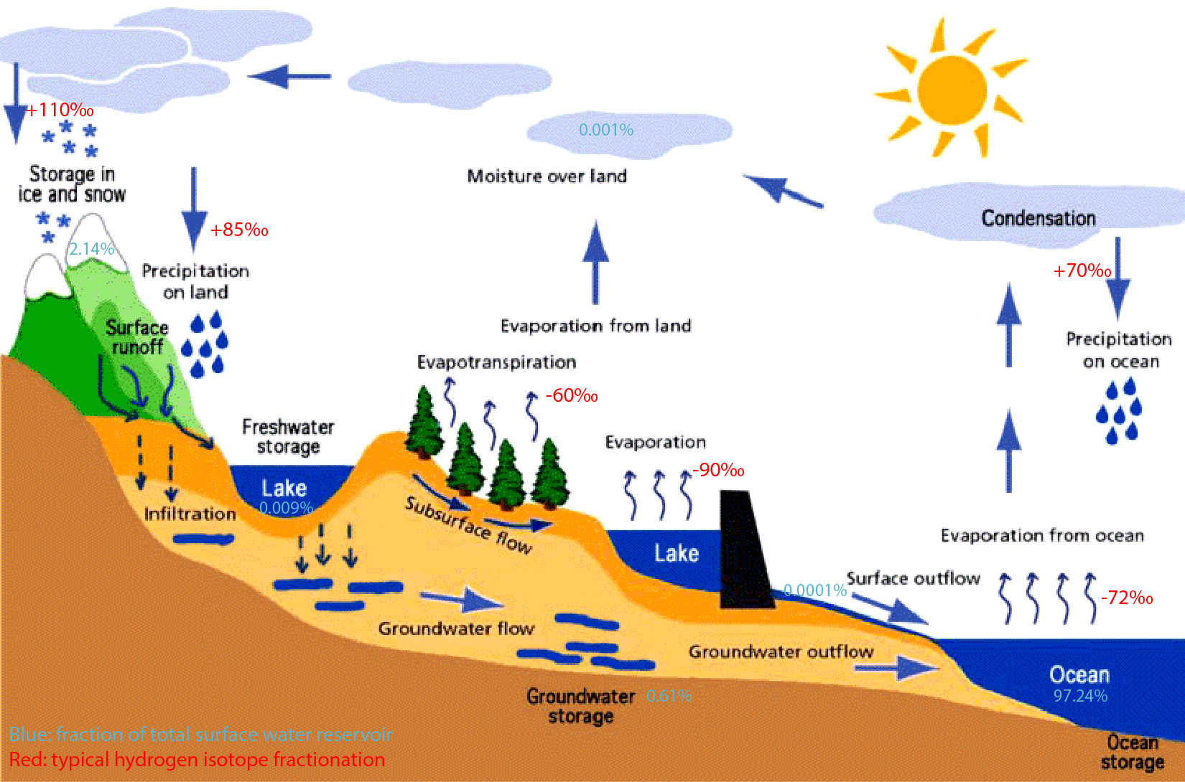
Hydrologic cycle
"File:F3 hydrological cycle.png" by Sunson08 is licensed under CC BY-SA 4.0
5

Slide 6
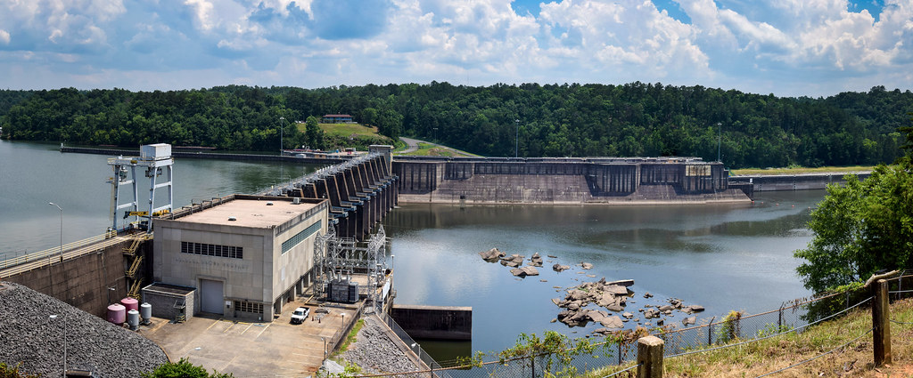
Hydroelectric generating station
"Holt Dam Tuscaloosa" by petridish38 is licensed under CC BY-NC 2.0
6

Slide 7
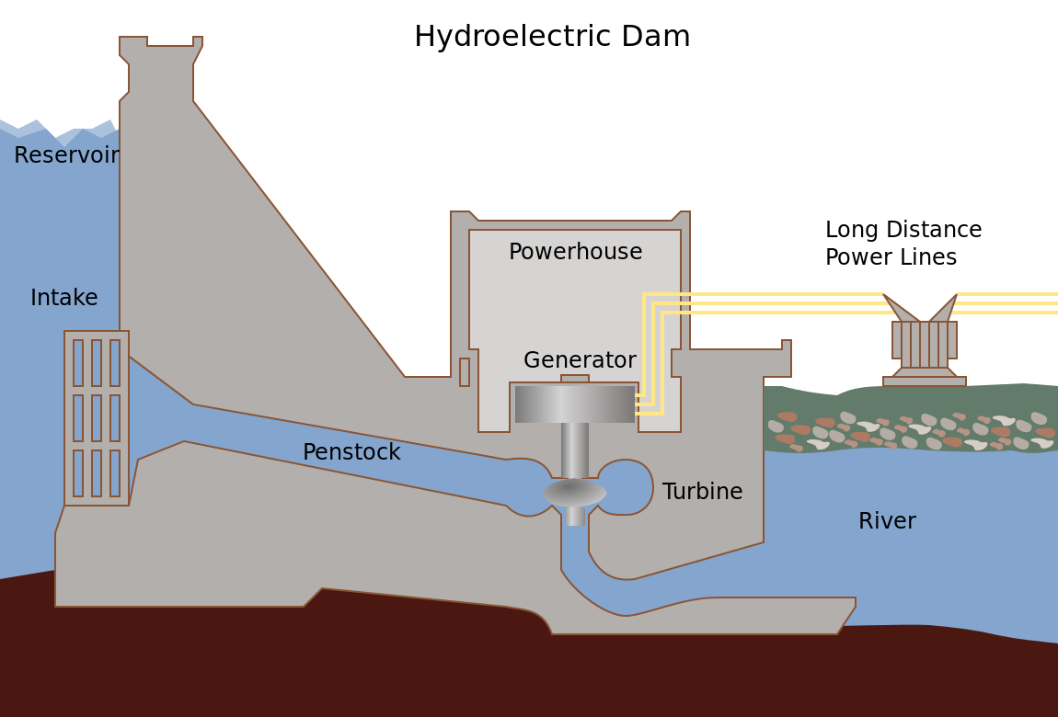
Tennessee Valley Authority; SVG version by Tomia. Licenced GFDL and CC-BY-2.5

Slide 8

"Dam causes a 100km of devastation" by joellehernandez is licensed under CC BY-NC-ND 2.0
8

Slide 9
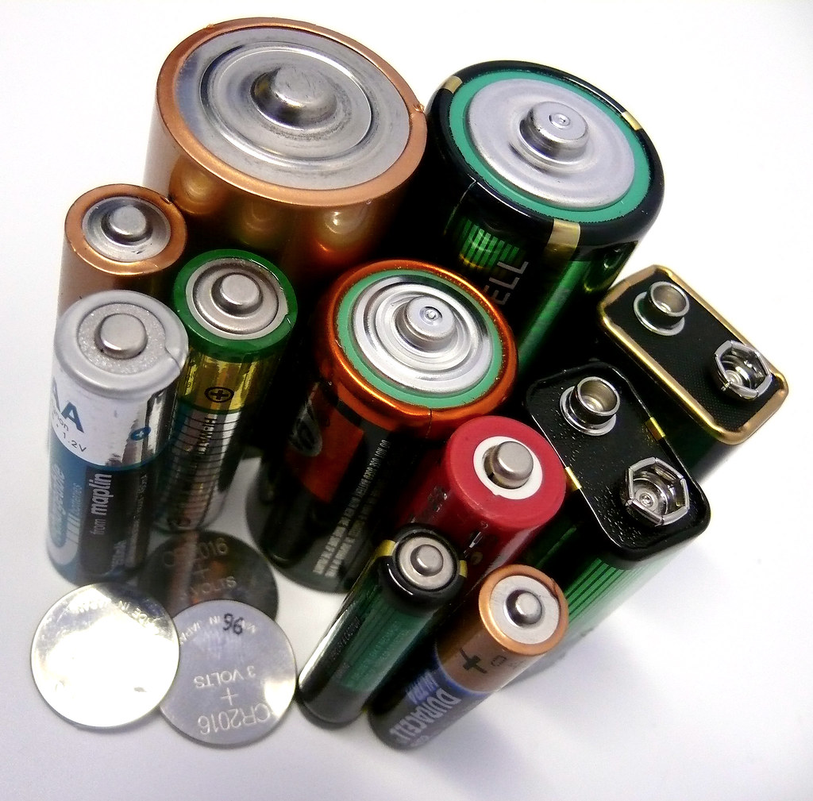
A battery (or galvanic cell) is a system for the direct conversion of chemical energy to electrical energy.
- convenient, transportable sources of stored energy.
"AJ_Batteries001" by Curious_Gregor is licensed under CC BY-NC-SA 2.0
9

Slide 10
Nickel-Cadmium battery
a redox reaction where the cadmium is oxidized and the nickel is reduced.
10
Notes:
10

Slide 11
Fuel Cell
chemical reaction corresponding to hydrogen combustion but the energy is released as electricity.
11

Slide 12
Hydrogen
combustion:
  H_{2(g)} + ½ O_{2(g)} H₂O_{(l)}
yields 143 kJ/g and water
fuel cell redox reaction: has the same overall reaction as combustion
12

Slide 13
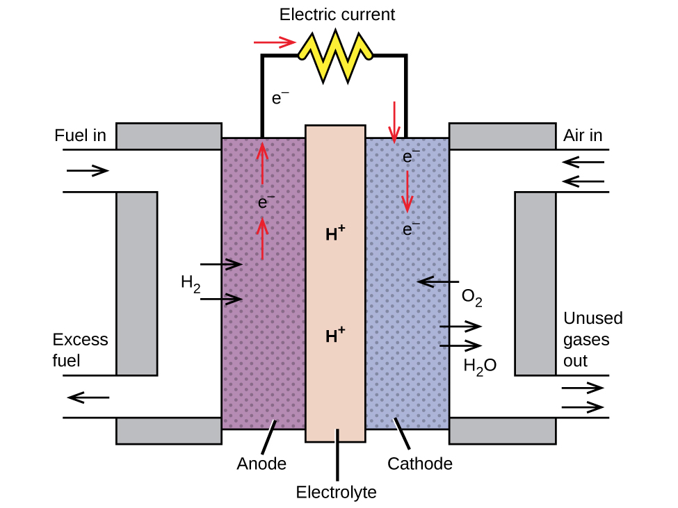
A fuel cell produces electricity by converting the chemical energy of the hydrogen directly into electricity without the combustion.
Chemistry and the Environment by Devin R. Latimer is licensed under a Creative Commons Attribution 4.0 International License
13

Slide 14
Compare Hydrogen Energy
combustion vs fuel cell
14
Notes:
14

Slide 15

"DSC_4247" by (buses[IN]gapore!) is licensed under CC BY-NC-SA 2.0
But, where will we get the H₂?
15

Slide 16
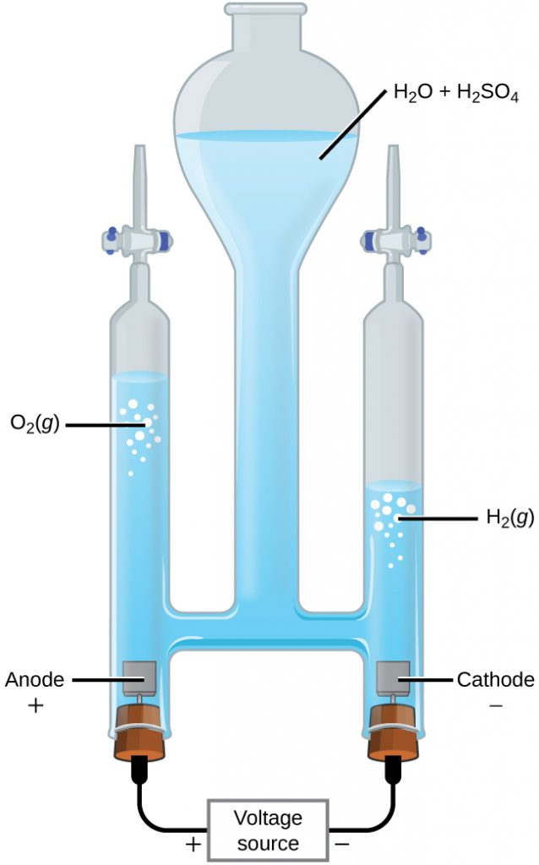
Chemistry and the Environment by Devin R. Latimer is licensed under a Creative Commons Attribution 4.0 International License
16

Slide 17
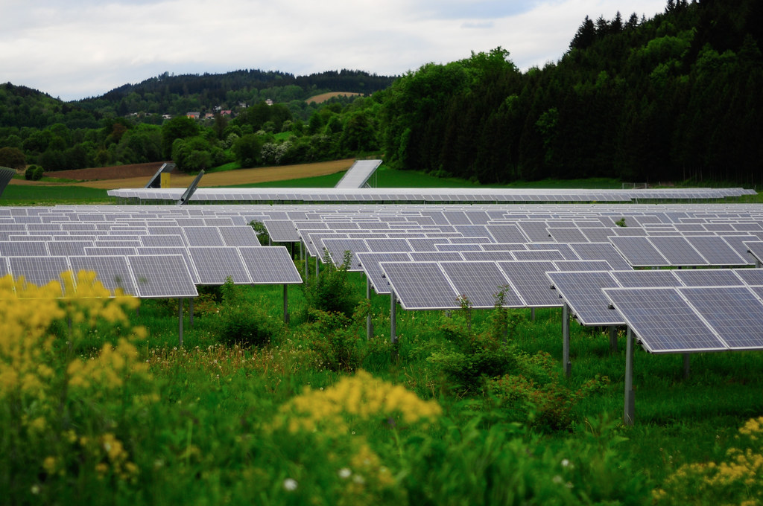
Photovoltaics - involves the flow of electrons directly from the impact of the sun.
normally using semiconductors
17
"_DSC6988.jpg" by theaelix is licensed under CC BY 2.0

Slide 18
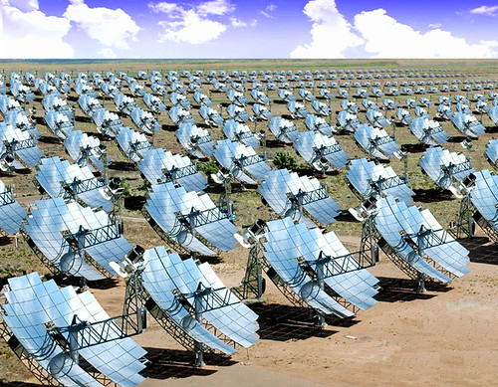
Solar Thermal - concentration of heat energy directly from the sun for use in heating or electricity generation
"Solar Thermal" by International Rivers is licensed under CC BY-NC-SA 2.0
18

Slide 19
Fusion
of nuclei can produce massive amounts of energy.
19
Notes:
19

Slide 20
Fusion
of nuclei can produce massive amounts of energy.
E = mc²
Temperature of 100,000,000 ºC required.
20
Notes:
20

Slide 21
Summary
Fossil Fuels
BioFuels
Nuclear Fuels
Alternative Energy Sources
21
Notes:
21

