Slide 1
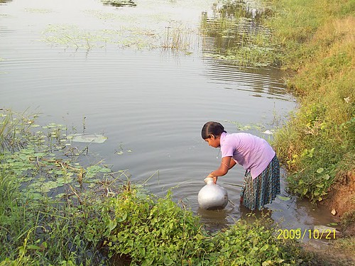
Water Quality
"Safe Drinking Water Supply and Sanitation Project for Puri district" by India Water Portal is licensed under CC BY-NC-SA 2.0
1

Slide 2
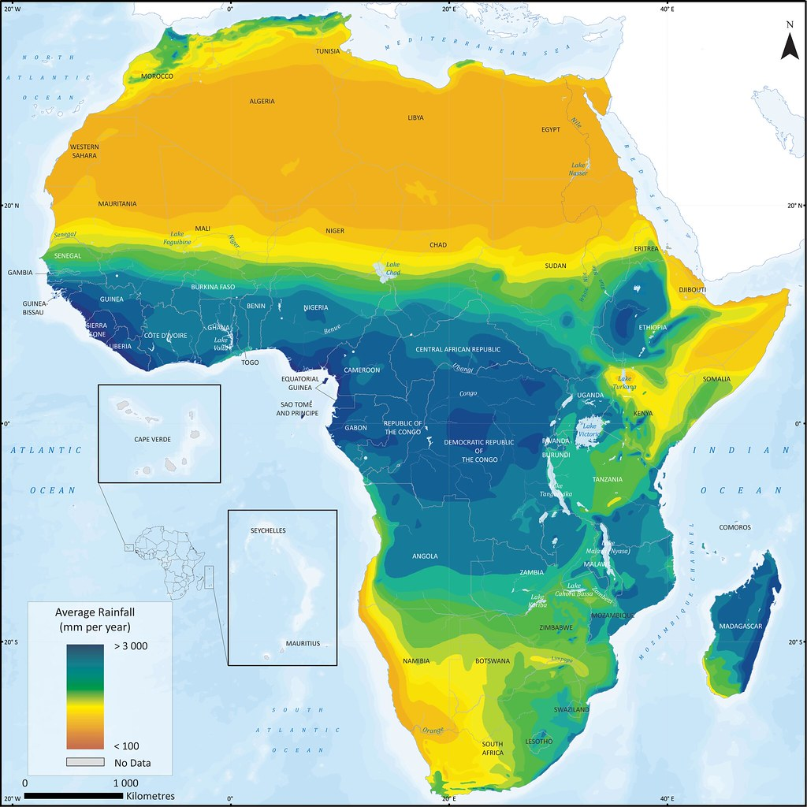
"Africa Water" by Nathan Laurell is licensed under CC BY-NC 2.0
2

Slide 3
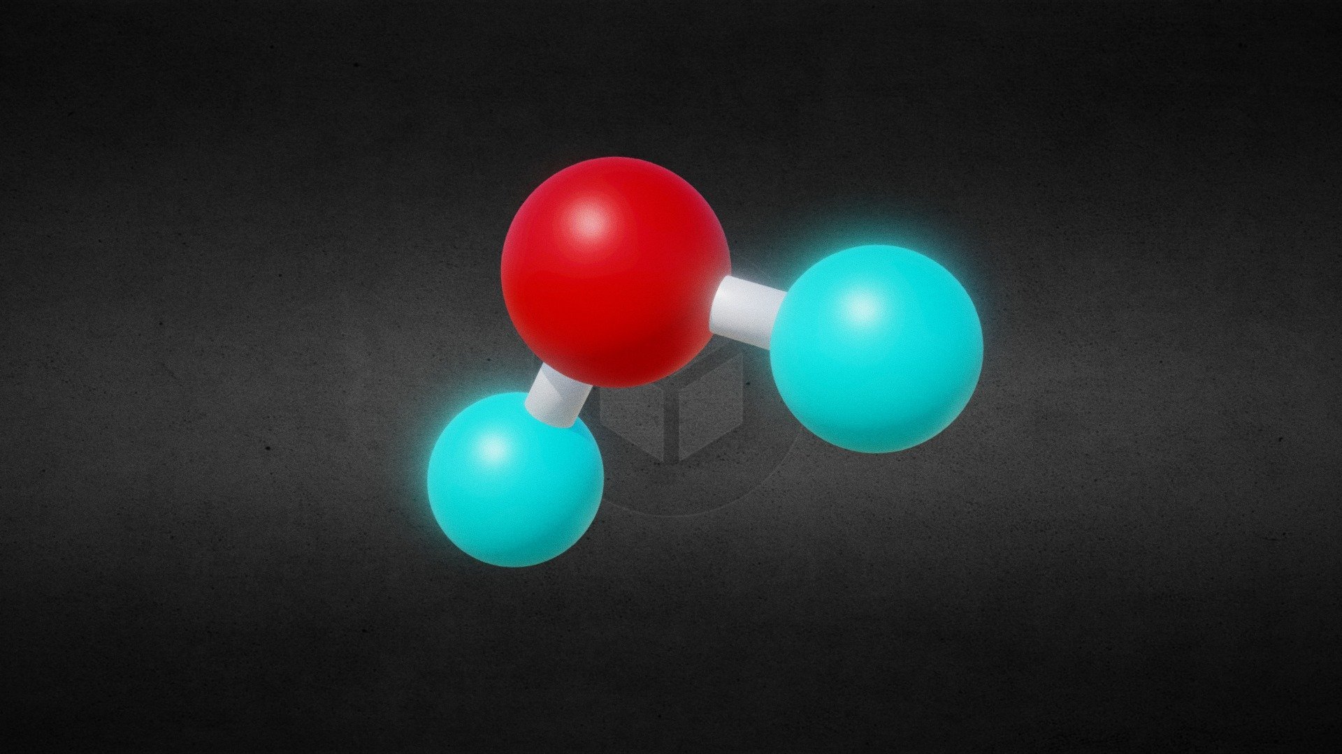
Water
"Water Molecule ball-and-stick model" by borkia is licensed under CC BY-SA 4.0

Slide 4
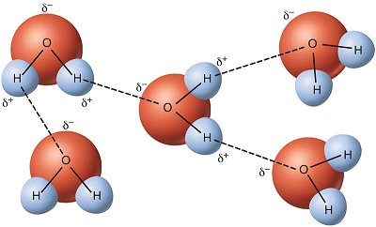
"File:Miri9.jpg" by J:136401 is licensed under CC BY-SA 3.0

Slide 5
Hydrogen bond
an especially strong intermolecular force between an electronegative element (such as N, O or a halogen) and a hydrogen that is covalently bound to an electronegative element (such as N, O or a halogen).
Ex: H₂O, NH₃, CH₃C(=O)CH₃,
NH₃ in CH₃C(=O)CH₃

Slide 6
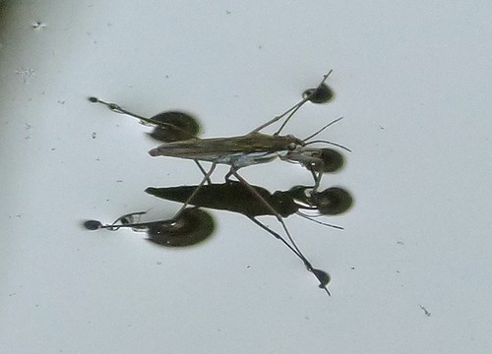
Surface Tension
"Gerridae" by Arctic Wolf Pictures is licensed under CC BY-ND 2.0

Slide 7
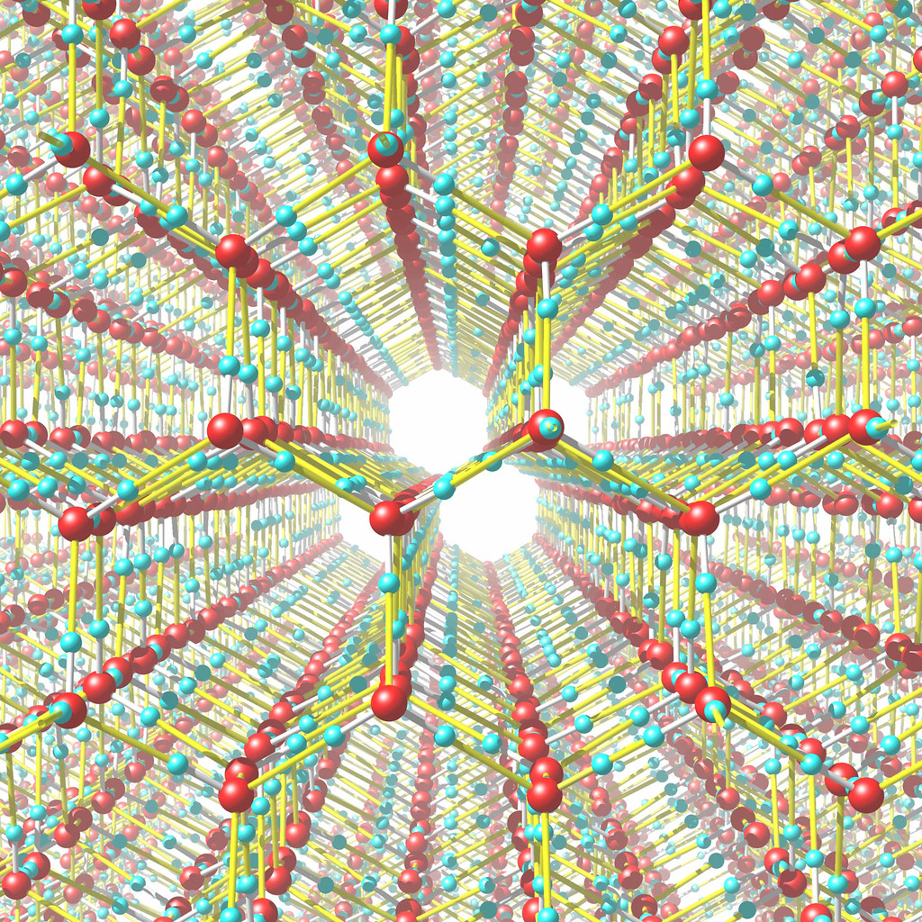
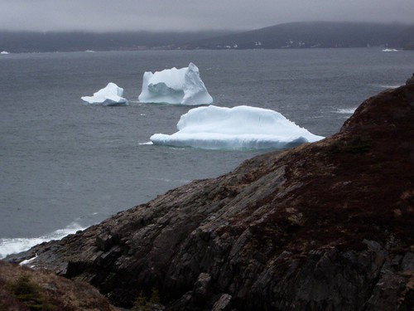
Ice floats
"iceIh" by vitroid is licensed under CC BY 2.0
"IMGP2804.JPG" by lIHd is licensed under CC BY-NC-SA 2.0

Slide 8
ion
  an atom or group of atoms that has lost or gained one or more electrons so that it is no longer electrically neutral
    Will form based on the ‘stable’ electron configuration of the noble gases (Group 8)
  ex: potassium chloride
8

Slide 9
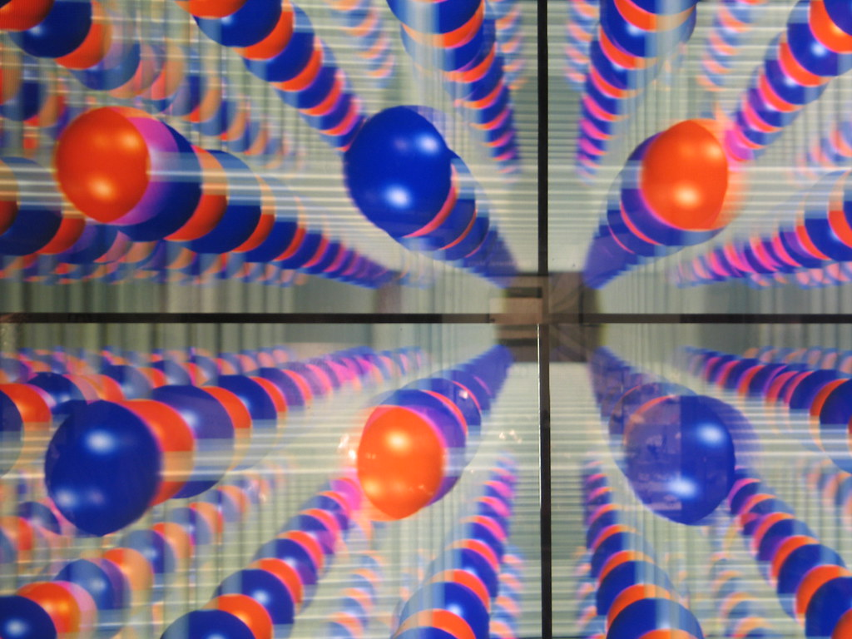
lattice energy - a measure of the strength of bonds in an ionic compound
"Structure of a Crystal lattice" by Fovea Centralis is licensed under CC BY-ND 2.0
9
Notes:
9

Slide 10
Dissolution of KCl(s) in water

Slide 11
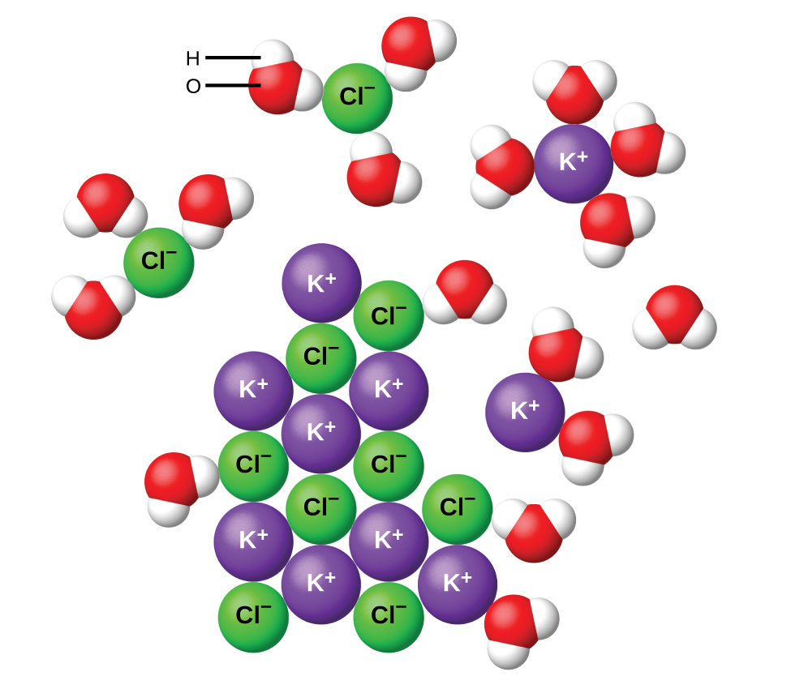
Chemistry and the Environment by Devin R. Latimer is licensed under a Creative Commons Attribution 4.0 International License
11

Slide 12
Second Law of Thermodynamics
Spontaneous processes involve an increase in the entropy (a measure of the disorder of the system) of the universe.

Slide 13
Chemistry and the Environment by Devin R. Latimer is licensed under a Creative Commons Attribution 4.0 International License
13

Slide 14
CH₃CH₂CH₂CH₂CH₃
₊
H₂O
14
Notes:
14

Slide 15
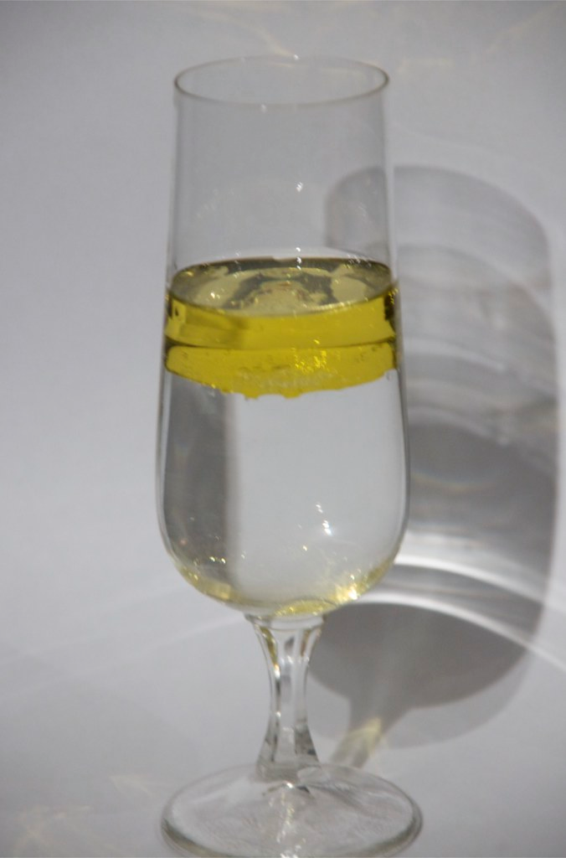
immiscible liquids
"Oil & water 2" by bitjungle is licensed under CC BY-SA 2.0

Slide 16
CH₃CH₂CH₂CH₂CH₃
₊
CH₃CH₂CH₂CH₃
16
Notes:
16

Slide 17
“Like dissolves like”
Polar (hydrophilic) compounds normally dissolve other polar compounds, while non-polar (hydrophobic) dissolve non-polar.
17

Slide 18
CH₃CH₂OH + H₂O
18
Notes:
18

Slide 19
CH₃CH₂CH₂OH + H₂O
19
Notes:
19

Slide 20
CH₃CH₂CH₂CH₂CH₂CH₂CH₂CH₂OH
+ H₂O
20
Notes:
20

Slide 21
CH₃CH₂CH₂CH₂CH₂CH₂CH₂CH₂OH
+ H₂O
Now, estimate/measure the differential solubility of a compound between these two solvents.
21

Slide 22
CH₃CH₂CH₂CH₂CH₂CH₂CH₂CH₂OH
+ H₂O
Now, estimate/measure the differential solubility of a compound between these two solvents.
K_{ow}: octanol-water partition coefficient.
Environmental fate modelling
22

Slide 23
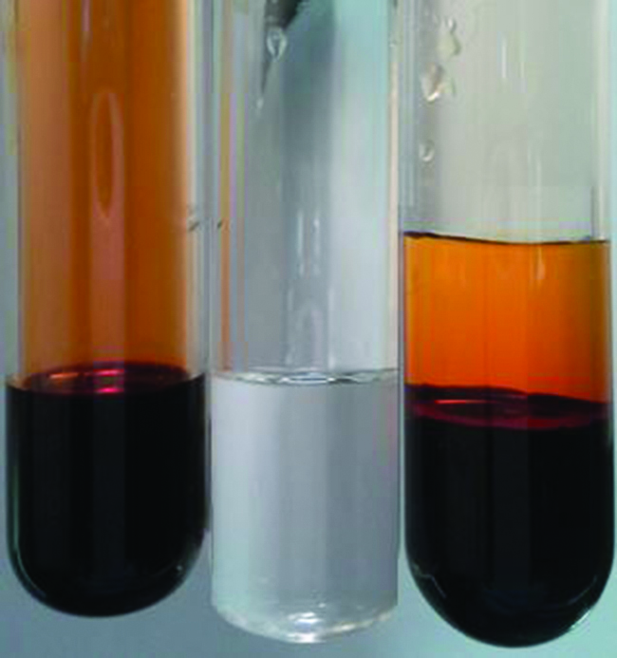
Chemistry and the Environment by Devin R. Latimer is licensed under a Creative Commons Attribution 4.0 International License
23

Slide 24
Would you expect MgCl2 to be more soluble in water or the long chain hydrocarbon, CH₃CH₂CH₂CH₂CH₂CH₂CH₂CH₂OH ?
A. Water
B. CH₃CH₂CH₂CH₂CH₂CH₂CH₂CH₂OH
C. Equal solubility.
24

Slide 25
Would you expect CH₃CH₂CH₂CH₂CH₂CH₂CH₂CH₂Cl to be more soluble in water or the long chain hydrocarbon, CH₃CH₂CH₂CH₂CH₂CH₂CH₂CH₂OH ?
A. Water
B. CH₃CH₂CH₂CH₂CH₂CH₂CH₂CH₂OH
C. Equal solubility.
25

Slide 26
Compared to CH₃CH₂OH, what would you expect the solubility properties of CH₃CH₂CH₂CH₂OH to be?
A. More soluble in octanol, less soluble in water and organic matter.
B. Less soluble in octanol, more soluble in water and organic matter.
C. More soluble in octanol and organic matter, less soluble in water.
D. Less soluble in octanol and organic matter, less soluble in water.
26

Slide 27
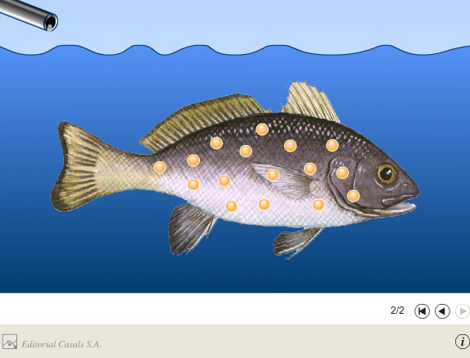
Bioconcentrate: from non-dietary (water) partitioning
"Bioconcentration" by AmadeuBlasco is licensed under CC BY-NC-ND 3.0
27

Slide 28
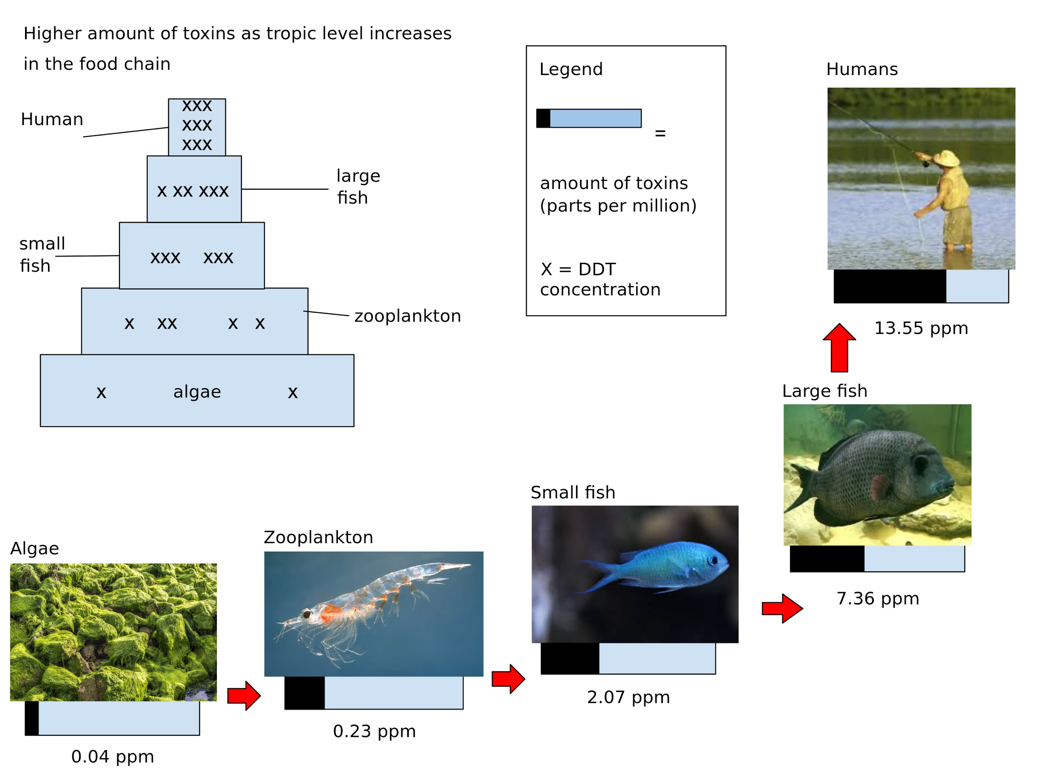
Biomagnify: concentration up the foodchain
28
"File:The build up of toxins in a food chain.svg" by Øystein Paulsen is licensed under CC BY-SA 3.0

Slide 29
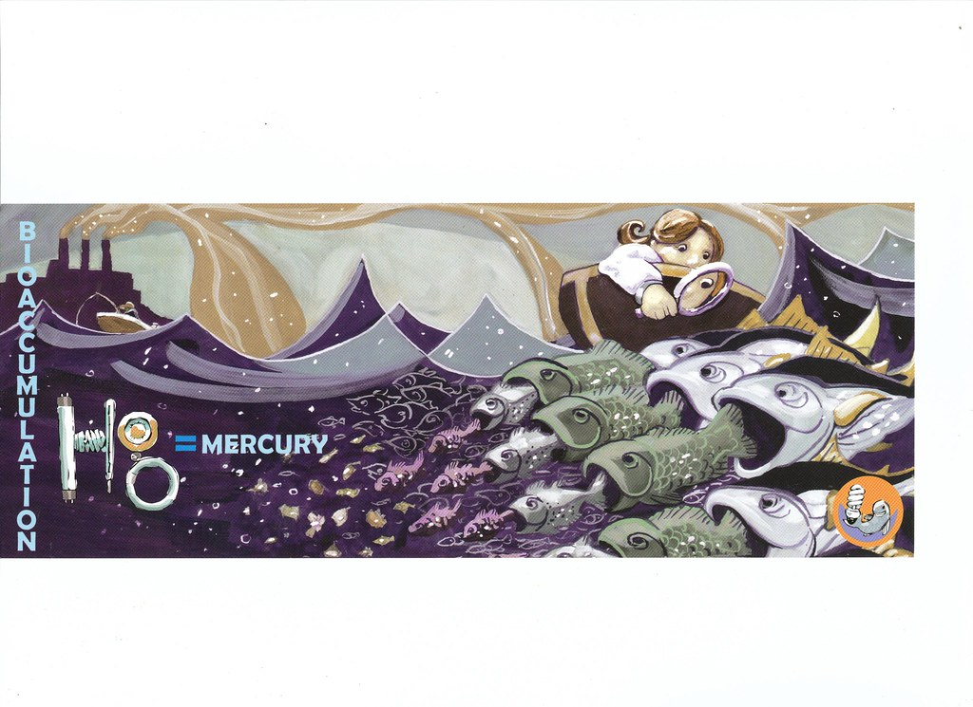
Bioaccumulate
"Hg" by matthetube is licensed under CC BY-NC-ND 2.0
29

Slide 30
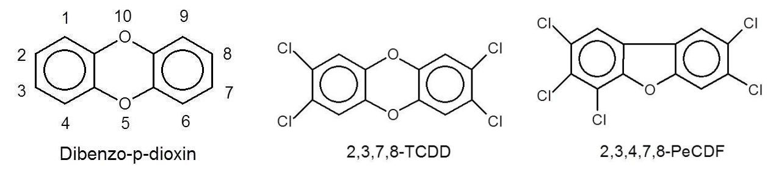
Ex: “dioxins”
"File:Structures of dibenzo-p-dioxin, 2,3,7,8-tetrachlorodibenzo-p-dioxin and 2,3,4,7,8-pentachlorodibenzofurane.jpg" by Viinamakelainen is licensed under CC BY-SA 4.0

Slide 31
Ex: “dioxins”
lipophilic, bioaccumulate
teratogen, carcinogen, mutagen
"File:Structures of dibenzo-p-dioxin, 2,3,7,8-tetrachlorodibenzo-p-dioxin and 2,3,4,7,8-pentachlorodibenzofurane.jpg" by Viinamakelainen is licensed under CC BY-SA 4.0

Slide 32
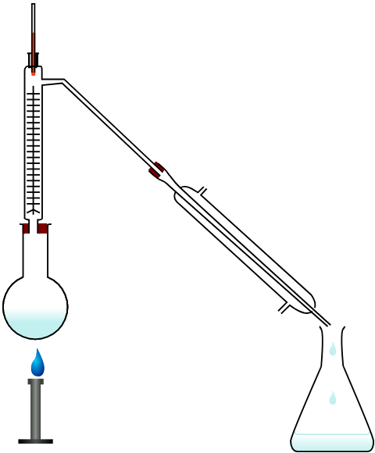
The Grasshopper Effect: Global Distillation
"File:Fractional distillation lab apparatus blank version.svg" by This SVG image was created by Medium69. Cette image SVG a été créée par Medium69. Please credit this : William Crochot is licensed under CC BY-SA 3.0
32

Slide 33
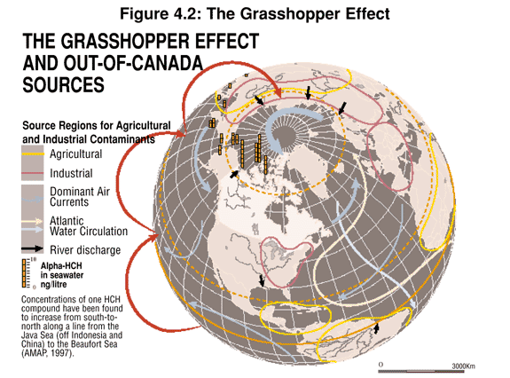
Canada House of Commons government report
https://www.ourcommons.ca/DocumentViewer/en/36-2/ENVI/report-1/page-66

Slide 34
Concentration Terms
Mass % = [mass solute/mass solution] x 100
Molarity = moles solute/L of solution
Ex: What is the concentration (in mass % and M) of the resulting solution when you add 5 grams of NaOH to 95 mL of water?
34
Notes:
34

Slide 35
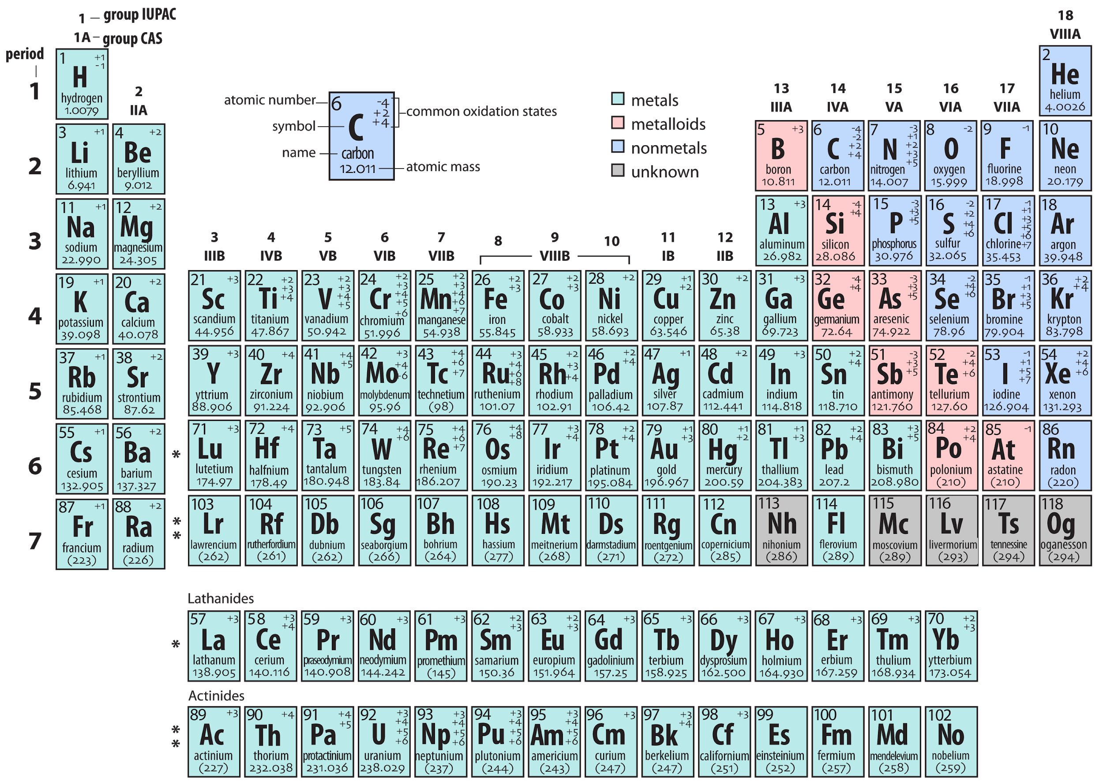
"File:Periodic table AH.png" by Ahazard.sciencewriter is licensed under CC BY-SA 4.0

Slide 36
Concentration Terms
Parts per hundred (percent)
Parts per million (ppm)
1 part solute in 1,000,000 parts solvent = 1 in 1 x 10⁶
Parts per billion (ppb)
1 part solute in 1,000,000,000 parts solvent = 1 in 1 x 10⁹
Ex: The maximum contaminant level [MCL] for dioxin in drinking water is set at 3 × 10⁻⁸ ppm. A sample of drinking water is found to contain 2 × 10⁻⁴ ppb. Is the sample of water safe to drink?
1 g of NaCl as part of 100 g of solution is a 1% NaCl solution
1 in 100 = 1 in 1 x 10²
36

Slide 37
The 1 %
For example, present carbon dioxide concentrations in air ~ 0.040 %
Q - if the indoor CO₂ concentration in a building is measured at 4002 ppm, would this be considered normal?
  ie. What is the 0.040 % concentration expressed as ppm?
37

Slide 38
The 1 %
For example, carbon dioxide = 0.040 %
or 400 ppm.
So, the measurement of 4002 ppm is 10 times the normal tropospheric [CO₂].
(most likely, more outside air would need to be introduced to the building)
38

Slide 39
The permissible upper limit for concern for ground level carbon monoxide is given as 0.009 ppt. A researcher finds the level in Winnipeg one day to be measuring at 6 ppm. What is the measured value in ppt and is this permissible?
  A. 0.06 ppt, this is not permissible
  B. 0.06 ppt, this is permissible
  C. 0.006 ppt, this is not permissible
  D. 0.006 ppt, this is permissible
  E. 0.0006 ppt, this not permissible
39

Slide 40
The permissible upper limit for ground level ozone is 0.12 ppm. A researcher finds the level in Toronto one day to be measuring at 580 ppb. What is the measured value in ppm and is this of concern?
  A. 58 ppm, this is of concern
  B. 0.00058 ppm, this is of no concern
  C. 0.58 ppm, this is of concern
  D. 58 ppm, this is of no concern
  E. 0.58 ppm, this is of no concern.
40

