Slide 1

Acid Precipitation
Photo by Steve Schlachter reproduced under Creative Commons Attribution License 4.0
Notes:
1

Slide 2
One way to define an acid is as a substance that releases hydrogen ions, H⁺, in aqueous solution.
Since the hydrogen ion has no electron, and only one proton (hence the positive charge), the hydrogen ion sometimes is referred to as a proton.
Example:
H₂O
HCl(g) H⁺(aq) + Cl–(aq)
(a proton)
6.1

Slide 3
However, in aqueous solution, the H⁺ will be associated with a water molecule to form the hydronium ion, H₃O⁺
Notes:
3

Slide 4
One way to define a base is as a substance that releases hydroxide ions, OH⁻, in aqueous solution.
Example:
NaOH
NH₃
6.1

Slide 5
When acids and bases react with each other, it is called a neutralization reaction.
HCl(aq) + NaOH(aq) NaCl(aq) + H₂O(l)
In neutralization reactions, hydrogen ions from an acid combine with the hydroxide ions from a base to form molecules of water.
The other product is a salt (an ionic compound) and will often be dissolved in the aqueous solution.
6.3
Notes:
5

Slide 6
pH and pOH
a measure of the concentration of H⁺ (pH) and OH⁻ (pOH) in solution.
pH = - log [H⁺]
pOH = - log [OH⁻]
pH + pOH = 14
6.3
Notes:
6

Slide 7
What is the pH of a solution with [H₃O⁺] = 1.0 x 10⁻⁷ M ? What is the pOH

Slide 8
What is the pH of a solution with [H₃O⁺] = 2.0 x 10⁻⁶ M ? What is the pOH

Slide 9
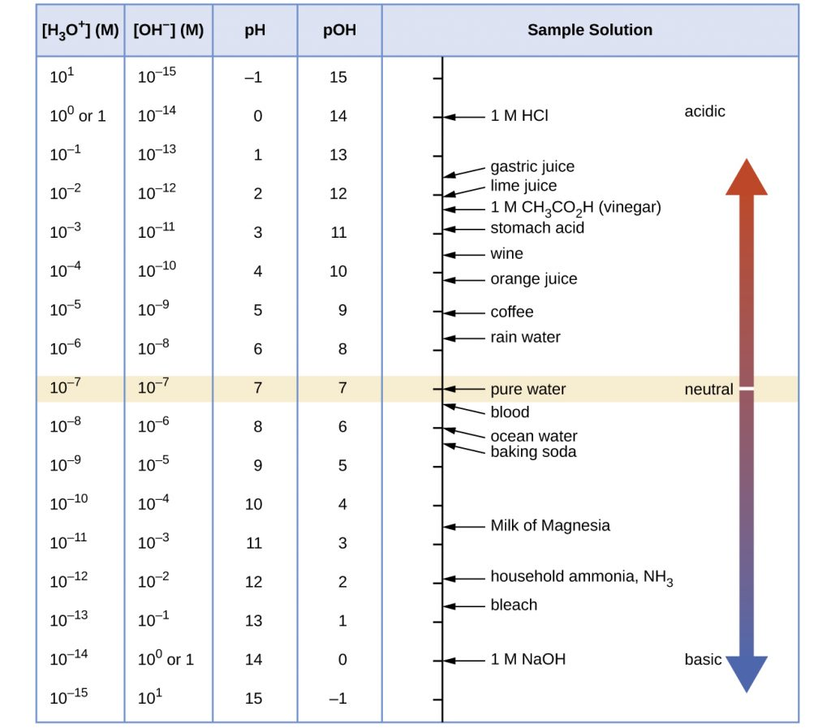
Chemistry and the Environment by Devin R. Latimer is licensed under a Creative Commons Attribution 4.0 International License
9

Slide 10
Pure water has a pH of 7.0, while normal rain has a pH of around 5.7 because of dissolved CO₂
6.5

Slide 11
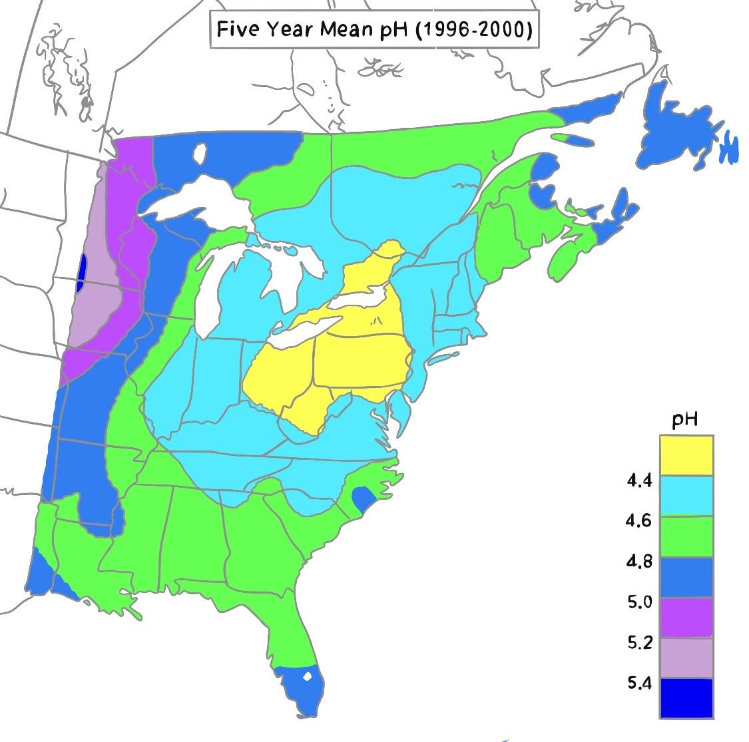
But acid precipitation can have very low pH values

Slide 12
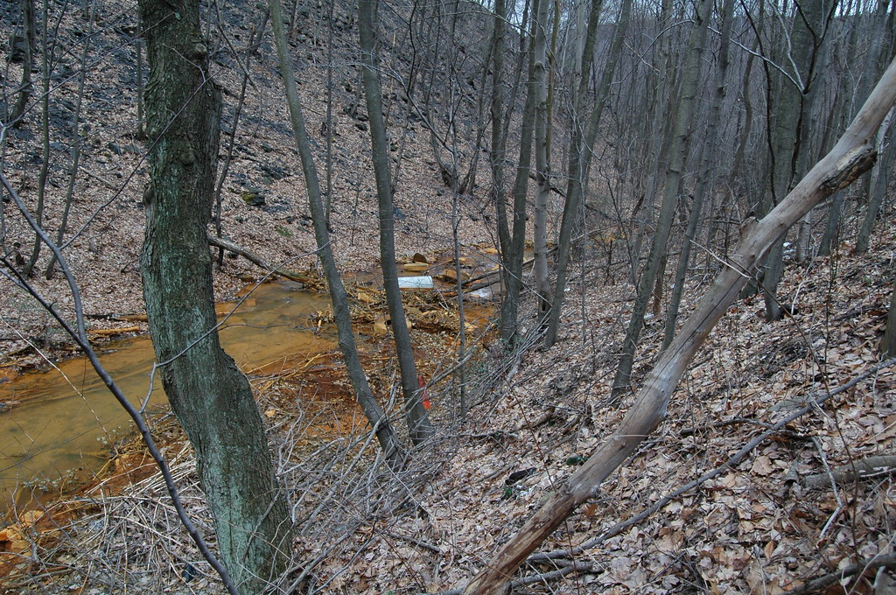
Acidic precipitation damages forests, aquatic life, monuments
"Big Mine Run, Acid Mine Drainage" by Chris_Williams_PhD is licensed under CC BY-NC 2.0

Slide 13
Remember: Because the pH scale is logarithmic, 1 unit of pH is a difference of 10 times in the amount of acidity.
Analysis of rain for specific compounds has indicated that the primary components responsible for the extra acidity are the oxides of sulfur and nitrogen:
Notes:
13

Slide 14
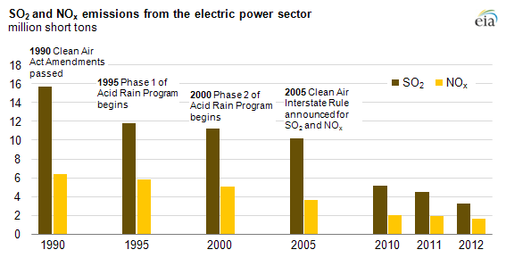
Source - U.S. Energy Information Administration

Slide 15
BBC - The bittersweet story of how we stopped acid rain (ELA)
https://www.bbc.com/future/article/20190823-can-lessons-from-acid-rain-help-stop-climate-change

