Slide 1

Polymers
"Alaska National Guard Iron Dog snowmobile race, Camp Denali, Alaska" by The U.S. Army is licensed under CC BY 2.0
Notes:
1

Slide 2
A monomer is a molecule that forms the basic unit for polymers. Monomers bind to other monomers to form repeating chain molecules through a process known as polymerization.

Slide 3
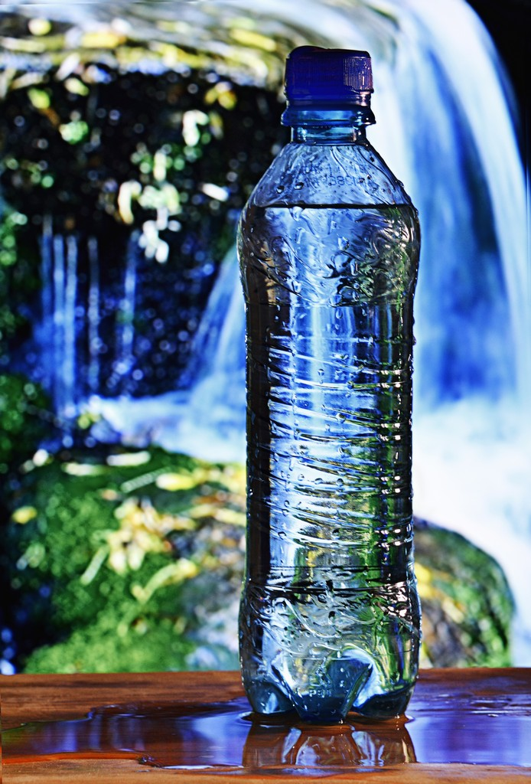
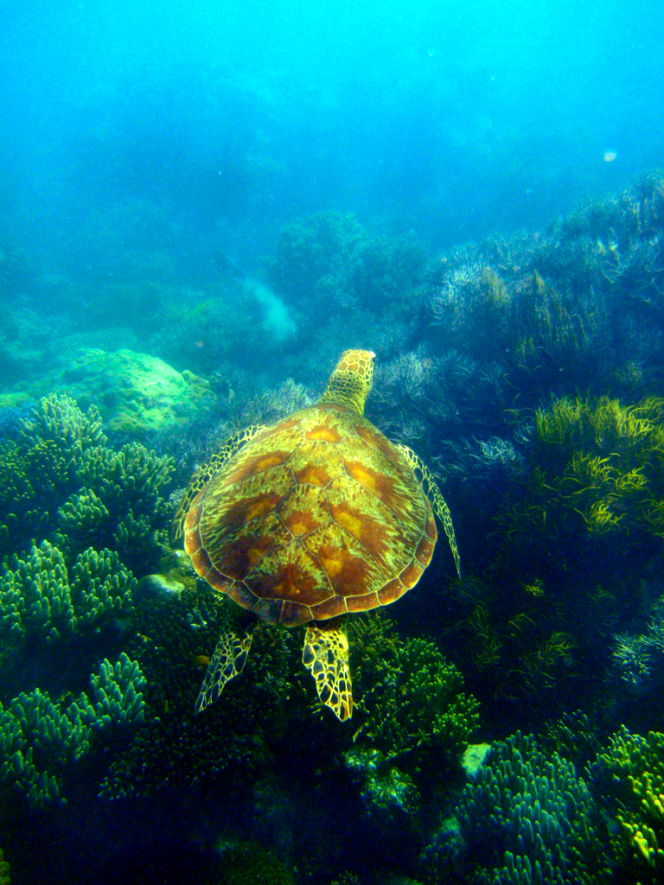
"plastic bottle with clean water" by begemot_dn is licensed under CC BY-NC 2.0
"Sea Turtle" by dbaist5 is licensed under CC BY 2.0

Slide 4
Addition Polymers
ex: polyethylene

Slide 5
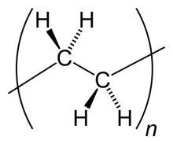
Polyethylene
"ldpe hdpe structure" by taylorivy is licensed under CC BY 2.0

Slide 6
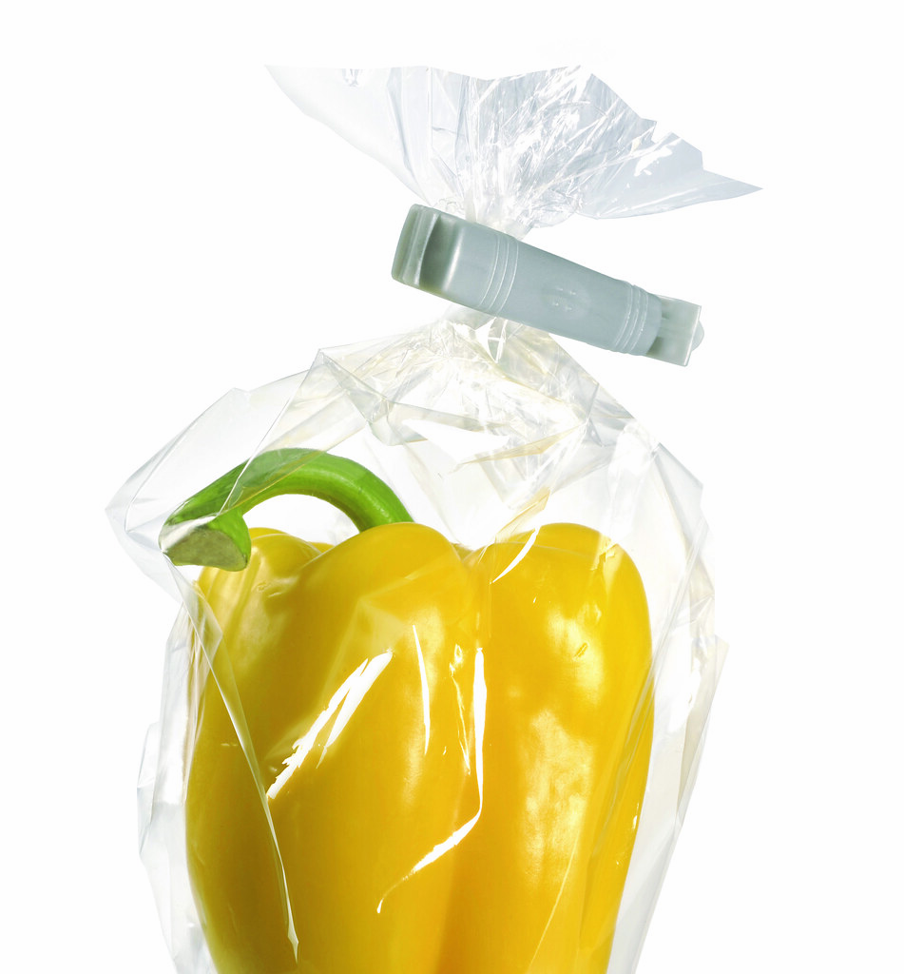
Low density polyethylene (LDPE)
"SABIC: SABIC® LDPE 2801TH00W is designed for collation shrink packaging of food and beverages. (Photo SABIC, PR047)" by PressReleaseFinder is licensed under CC BY-NC-ND 2.0

Slide 7
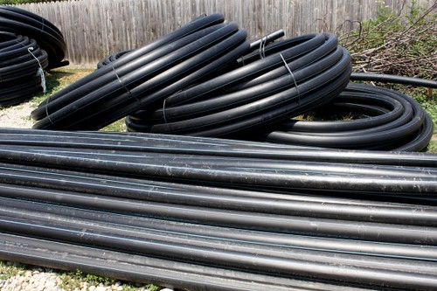
High density polyethylene (HDPE)
"High-Density-Polyethylene-Pipes_Black-HDPE-pipes__IMG_3404-580x386" by Public Domain Photos is licensed under CC BY 2.0

Slide 8
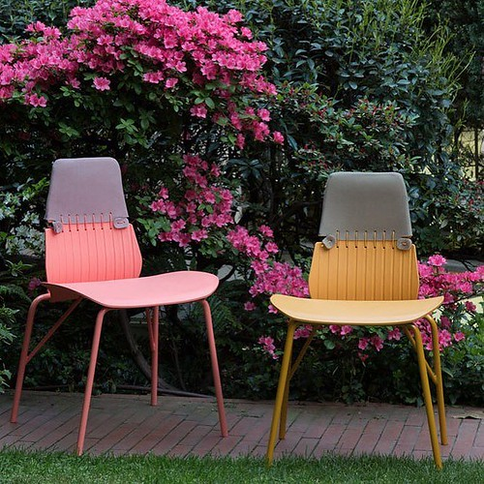
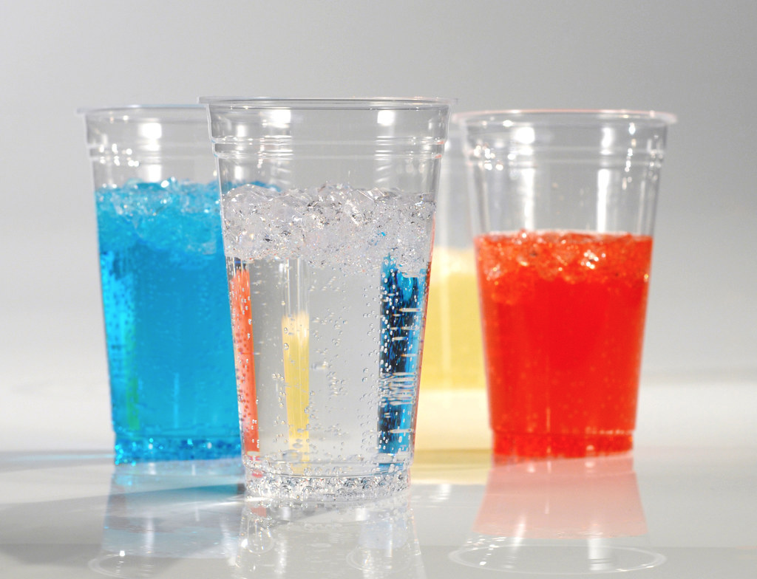
Polypropylene
"#Baldessariebaldessari designed Zigozago, an #outdoor #chair that looks as if it’s been stitched together. Designed for Taiwanese brand #Lagoon, the chair is polypropylene-molded to seem like it’s made of two pieces, but it’s actually just one piece." by designmilk is licensed under CC BY-SA 2.0
"Milliken: Clear Plastic Drinking Cups Made With Total Petrochemicals' Lumicene® M3382MZ Polypropylene, Clarified With Milliken's Millad® NX8000. (Photo Milliken, MKPR059)" by PressReleaseFinder is licensed under CC BY-NC-ND 2.0

Slide 9
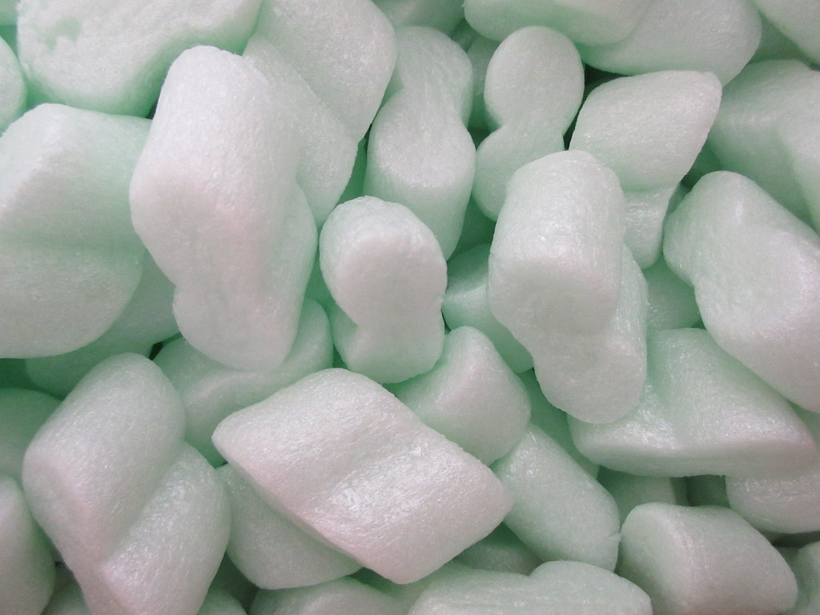
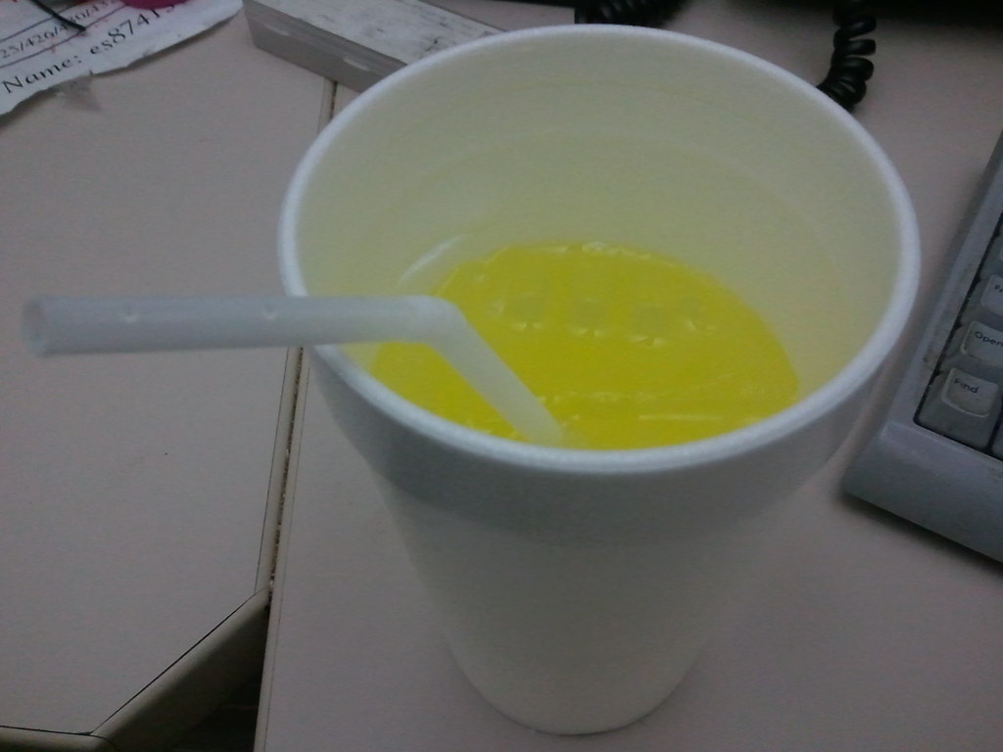
Polystyrene
"Green polystyrene IMG_7960" by tomylees is licensed under CC BY-NC-SA 2.0
"expanded polystyrene" by Richard Masoner / Cyclelicious is licensed under CC BY-SA 2.0

Slide 10
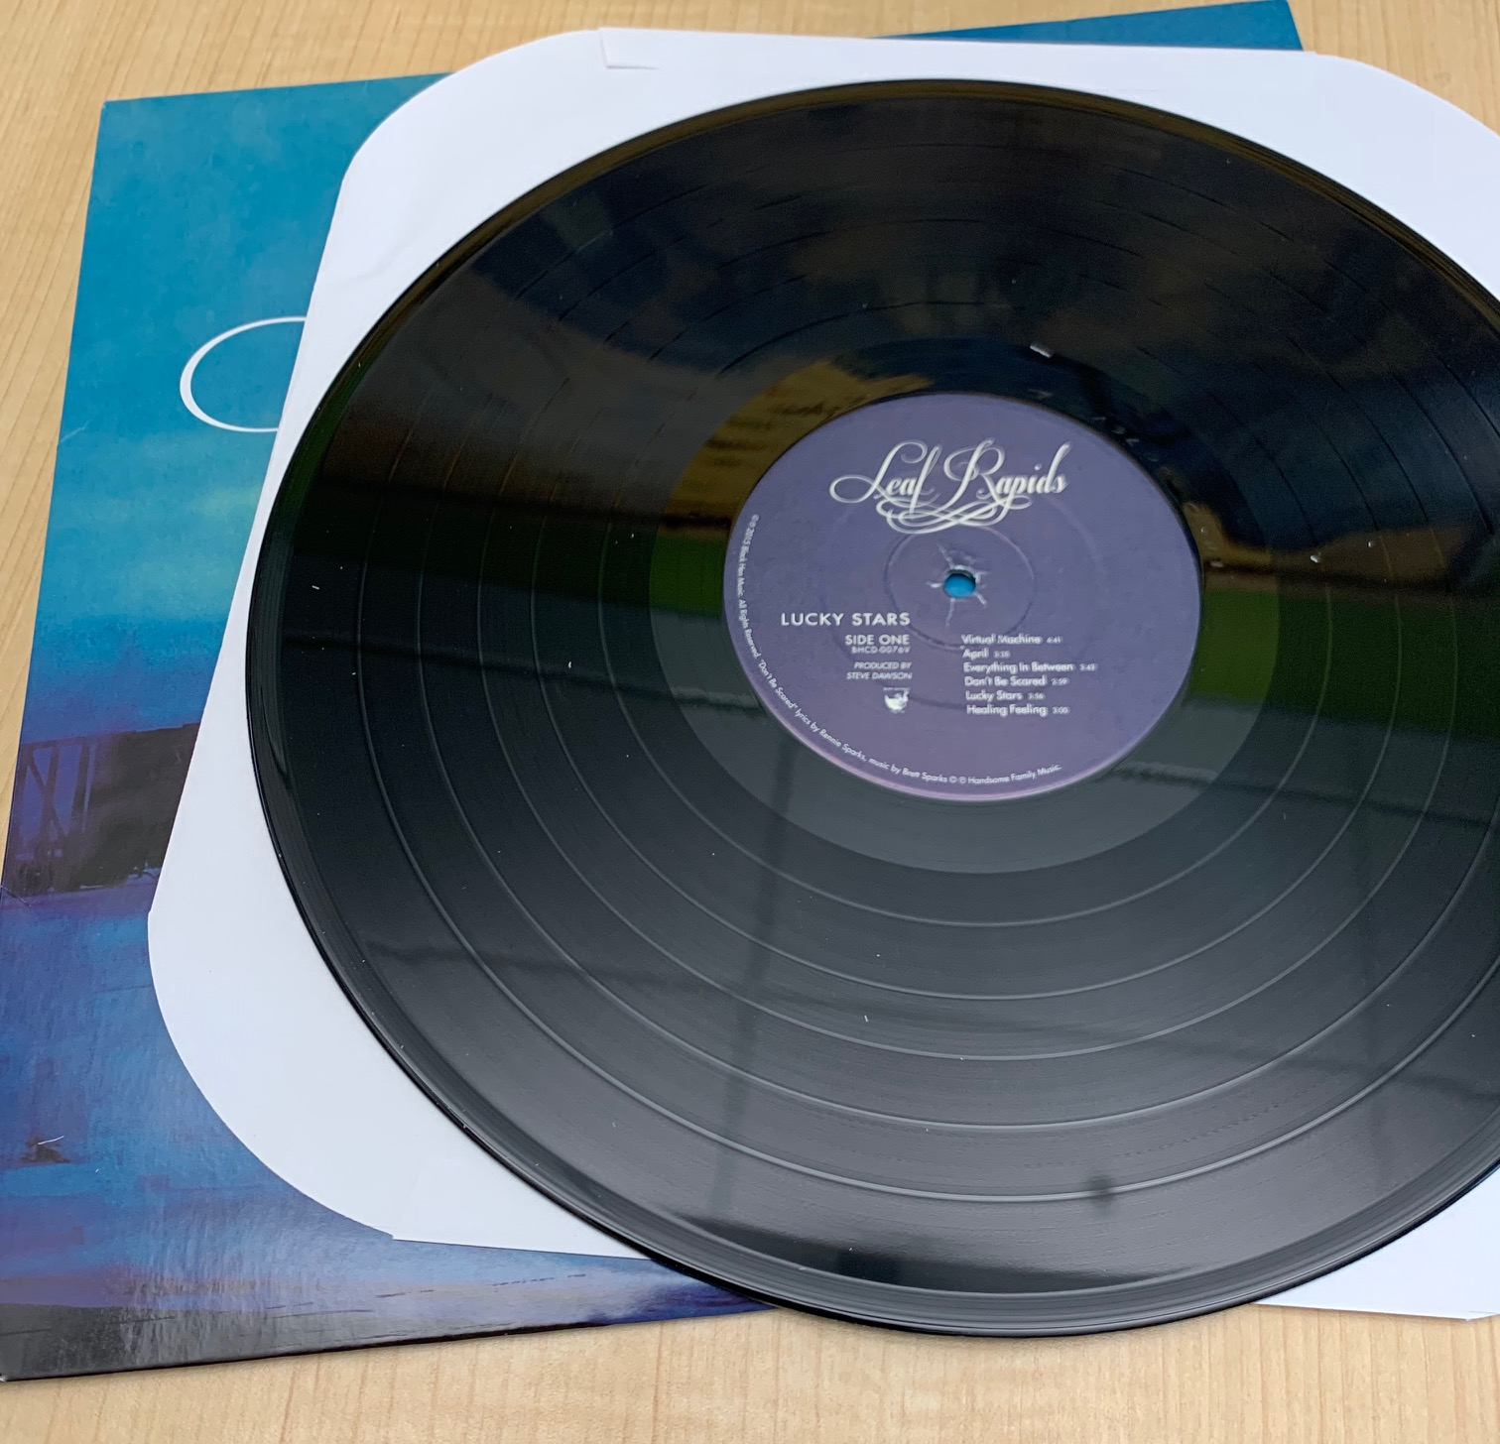
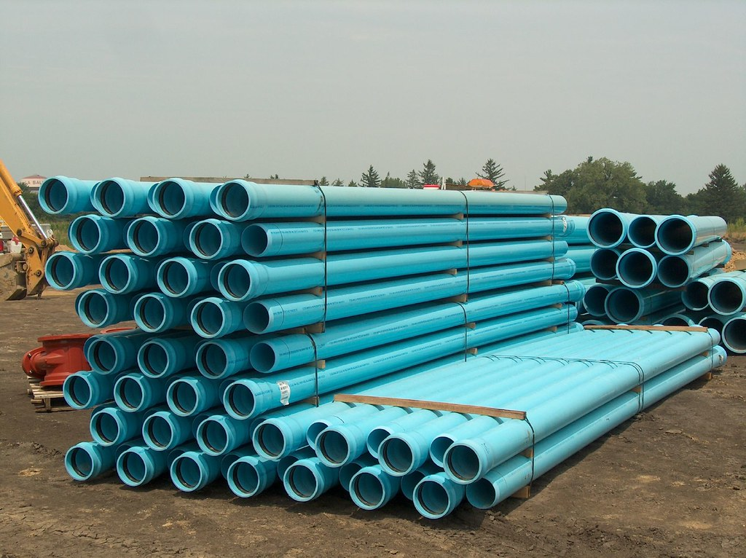
Polyvinyl chloride (PVC)
"PVC Pipe" by Pam_Broviak is licensed under CC BY-SA 2.0

Slide 11
How many chloroethene (vinyl chloride) subunits are in a molecule of polyvinyl chloride with a molar mass of 3122.5 g/mole?
A. 100
B. 500
C. 250
D. 50
E. 550

Slide 12
What is the molar mass of one molecule of polypropylene with 300 propylene subunits?
A. 12,600
B. 6,300
C. 25,200
D. 100,800
E. 50,400

Slide 13
Condensation Polymers
Monomer units join by eliminating (splitting out) a small molecule, often water.
Ex: polyethylene terephthalate (PET)
Notes:
13

Slide 14
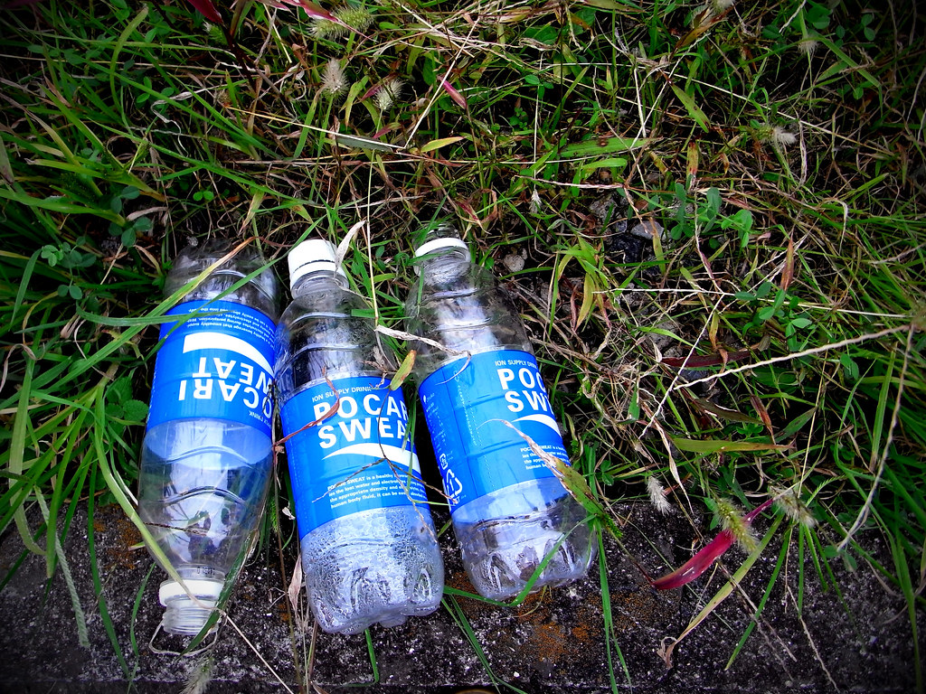
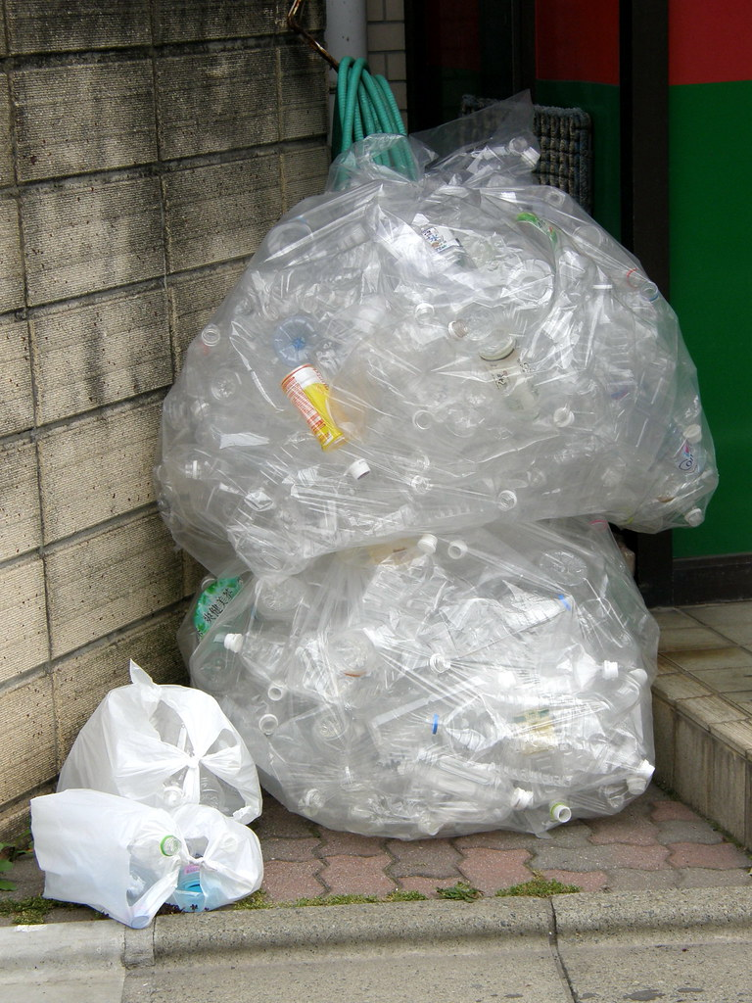
PET
"Polyethylene Terephthalate" by chidorian is licensed under CC BY-SA 2.0
"#5549 recycled plastic (PET) bottles" by Nemo's great uncle is licensed under CC BY-NC-SA 2.0

Slide 15
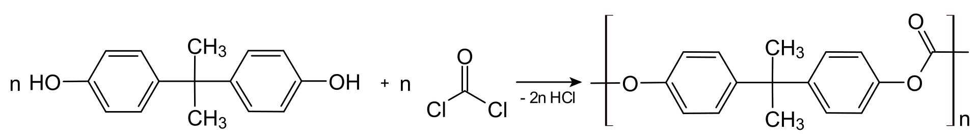
Polycarbonates
The main polycarbonate material is produced by the reaction of bisphenol A and phosgene COCl2.
strong, transparent

Slide 16
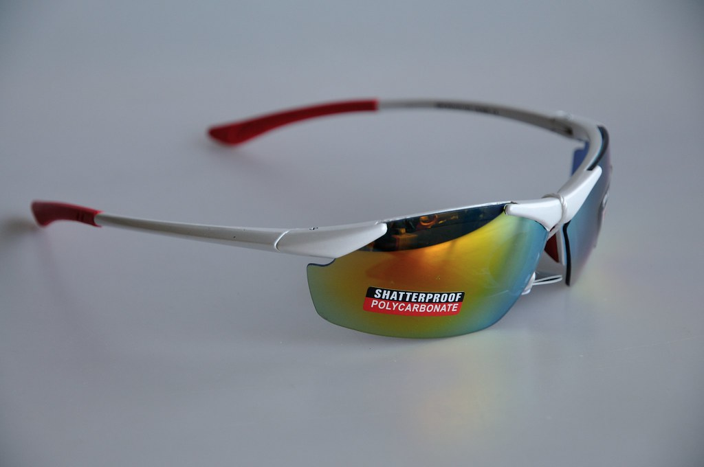
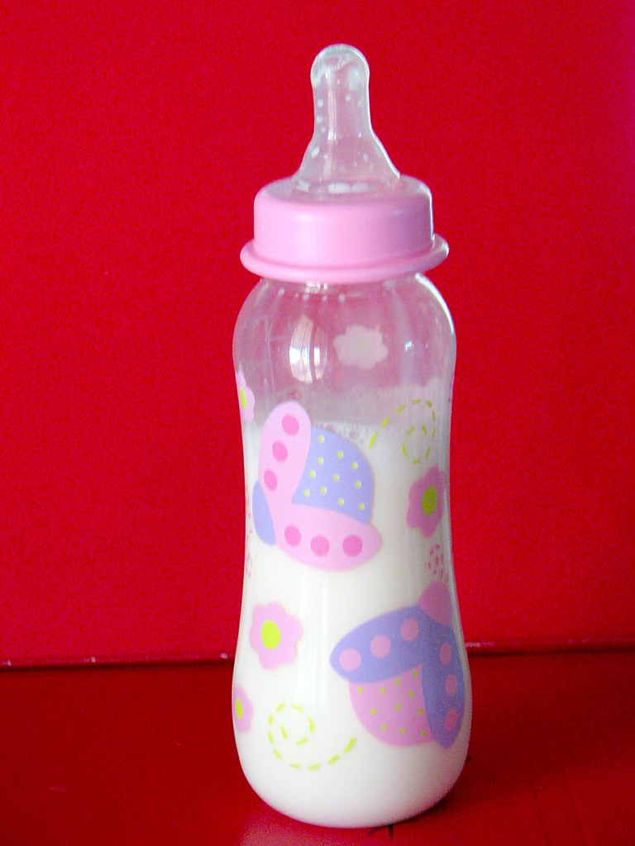
"Polycarbonate (6)" by Eurosunshine is licensed under CC BY-NC-ND 2.0
"Baby Bottle" by brokinhrt2 is licensed under CC BY 2.0

Slide 17
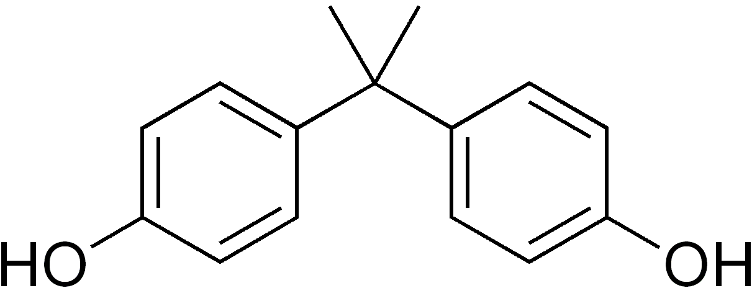
Polycarbonates and bisphenol A
Bisphenol A: estrogen-mimicking, hormone-like properties
Various studies have found a range of effects - from ‘significant’ to ‘none’

Slide 18
Polycarbonates and bisphenol A
Bisphenol A: estrogen-mimicking, hormone-like properties
Bisphenol A leachate low-dose effects (Saal and Hughes; https://ehp.niehs.nih.gov/doi/10.1289/ehp.7713)
  Industry-funded studies tend to find no significant effects
  government-funded studies tend to find significant effects

Slide 19
Additives, etc…
Antioxidants, blowing agents, colorants, coupling agents, flame retardants, heat stabilisers, impact modifiers, lubricants, plasticisers, preservatives, uv stabilisers, etc.
Notes:
19

Slide 20
After Use?
Re-use
Notes:
20

Slide 21
After Use?
Re-use
Recycle, Down-cycle – ex: depolymerization
  Energy intensive, low market value.
Notes:
21

Slide 22
After Use?
Re-use, Recycle, Down-cycle
Incineration – high energy content,
  Produces CO2 and potentially other harmful compounds
Notes:
22

Slide 23
After Use?
Re-use, Recycle, Down-cycle.
Incineration
Trash - Landfill
Notes:
23

Slide 24
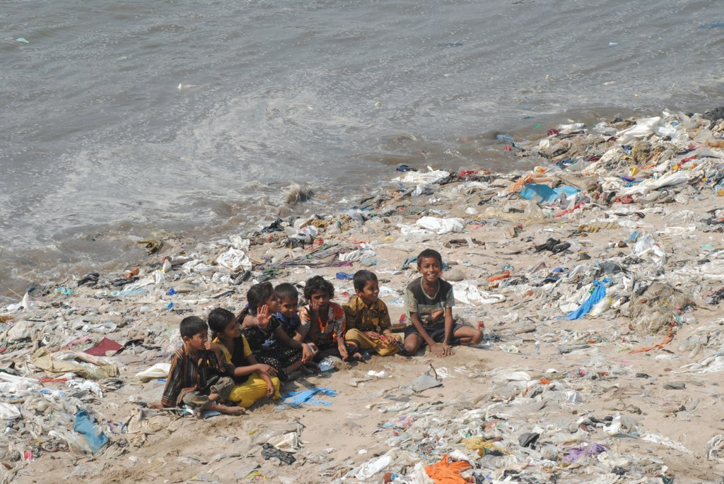
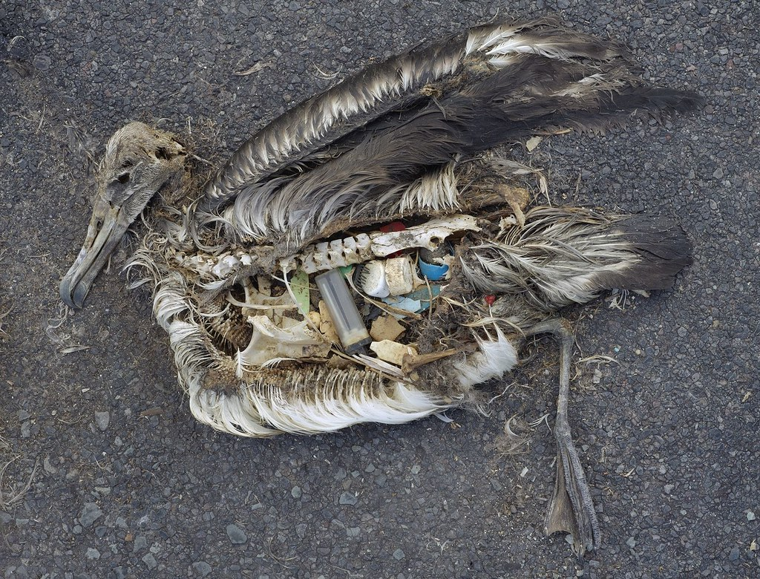
"Plastic Beach" by ravi khemka is licensed under CC BY 2.0
"Albatross at Midway Atoll Refuge" by USFWS Headquarters is licensed under CC BY 2.0

Slide 25
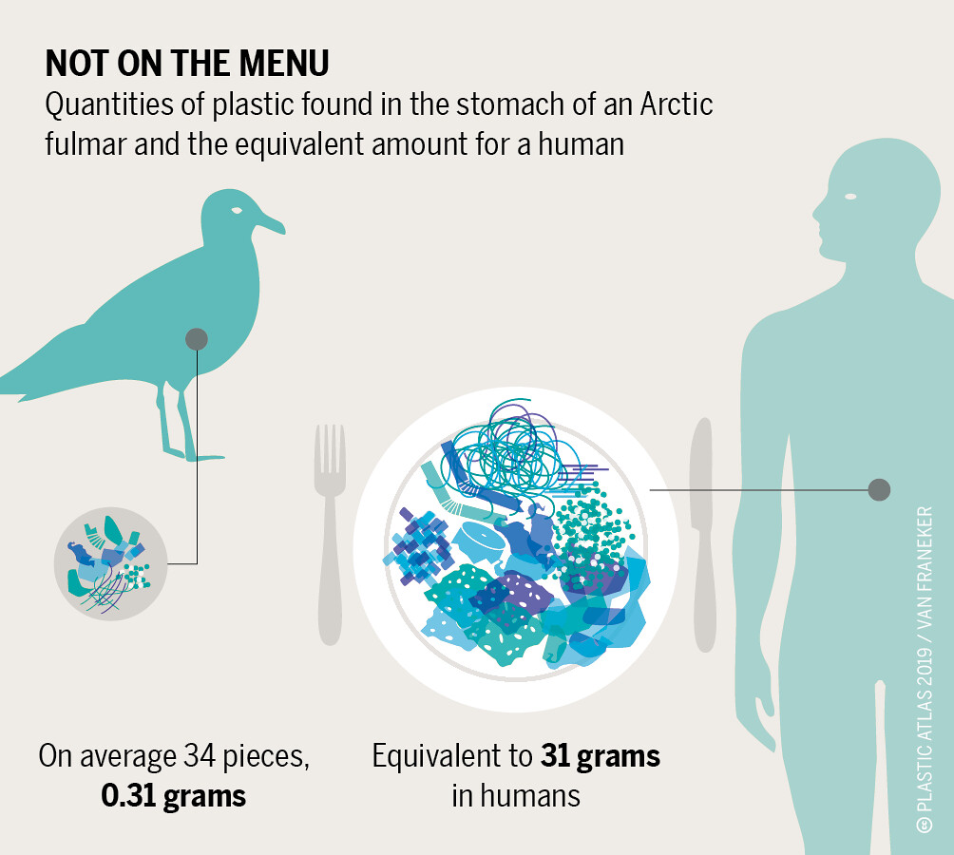
"Plastic Atlas - As they hunt, many birds cannot distinguish between a fish and a glistening piece of plastic floating in the water." by boellstiftung is licensed under CC BY 2.0

Slide 26
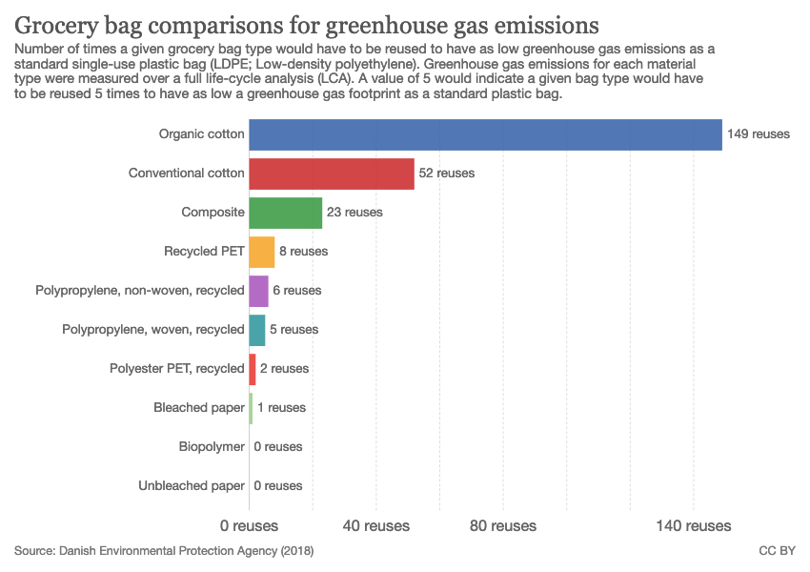
"File:Grocery bag comparisons for greenhouse gas emissions, OWID.svg" by Our World In Data is licensed under CC BY 3.0

Slide 27
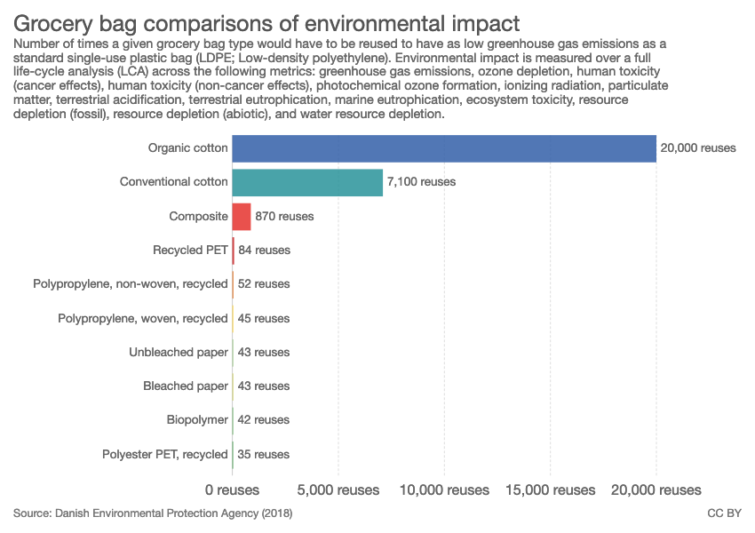
"File:Grocery bag comparisons of environmental impact, OWID.svg" by Our World In Data is licensed under CC BY 3.0

Slide 28
National Geographic - biodegradable polymers
https://www.nationalgeographic.com/environment/2018/11/are-bioplastics-made-from-plants-better-for-environment-ocean-plastic/#close

Slide 29
After Use?
Landfill
Re-use, Recycle, Down-cycle – ex: depolymerization
  Energy intensive, low market value.
Incineration – high energy content,
  Produces CO2 and potentially other harmful compounds
Biodegradation – some natural polymers are degraded by worms, bacteria and fungi.
  must be designed into the polymer
  disposal sites must be redesigned to allow this.
Notes:
29

