Slide 1
Successful Tenancies for the Hard to House
A Narrated Tutorial Presentation
by the Institute of Urban Studies

Slide 2
Eviction is Easy…
Intervention and Supporting people is HARD, but rewarding....
For your tenants, your organization, and your community.
Notes:
When dealing with challenging tenants…
Eviction is Easy, Intervention and Support is hard but rewarding work!
It pays off through better results for your tenants, your organization, and your community.

Slide 3



Who we are:
Notes:
Institute of Urban Studies founded in 1969 by Lloyd Axworthy.
Independent research arm of the University of Winnipeg.
Focus on inner-city, environmental, Aboriginal, and community development issues.
Involved with the At Home/Chez Soi project since its start in 2009.
A $110 Million research study by the Mental Health Commission of Canada, testing the Housing First model in Canada
Jino Distasio is co-principal investigator for the study.
Host the research team, community liaison coordinators, and Lived Experience Committee.
We have been working on issues about housing the homeless for a long time,
Have recently

Slide 4


Objective of this presentation:
Supporting Success in Housing:
“This presentation offers practical tools and direction by which housing and housing related agencies can think more broadly about how and why they should support vulnerable tenants to remain housed as challenges and difficulties arise”
Audience for this presentation and report:
Agencies currently providing housing, but not services, or working from Housing First principles.
Notes:
“This presentation offers practical tools and direction by which housing and housing related agencies can think more broadly about how and why they should support vulnerable tenants to remain housed as challenges and difficulties arise”
It is about helping people become successful tentants…
It is about Successful Tenancies.
Audience: Agencies currently providing housing, but not services or working with Housing First principles.

Slide 5
Project Background:
The Winnipeg Site of the At Home project had higher re-housing rates than other sites.
Rehousing Challenges:
High stress on participants / tenants
Expensive for the project and housing agencies
High stress on staff – multiple rehousing events
Response:
Eviction Prevention Strategies
Housing Retention Strategies
Notes:
Background:
Rising out of the At Home / Chez Soi project of the MHCC
500 participants
250 housed … 170 remained housed – about 70%; caused lots of challenges
Higher rate of eviction than other sites
High stress on participants, high stress on staff, expensive, challenge fro the project.
It’s counter productive. If our goal is to house people, then perhaps we shouldn’t evict them.
So the IUS began to look at ‘Eviction Prevention Strategies’ across Canada.

Slide 6
Why are supports important?
Joes thoughts here

Slide 7
Methods:
Literature review of eviction prevention programming.
In-depth, key informant interviews, n=30
Short key informant interviews with senior admin, n=4
Focus-group with Alliance to End Homelessness, Ottawa
Focus-group with Lived Experience Committee, Winnipeg
Site visits (and interviews) in in Vancouver, Winnipeg, Ottawa, and Waterloo Region.
Collected best and promising practices from Calgary, Edmonton, and Toronto.
Multiple reviews of progress with Project Leadership Team (a national team of experts).
Notes:
Slide: Methods: setting up national team to help, visiting with LEC, conducting site visits, case studies and key informants (bullets only)

Slide 8
Programs interviewed, by city:
Vancouver:
BC Housing (Regional Operations)
BC Housing (Supportive Housing)
MPA Society
RainCity Housing
Atira Women’s Resource Centre
Lookout Emergency Aid Society
BC Non-Profit Housing Association
Edmonton:
Homeward Trust (Planning & Research)
John Howard Society
Boyle St. Housing
Capital Region Housing Corporation
Landlord and Tenant Advisory Board
Winnipeg:
Community Wellness Initiative
At Home / Chez Soi Winnipeg Site
Manitoba Green Retrofit
Lived Experience Committee
Waterloo Region :
(Waterloo, Kitchener, Cambridge):
Region of Waterloo Social Services
‘Whatever it Takes’ Program
STEP Homes
The Working Centre
Lincoln House
The Bridges
Cambridge Self-Help
The Argus
House of Friendship
Calgary:
Pathways to Housing: The Alex
Toronto:
MainStay Housing
Toronto Community Housing
Ottawa:
Focus-group with fifteen organizations of the
Alliance to End Homelessness, Ottawa
Notes:
We interviewed and researched 27 different programs in 9 cities; that help house people in a variety of circumstances:
Included programs for public housing, affordable housing, youth housing, women’s, and homeless specific.
Programs ranged from small specialized programs with only a single residence, to BC Housing which has programming in place for all of its social housing and all of the shelters. (more than 100,000 units)
Including some of the most experienced and successful housing programs in Canada:
Mainstay Housing in Toronto
The Alex in Calgary
Homeward Trust in Edmonton
Raincity Housing Vancouver

Slide 9

The Revolving Door of Eviction
$
$
Typical Person with History of being Homeless
Homeless
Hidden Homeless
In Shelter
REHOUSED
Traditional Eviction
Finds or is placed in Housing
$
Residential Instability
Legal or
Informal
Adverse Event or Action
Notes:
Revolving Door of Eviction has been long recognized by front-line staff and researchers.
EARLY intervention in this cycle is the best preventative measure.
see “Cycles of Homelessness” Report (National Homelessness Initiative, 2006)

Slide 10
Costs of Eviction…
Tenant costs: moving costs, replacement of possessions abandoned, lost damage deposit, lost rent, repairs, legal costs, and most important… lowered standing with a program including their ability to be rehoused.
Landlord costs: repairs, lost rents, and administrative/legal costs associated with legal proceedings.
Program costs: multiple rehousing events, staff-time, services disruption, goodwill of private landlords.
Society: costs of a person returning to the street – increased use of services.
For Programs we found that…
Positive moves, or basic turnover, the cost very little. Less than $1000.
For Evictions, typical costs across Canada ranged from $3000-$6000.
Exceptional damage situations ranged from $10,000-$60,000.
It may be less expensive to provide additional supports or caseworker visits, than to go through an eviction process.
Notes:
There are major costs to Residential Instability; borne by four groups:
Tenants: costs may include moving, replacement of possessions abandoned, lost damage deposit, losing what is left in that months’ rent, the cost of repairs, legal costs, lowered standing with a program including their ability to be rehoused.
landlords (where private-market housing is utilized) for repairs, lost rents, and administrative/legal costs associated with legal proceedings.
programs bare the largest financial costs and these can be significant and affect program operations.
Society – costs of a person returning to the street – increased use of services
Herein lies the cycle of homelessness, and the costs can escalate rapidly as persons move into and out of housing.
At each stage, society bears the brunt of the impact as the cost of being homeless can be staggering (both socially and financially).
The important consideration is that simply keeping someone housed over the longer term can cost less than evictions and residential instability.
Why prevent eviction?…”what’s the point, it’s too damn hard!”
(economic savings, social good)

Slide 11
We talked to 27 programs in 9 cities
They all said the same thing…
Notes:
We talked to 27 programs in 9 cities about helping people maintain their tenancies…
All these programs told us the exact same thing…

Slide 12
“Housing is not enough…”
“Housing alone is not enough; you need housing plus the services. ” (BC Housing)
“We are not just a housing program; we are a housing-and-support program.” (The Alex, Calgary)
“…there are 3 pillars to housing stability:
  1. Adequate housing;
  2. Adequate income; and
  3. Adequate support” (STEP Home, Waterloo)
Notes:
FOR MANY PEOPLE, ESPECIALLY THOSE WHO HAVE EXPERIENCED HOMELESSNESS, OR MENTAL HEALTH CHALLENGES,
HOUSING IS NOT ENOUGH FOR A STABLE TENANCY. THEY REQUIRE SOME SUPPORTS!

Slide 13
So, what does housing with supports look like?
Notes:
What does this look like?

Slide 14
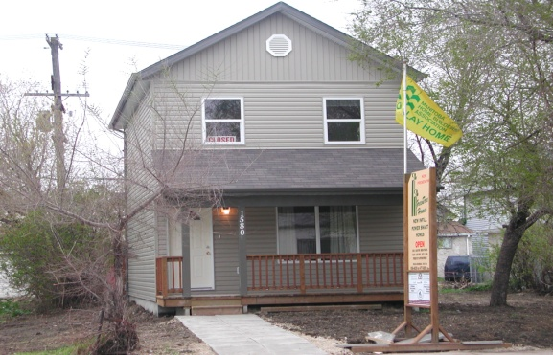
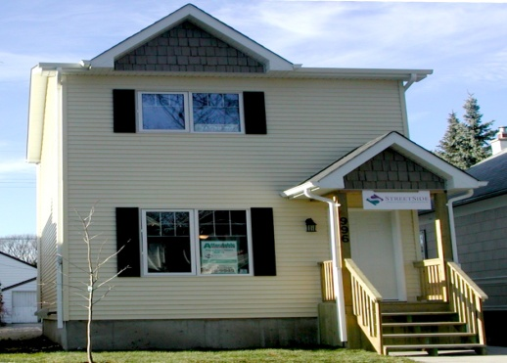
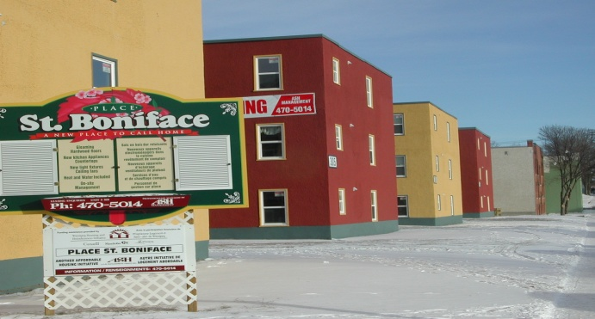
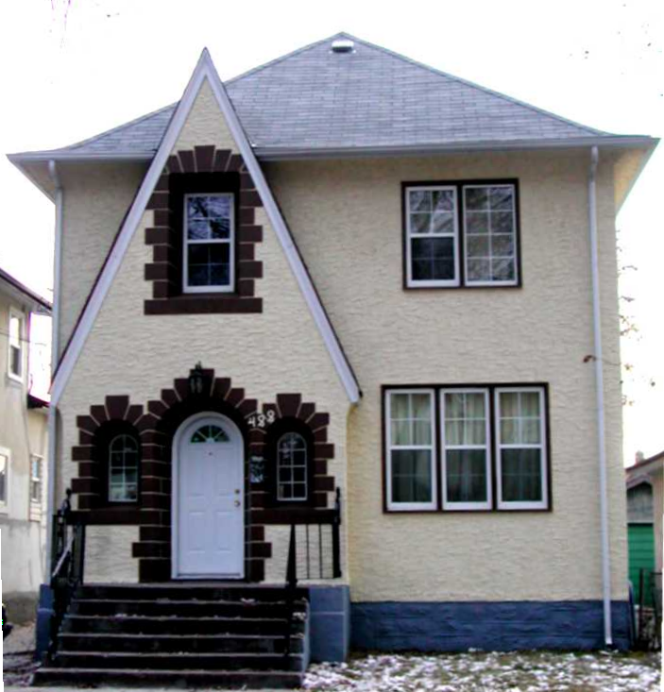
Creating Successful Tenancies
Requires an organizational shift in:
  Philosophy, to focus on supporting successful tenancies
  Governance, set it up right
  Policies, to incorporate change in interventions
  Programs, created or partner to provide supports or programs
  Actions, delivery and monitor successes
Notes:
SBH requires an organizational shift in:
Philosophy, to focus on supporting successful housing
Policies, to incorporate change in interventions
Programs, to create or partner on supports or programs
Actions, delivery and monitor successes

Slide 15
Success Based Housing:
The SBH Toolbox includes the ten modules:
Changing DNA: Incorporating SBH into organizational mandates
Putting Clients First, Even in Housing First
Slamming the Door on Eviction and Homelessness
Building Relationships, Networks and Partnerships that work
Exploring Programs, Supports and Resources for Staff
Resources, Education and Supports for Clients
Adding Up Progress: Assessing Impacts for Meaningful Change
Embracing Challenges
Funding, Funding and more Funding
Bringing it all together: How to Make SBH work

Slide 16
Creating Successful Tenancies
Philosophy & Principles
  A Policy of ‘No Evictions’ – focus of program on Housing Retention, not rule adherence
  Consumer Movement
  Empowering Clients – doing with clients, not for clients
  Person Centered
  Respect for the Person
  A Different Language
  Consumer Choice
  Community Integration
  Harm Reduction Strategies
  Culturally and Spiritually Appropriate Services
  Easy Access, Single-point Access
  No ‘Cold-Referrals’. Don’t be a service navigator only.

Slide 17
Creating Successful Tenancies
Governance
  Create a single strategy document for city – coordinate services
  Changing Embedded Practice
  Understand that becoming a tenant is a ‘learned experience’
  Creative and informal problem-solving
  Providing a Spectrum of Housing and Support
  Policies for Violence and Pedophiles.
  Policies on Hoarding, Bedbugs, Behaviour, etc.
  Policies on Consumer Responsibility
  Policies on Landlord Responsibility
  Landlord Relations Manager, Relationship-building strategies with Landlords
  Importance of transparence and equity
Government Support: Funding is Critical

Slide 18
Creating Successful Tenancies
Implementation
  Collaboration & Partnerships: Especially with Addictions Recovery and First Nations
  Intervention Strategies
  Planning
  Flexible Supports
  Flex-Funding
  Proper Fit between Tenant and Housing
  Working with Landlords, (Many or Few)
  Normal Leases vs Head Leases
  Participation Agreements, House-Rules
  Staff – Selection, Training and Skills
  Client to Staff Ratios
  Staff Care
  Communication Systems: Mandatory phones, emergency call-lines
  Building Community

Slide 19
Creating Successful Tenancies
Programming and Supports:
  Early Intervention
  Multiple and Complimentary Services
  Engaging a Client’s family and friends
  Peer Support Model
  Education and Programming
    Tenancy Training
    Support Groups
    Day Programming is Critical, Social Activities
    Conflict Resolution, Anger Management Training
    Life-Skills Training, Budgeting
    Employment Training and Access
    Landlord Education

Slide 20
Creating Successful Tenancies
Tools:
  Public Education and Awareness
  Rent Paid Direct
  Intake Processes and Tools, Importance of Identifying Tenants that need support
  Move-In Orientation
  Tenant Handbooks, Guidebooks
  Data and Information Technology
  Referrals & Central Registries
  Planned Moves
  Eviction Notices as a Tool
  Planned Moves, Respite
  Communications – 24 Hour Emergency Line

Slide 21
Creating Successful Tenancies
Monitoring:
  Developing Indicators of Stability
  Monitor tenancy failures and successes, adjust programming
  Monitor at-risk and vulnerable tenants, tracking progress
  Using tenant feedback surveys

Slide 22
Indicators of Stability
Length of Tenure
Rehousing Episodes
(measuring for reduction)
Rent Payment
Housing Unit Measurements
Unit Maintenance issues
Level of Crisis and Response
Mental Wellbeing
Personal Growth and Goal Attainment
Behaviour Based Issues
Engagement with Case Planning
Self-Identified Success
Feeling Safe
Decreasing Isolation, Improving Interaction
Community Integration
Tenant Participation Levels
Improved Health
Formal Assessment Tool: SPDAT

Slide 23
Objective:
To break the Cycle of Homelessness
  by intervening early
To help tenants achieve stable tenancies
To build successful communities
To lower costs and stress on housing programs and clients.
Notes:
To break the Cycle of Homelesssness
by intervening early
To help tenants achieve stable tenancies
To build successful communities
To lower costs and stress on housers
THAT’S THE SHORT VERSION

Slide 24
What is a Successful Tenancy?”
Is it 6 months housed? A year?
Is time even an appropriate measure of stability?
Stability is highly individual; but we note:
Stability happens in stages:
  Building relationships and trust, allowing a homeless person to interact with an agency, and enter housing.
  A period of settling down to stability, and declining fear.
  Growth to a point where the tenant feels ‘part of the community’, or ‘in control of their circumstances’.
Most programs suggested 2-3 years for this to happen.

Slide 25
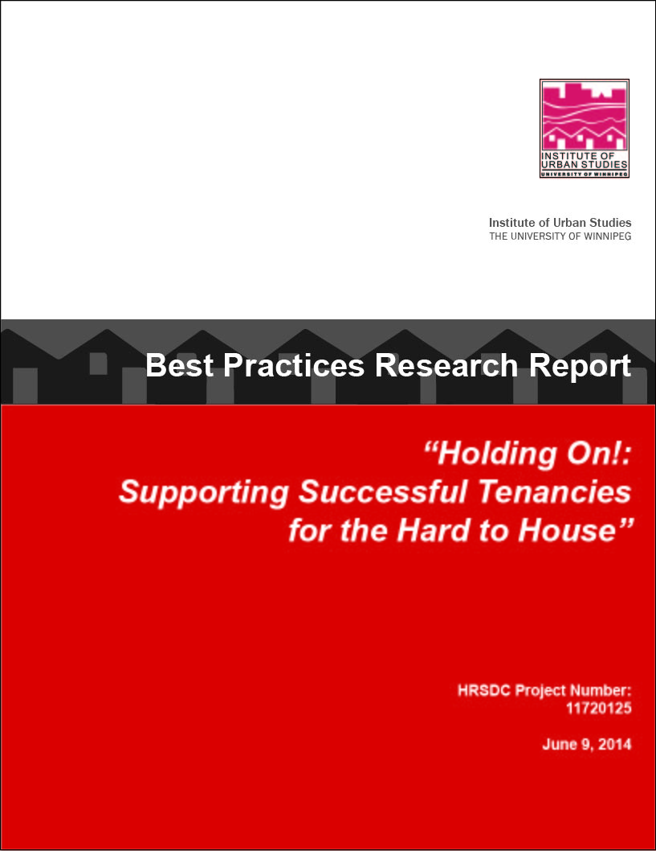
www.uwinnipeg.ca/ius
Notes:
The long versions are these…
Two major reports have come out of this work…
“Preventing Eviction and Managing for Successful Tenancies” came out in 2012 and is on our website.
The basics.
“Holding On! Supporting Successful Tenancies for the Hard to House” was completed this spring.
A more major report. A lot more information and detail.
HRDC to release early November.

Slide 26
Thanks to:
HRSDC
Authors:
  Jino Distasio & Scott McCullough
  Matthew Havens & Zoe St.Aubin
  Lise Gibbons

Slide 27
Thanks!

Slide 29
Success Based Housing and Housing First
Housing
Subsidies
Supports
(ACT/ICM)
Housing
First
+
=
Housing Stability
Housing
Providers
Tenancy
Support
Success
Based
Housing
+
=

Slide 30

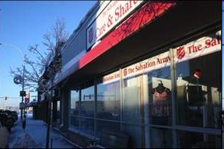
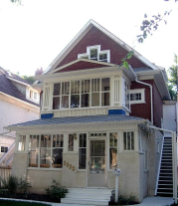
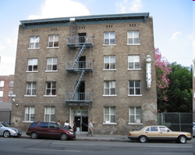
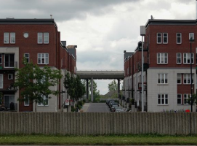

The Housing Stability Index
Limited to no Right to Tenure
Increasing Right to Tenure
Absolutely
Homeless
Securely
Housed
Shelter
Hidden Homeless
Rooming House
SRO
Transitional/ Supportive
Core Housing Need
Unaffordable Housing
Affordable Housing
Lack of Quality, and Security High Volatility
High Quality, with Security No Volatility
Level of Quality, Volatility and Security

